Slide 1
Compression in Monstrous Lymphedema
F.-J.Schingale, MD

Slide 2
disclosure
medi Bayreuth consultant

Slide 3
Compression therapy
Compression therapy represents the most important component of the decongestive lymphatic therapy

Slide 4
trunk edema

Slide 6
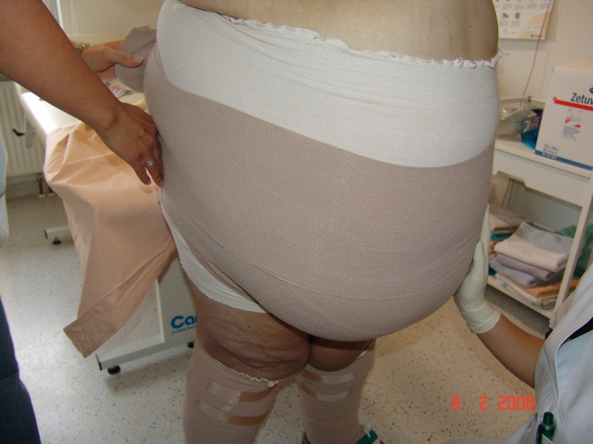
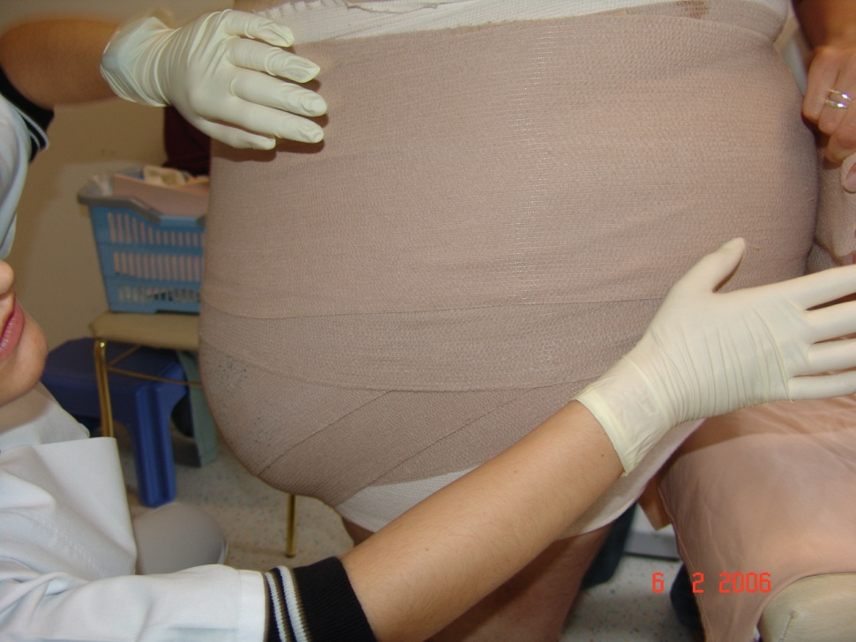
bandaging with long stretch bandages

Slide 7
Genital edema

Slide 8
Compression and lymphtape
05.04.2013
185,2kg
14.05.2013
163,6kg

Slide 9
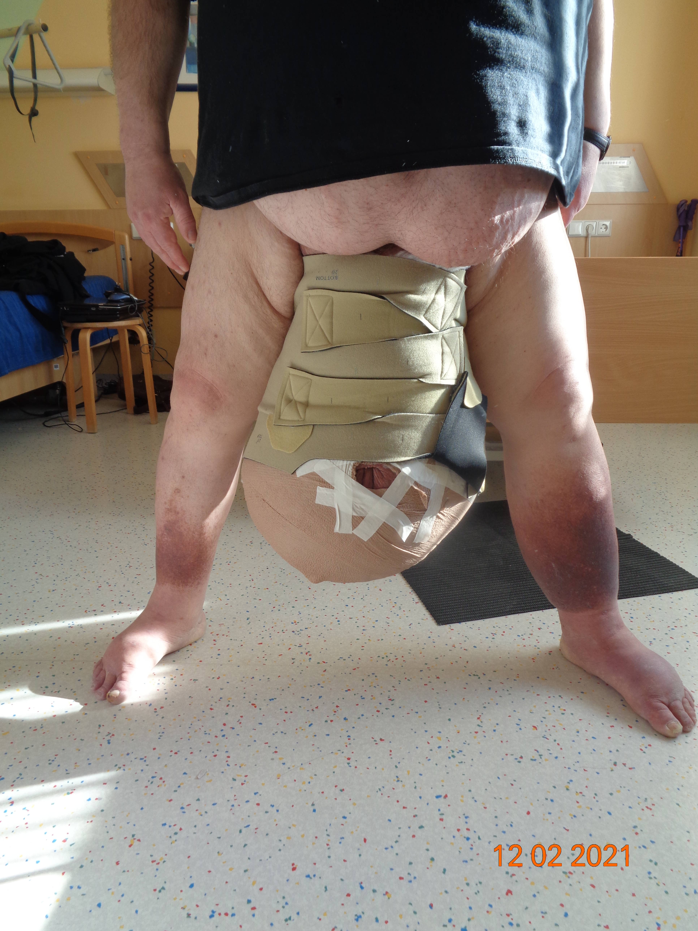
Decongestion with Velco Wrap

Slide 10
plastic surgery after decongestion
04.04.2019
08.04.2019

Slide 11
born 1981 height 172cm weight 290,6kg swelling of scrotum started 4 years ago
genital compression with velcro

Slide 12
after reduction > surgery

Slide 13
Obesity associated lymphoedema and compression
F.-J.Schingale, MD

Slide 15
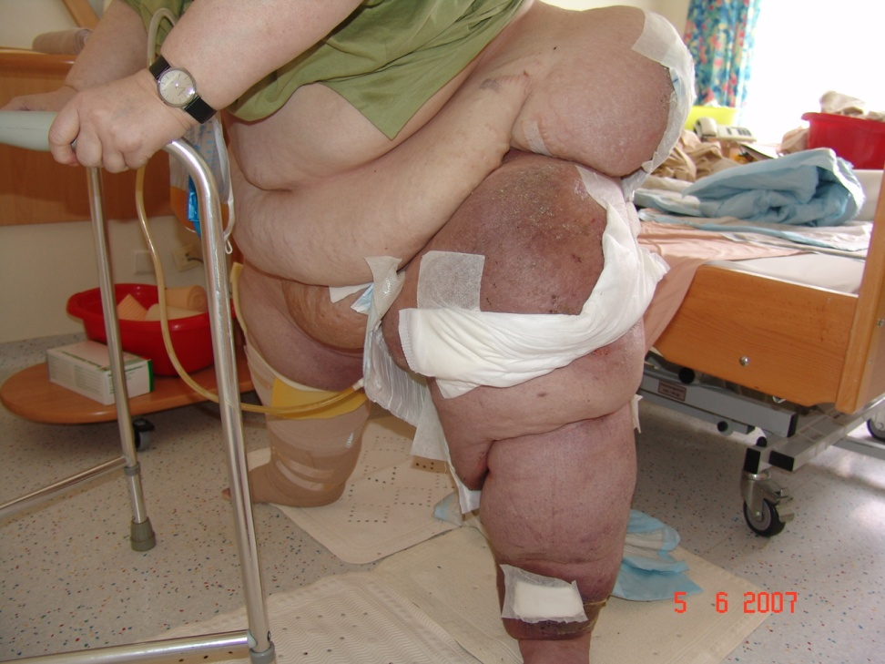
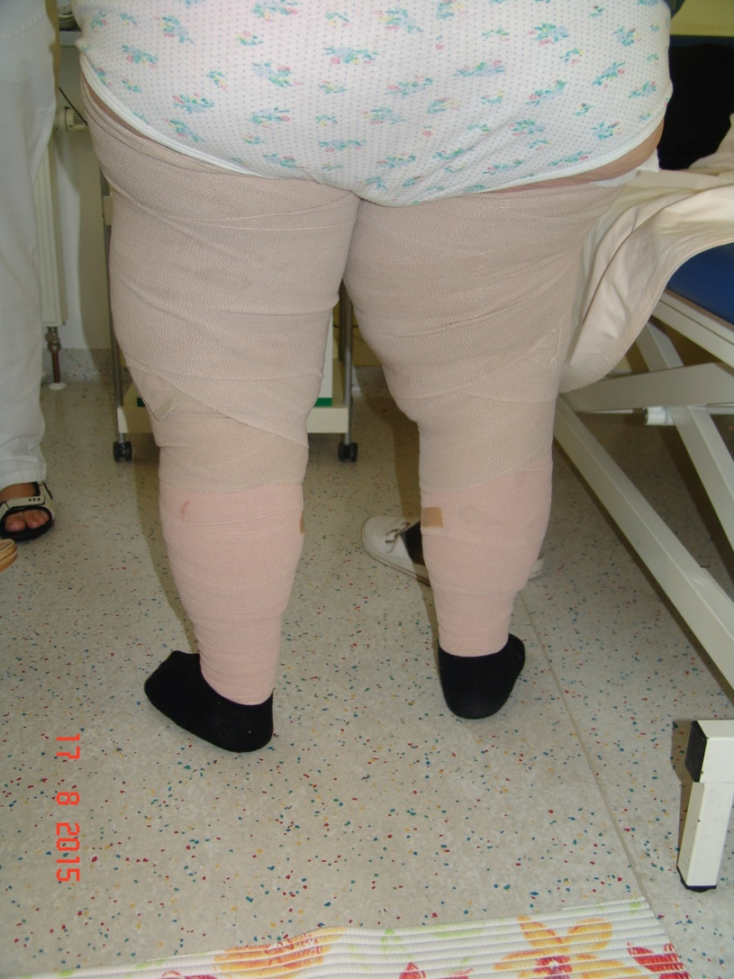
bandaging

Slide 16
obesity(320kg)

Slide 19
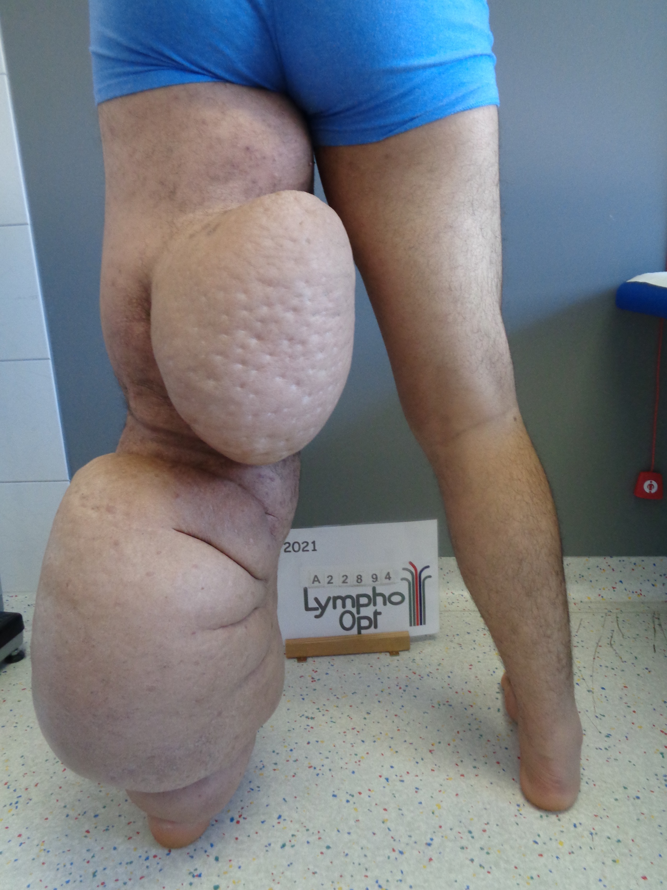
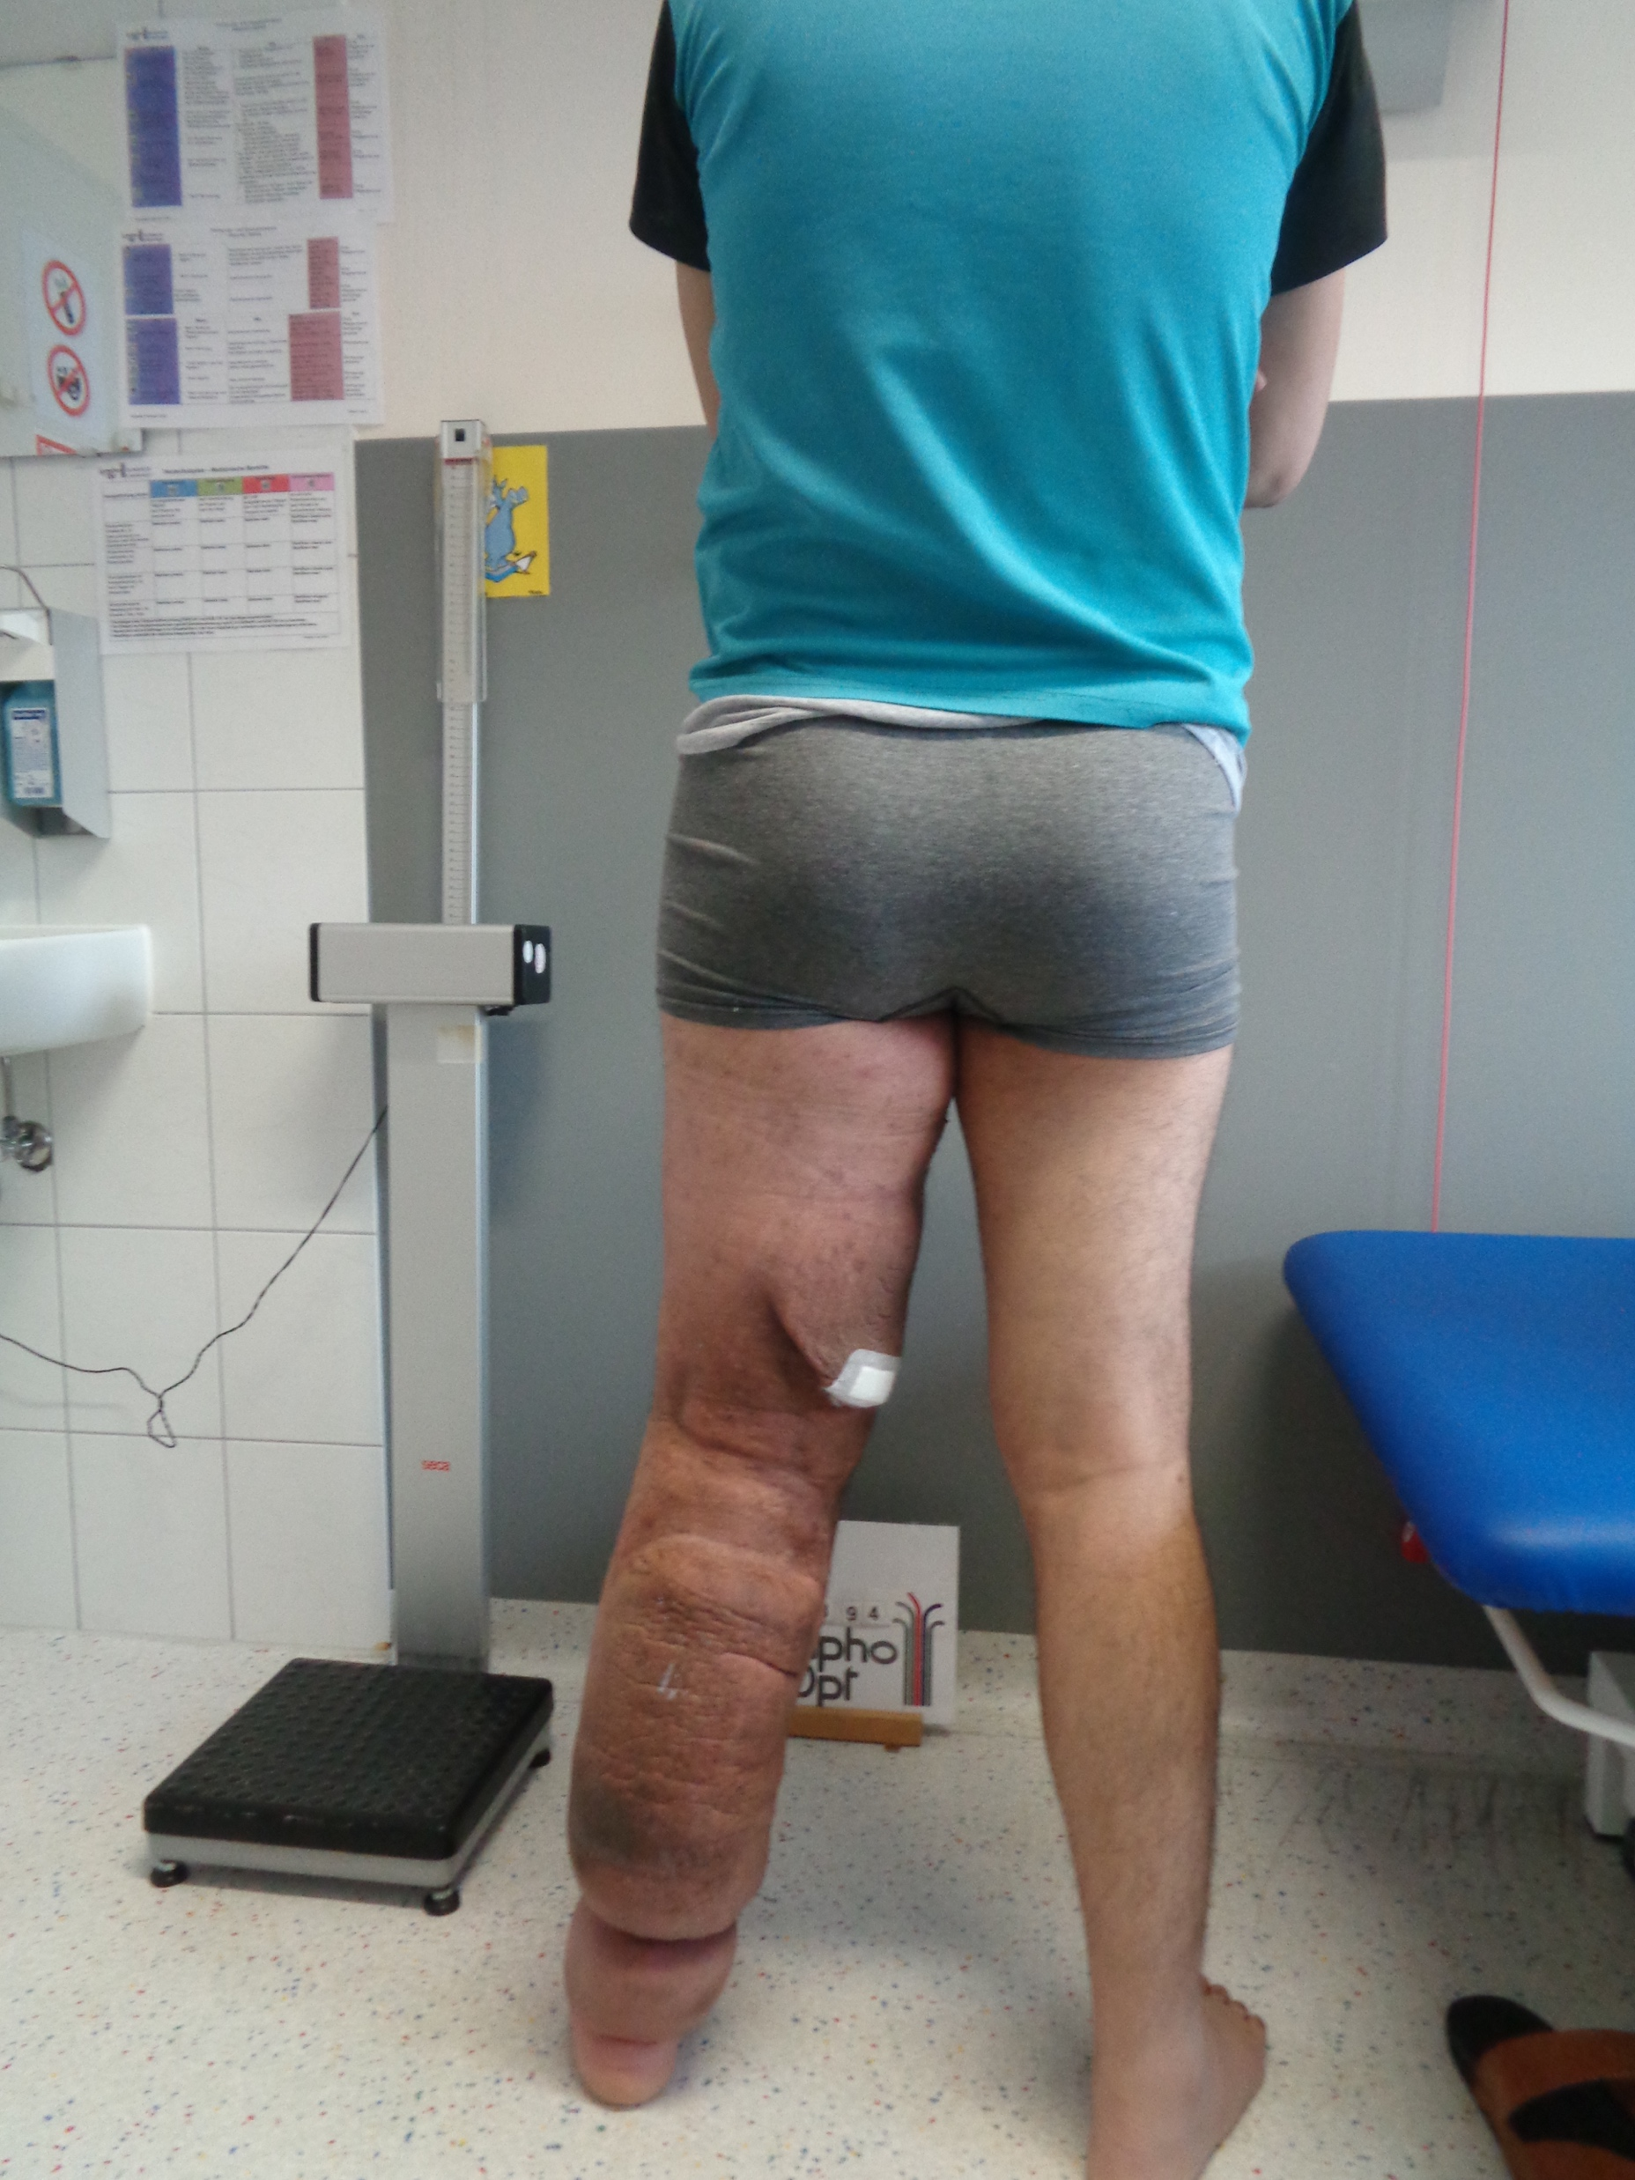
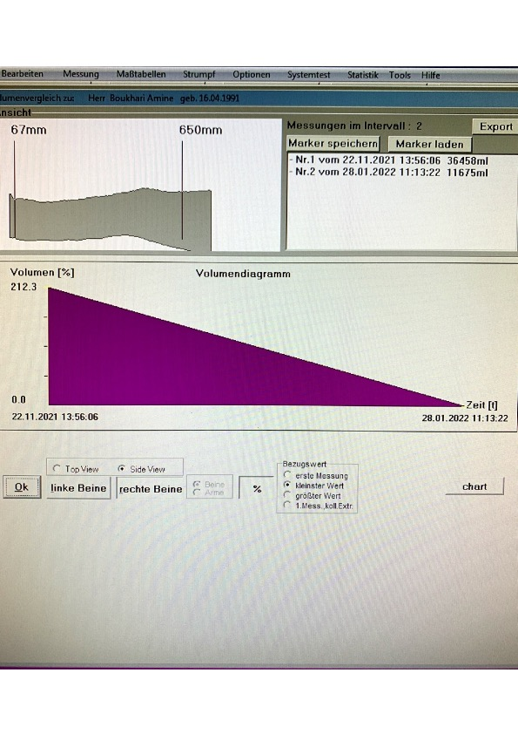
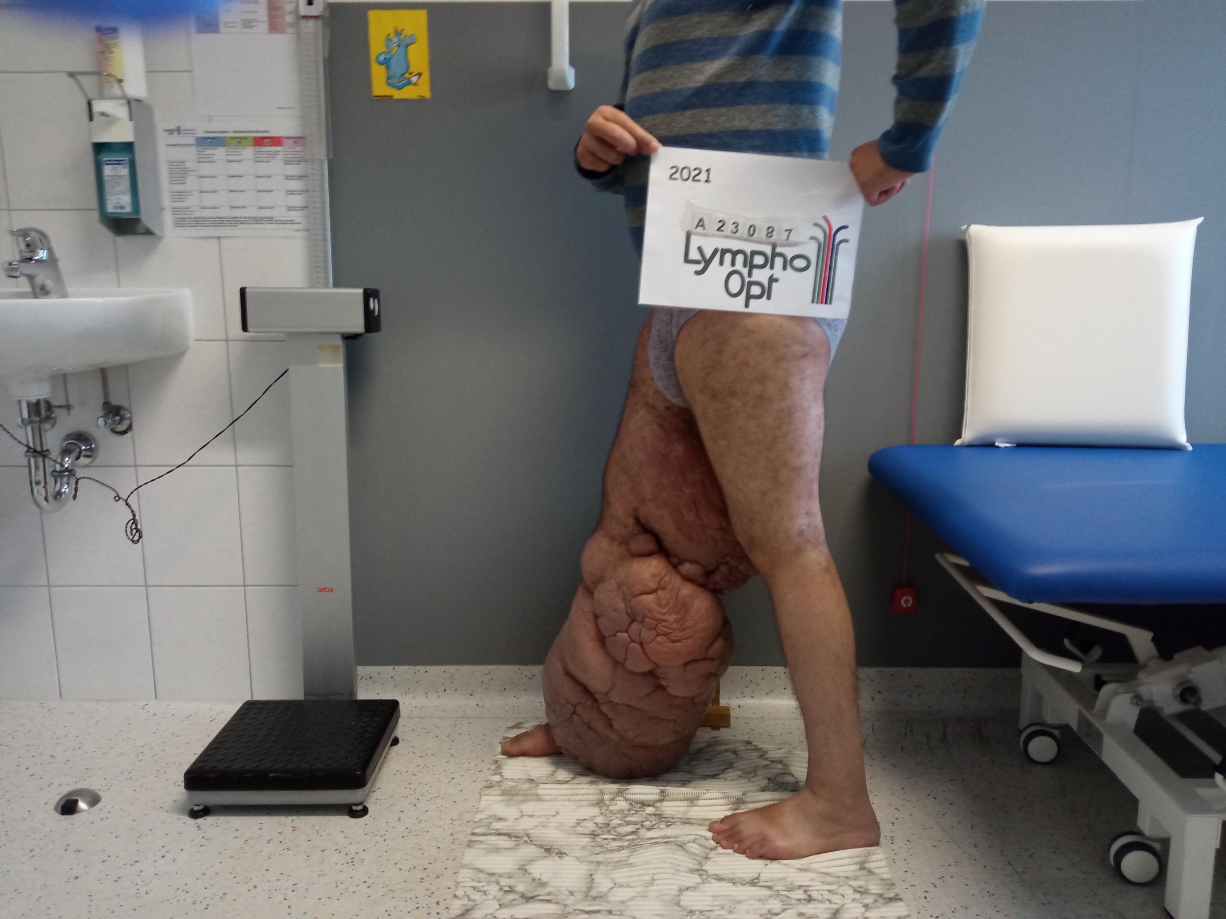
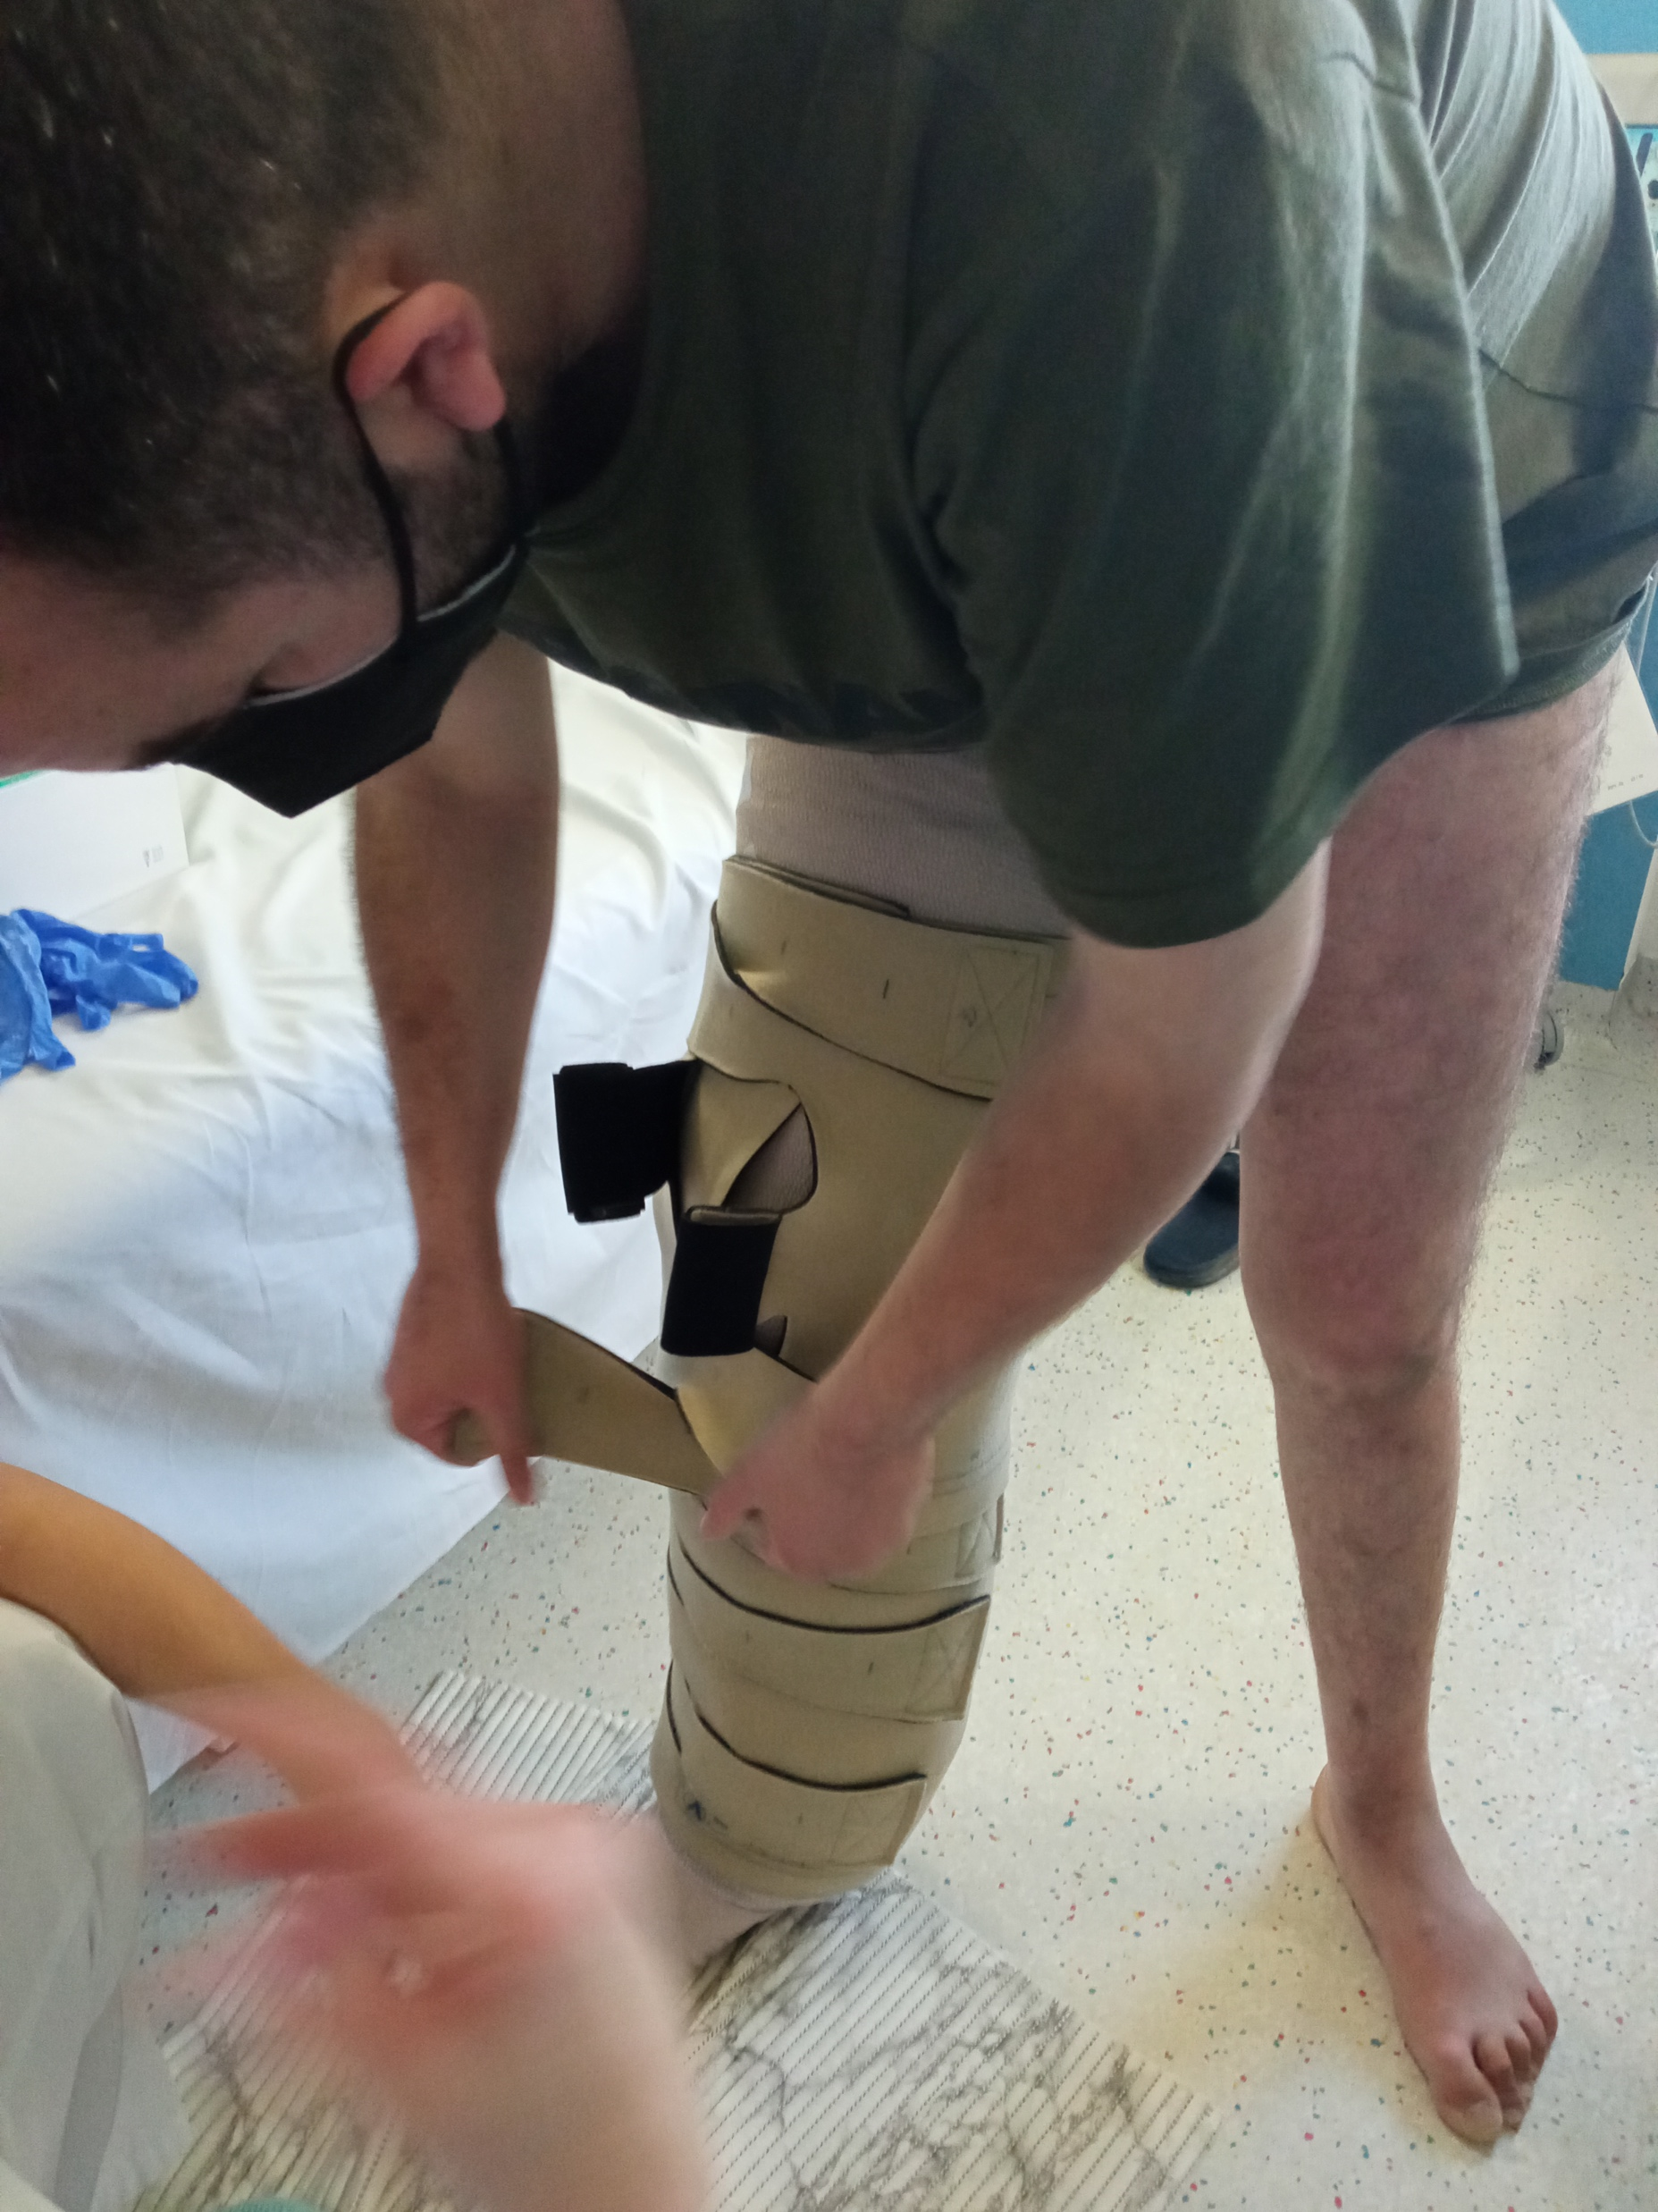
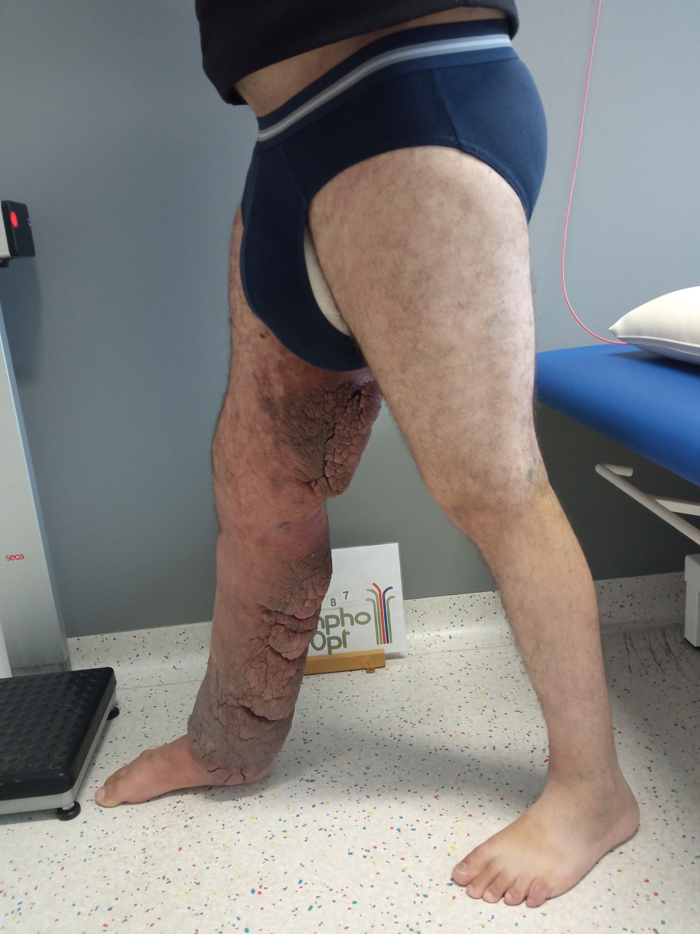
Results
03.05.21
03.05.21
02.03.21
02.03.21
02.11.21
28.01.22
25 liter less

Slide 20
Special case 2021

Slide 22
conclusion
In chronic edema compression is a must and it is possible even in unusual edema localization
it is a therapeutical challenge and
you have to try new ways

Slide 23
Thank you for your attention
F.-J.Schingale

