Slide 1
Controversies in Compression therapy
ICC Annual Meeting - 2021
Eduardo S. Da Matta, MD, MBA, MsC

Slide 2
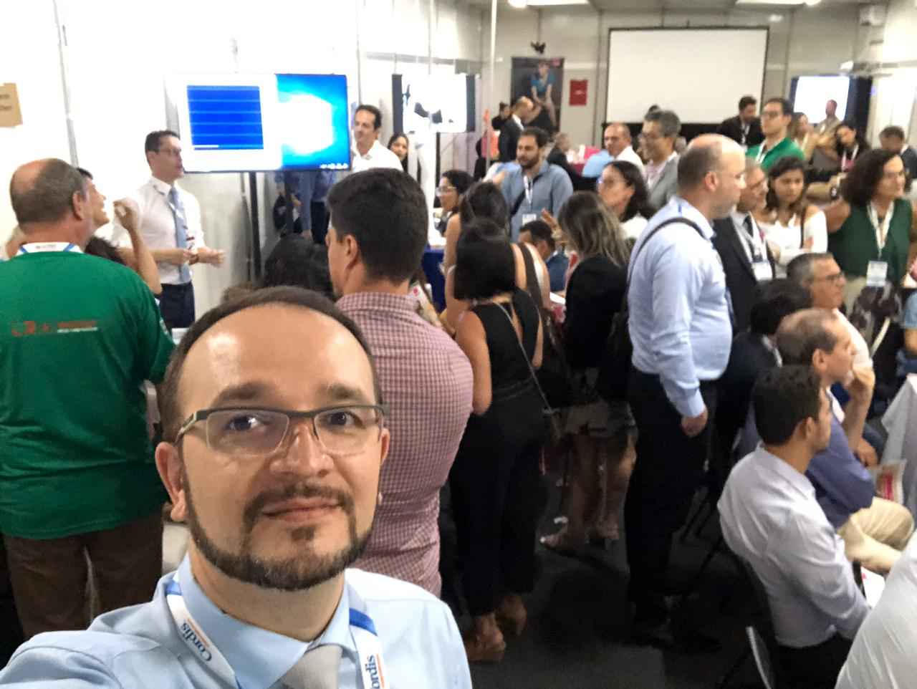
Education in compression or choice of an easy device?
Hands-on of Compression Therapy
ICC Meeting
Recife, Brazil – 2019.

Slide 3
No conflict of interest

Slide 4
Easy FOR WHOM?
“Easy describes something
that is not difficult and requires little effort”

Slide 5
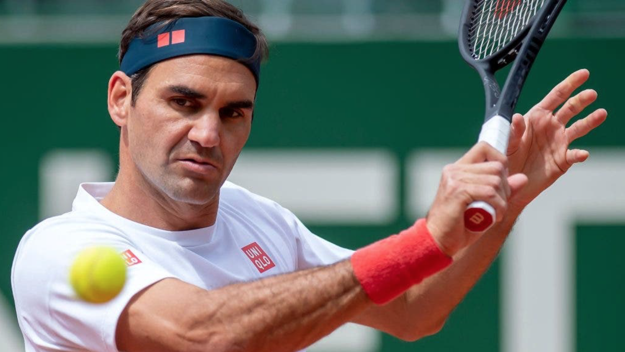
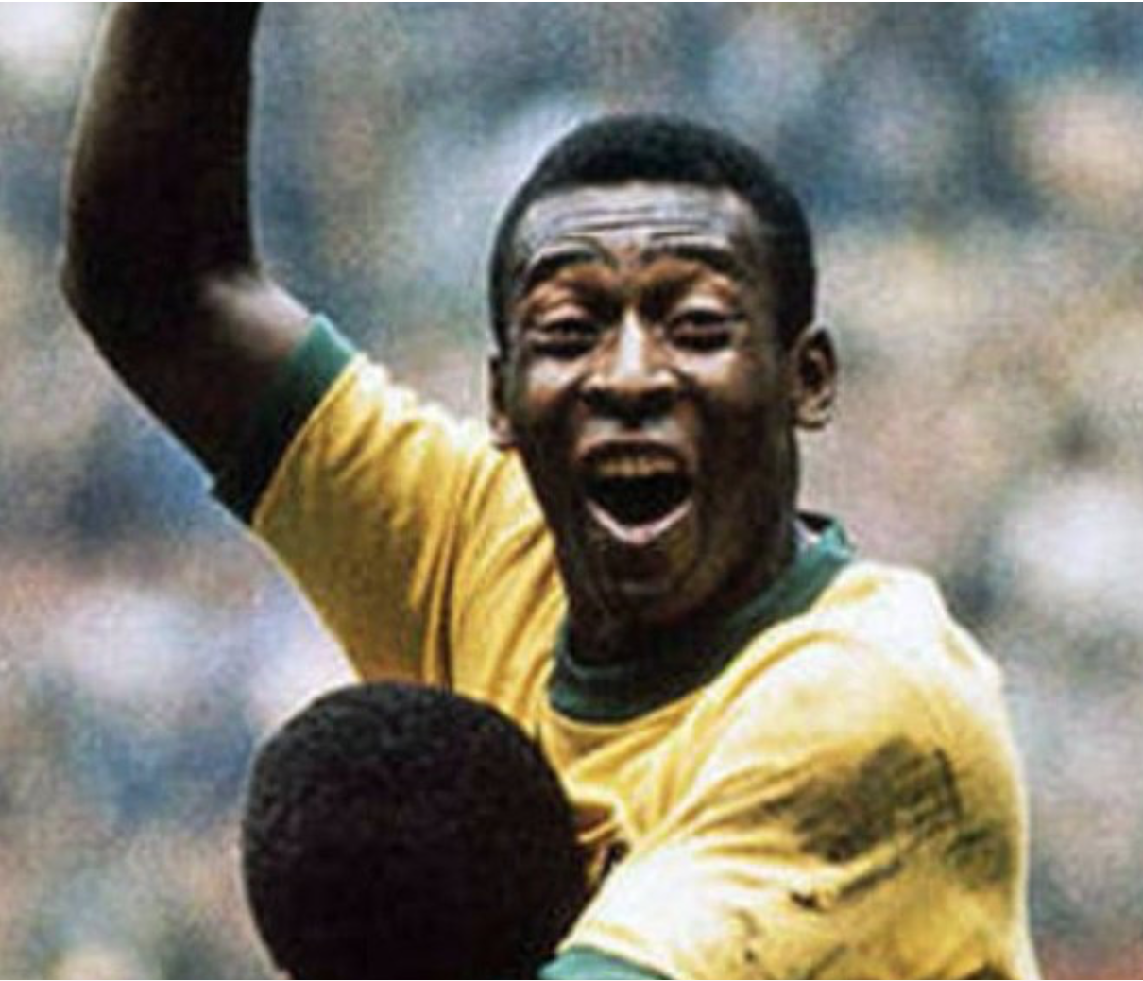
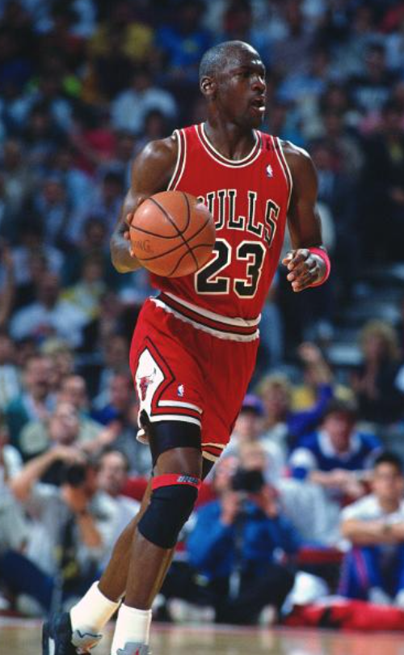
They will make it EASY!!
🎾
⚽️
🏀

Slide 6
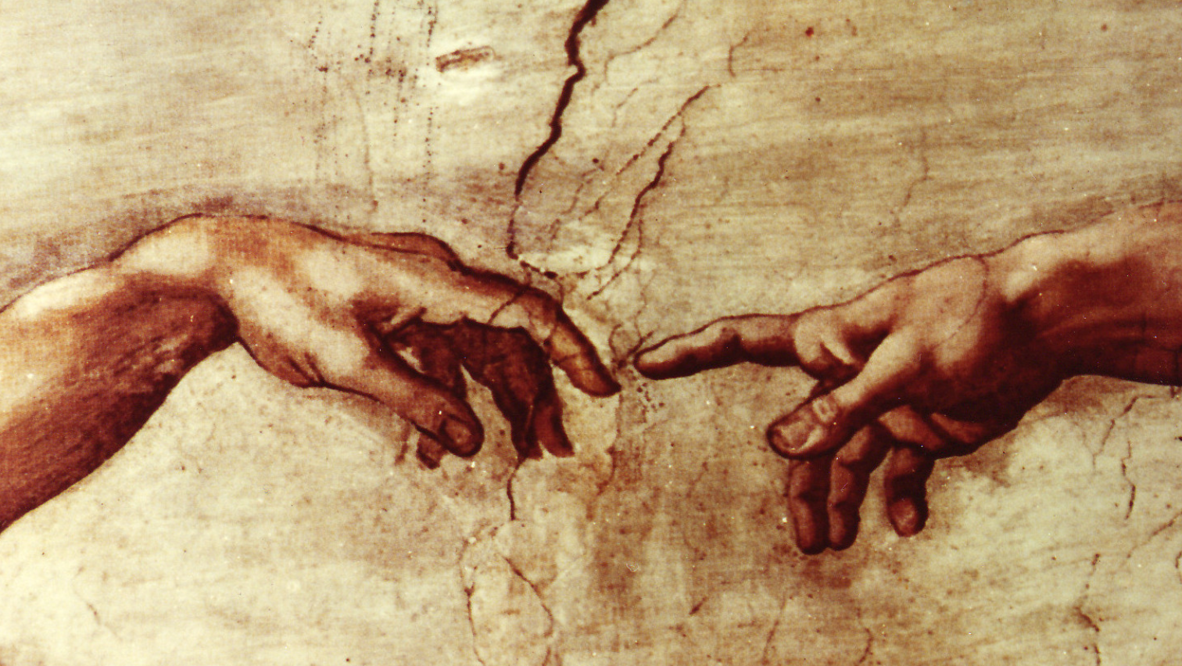
Michelangelo

Slide 7
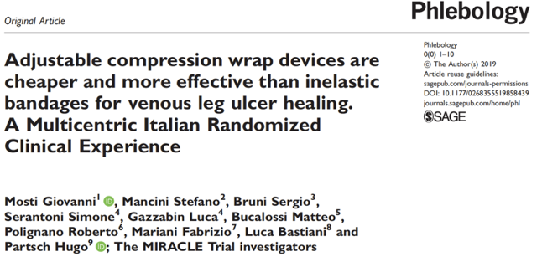
EDUCATION
- Venous Ulcers
- Ejection fraction
Lundatex®
- Lymphoedema
- Edema

Slide 8
EDUCATION
EDUCATION is the process of facilitating learning, or the acquisition of knowledge, skills, values, morals, beliefs, habits, and personal development.

Slide 9
EXPECTANCY

Slide 10
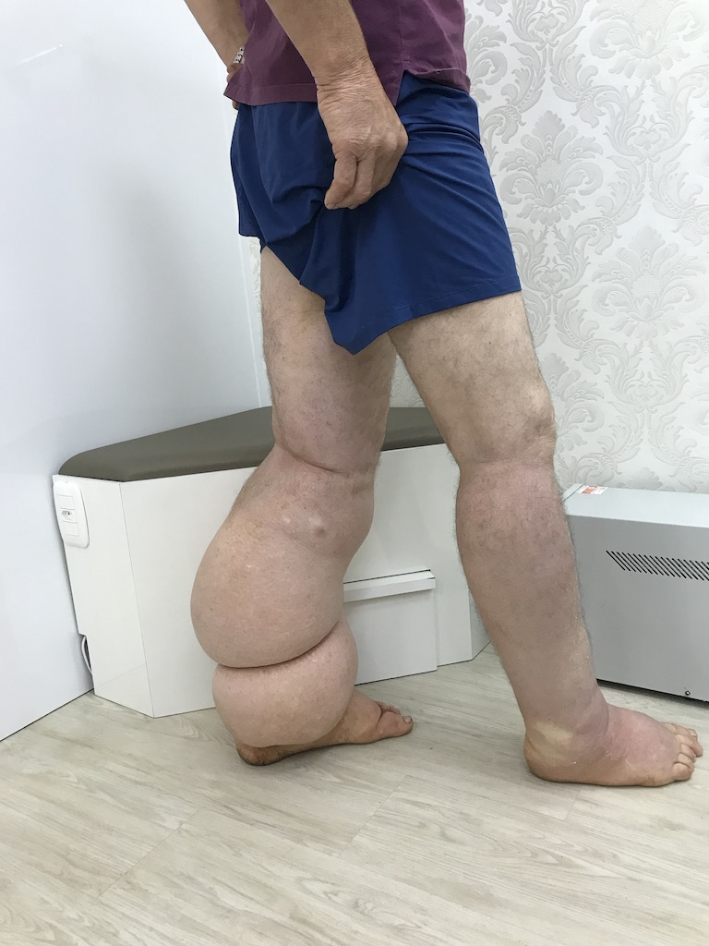
REALITY PRESCRIPTION BELIEVING THAT IT WORKS WITHOUT EDUCATION

Slide 11
“We can’t sell the idea that it is EASY, even being EASY for those who really understand about compression therapy.”

Slide 12
Compression Therapy
CINDERELLA

Slide 13
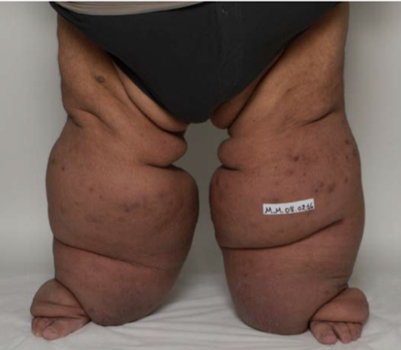
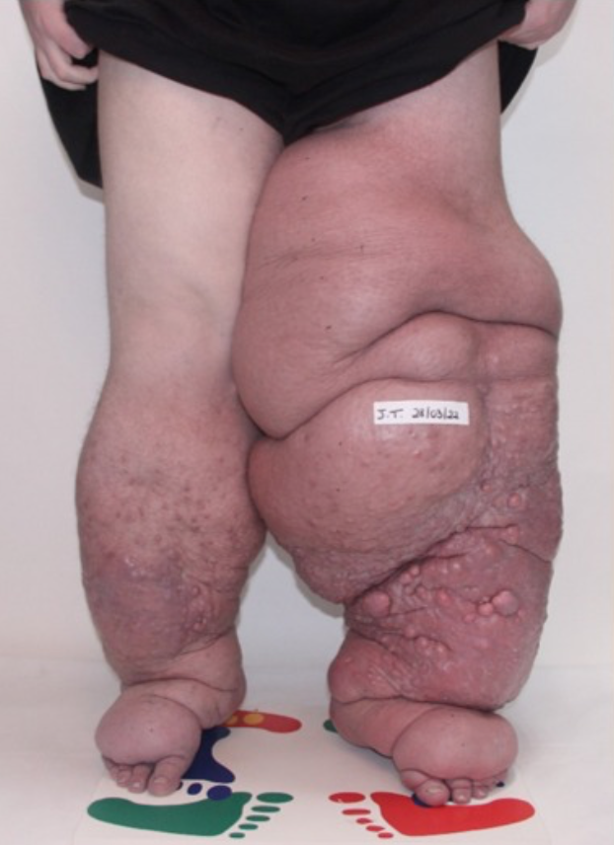
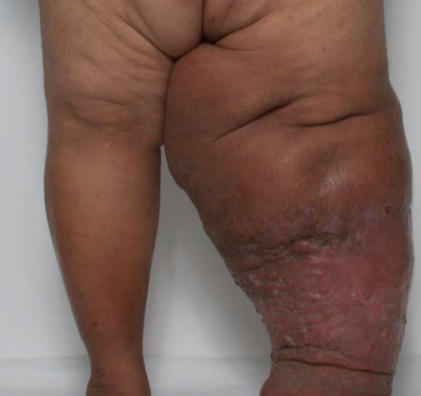
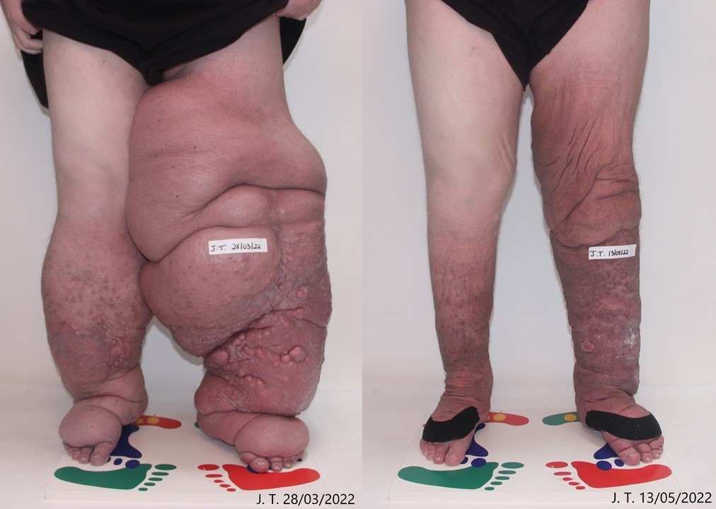
Lymphedema
↓ 50kg

Slide 15
SSI=5mmHg
IP=56mmHg

Slide 16
SSI=37mmHg
PI=51mmHg

Slide 18
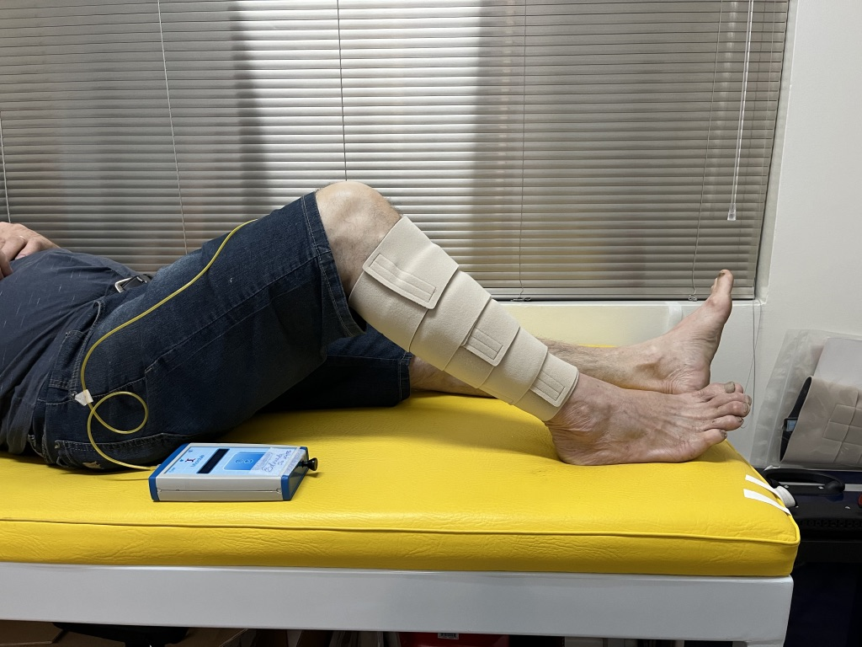
Phase I, Randomized Clinical Trial;
60 years old or ↑;
ELDERLY PHYSICALLY ACTIVES;
n=50 → n=44 (end of the study)
# They were requested to apply a VELCRO DEVICE (Ready Wrap, L&R), 3 times, after a brief instruction (pre test and post test, 3 months later).
# Brief Instruction: PERCEPTION of 50mmHg with esphigmomanometer, bandage (2 layers of Rosidal K) and Ready Wrap;

Slide 19
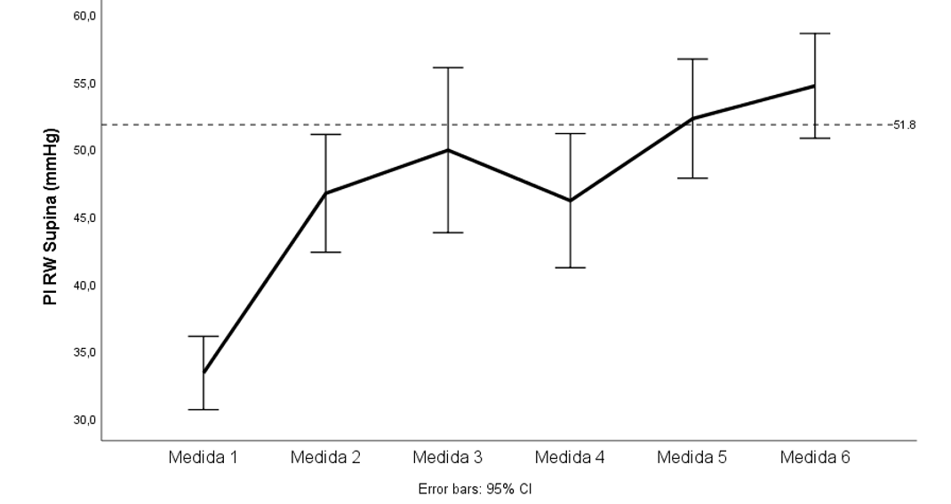
SUPINE POSITION

Slide 20
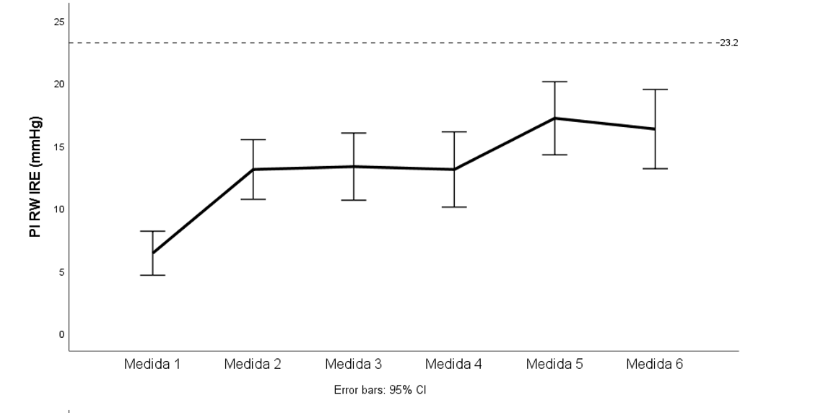
Static Stiffness Index

Slide 23
Conclusion
Easy devices are EFFECTIVE (maybe they will be the future), but we have to be trained (EDUCATION) to make them EASY!

Slide 24
Thank you very much!!
eduardodamatta@me.com
@dr.eduardodamatta

