Slide 1


PTS and Compression
Why we don’t always get good outcomes
Uncertainty about what we are compressing, poor pressure and pressure gradients
Are these reasons to avoid Compression in PTS?
Professor Neil Piller
Lymphoedema Clinical Research Unit, Department of Surgery, School of Medicine, Flinders University with input from Prof John Arkwright and Dr Luke Parkinson
Notes:
NEIL: Do I have to keep the same title that I submitted earlier? I guess that’s what will be on the program.

Slide 2
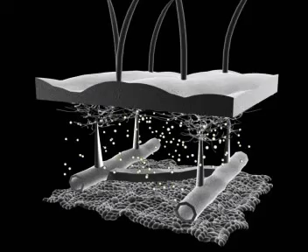
Pressure- its not this simple!

Slide 3

Considered Laplace’s law?
Stronger curvature means higher pressure
What if we don’t get the pressure right?
  At given point on a limb the pressure is high over a lymph collector or vein and low elsewhere
(This law explains why bubbles are spherical – pressure is equalised!)

Slide 4
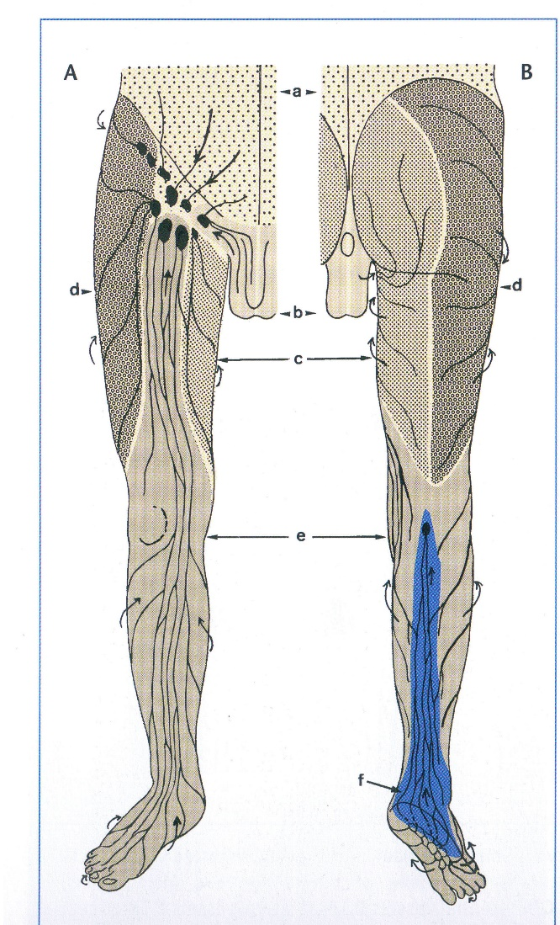
Pressure variation at a given circumferential point due to surface curvature – Just as important to consider as a pressure gradient along the limb!

Slide 5
Considered Pascal’s Law?
Contained fluids: A change in pressure in an enclosed fluid is transmitted undiminished to all parts of the fluid
Uncontained fluids: Fluids will flow down a pressure gradient
What if the fluid is forced from the compressed area distally?

Slide 6
We know what Compression does
  Reduces capillary filtration
  Shift fluids into non compressed parts
  Increase lymphatic reabsorption + transport
    Improves sub-fascial lymph transport
  Improve venous pump (in those with dysfunction)
  Accelerates blood flow in venous leg ulcers
  Possible breakdown fibro-sclerotic tissues

Slide 7
But there are issues with pressure
Poor pressure gradient
  Fluids forced distally
Pressure too high (general or local)
  Lymph or venous flow slowed or stopped
Garment difficult to Don or Doff
  Patient unable to wear
Older garments/bandages less elastic
  Less pressure and less variation with movement
Pressure can’t be adjusted with traditional garments (but can with wraps etc)
  as the fluids leave the limb and it reduces
So the symptoms of PTS (swelling, heaviness discomfort and functioning) may worsen!

Slide 8
OK - you need compression for your PTS patient
Lets just look at bandaging first

Slide 9
How can we be sure we are doing it right ?
Is it worth the risk?

Slide 10
External pressure
Could too much pressure close the lymphatics or reduce pump efficiency or interfere with venous drainage, damage valves or create another clot ?

Slide 11
We know
Too much pressure - Potential for harm- DVT again?
Too little pressure - Limited therapeutic effect
Wrong Pressure gradient – ulcers and distal oedema
The Conundrum
We can’t directly measure internal pressure in vivo without cutting holes in patients - NOT A GOOD IDEA!
The Problem
Values provided by interfacial pressure measurement devices are a function of their shape, deformation and transduction mechanism
The Solution
Measure the pressure applied at the limb surface to infer the internal limb pressure

Slide 12
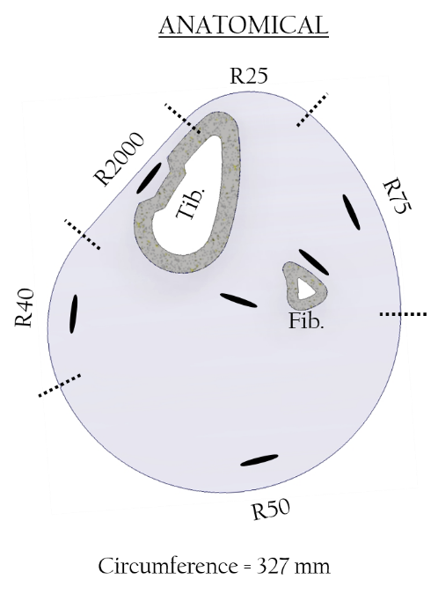
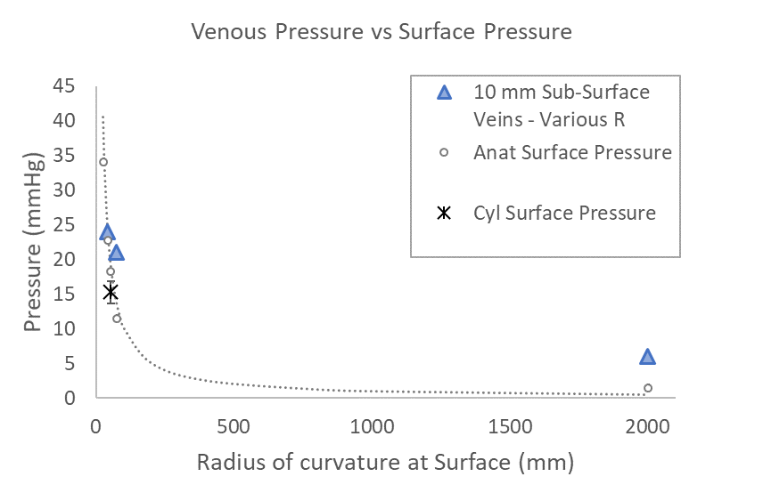
What happens inside the limb when overlying surface is flat or slightly curved ?
Venous pressure was affected by the adjacent local curvature
NOTE: Low or no curvature of the surface means low pressure delivered to vessels near or under that surface

Slide 13
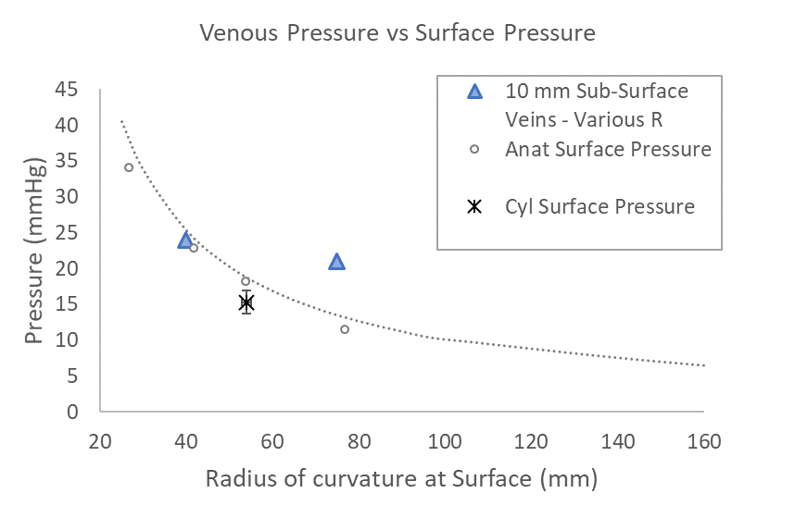
What happens inside the limb when nearby surface is more strongly curved?
Venous pressure was affected by the adjacent local curvature
NOTE: Greater surface curvature means higher pressure delivered on the vessels under that surface

Slide 14
What this showed
Superficial sub-surface regions are affected by the curvature of the adjacent surface.
Sub-bandage pressure measurement made at the surface is strongly affected by the location of the measurement and may not reflect the internal pressure

Slide 15
So where is/are the vein(s) you want to compress?
Where did the prior DVT occur?
Where are the lymphatics ?
What’s the nett effect ?

Slide 16
Do you think about these issues before using compression ?

Slide 17
Before any compression we MUST prepare the lymphatic System
Reduce lymph load
Clear/drain proximal lymphatic pathways
Ensure un-obstructed flow of blood, fluids and lymph proximally from compressed area
Do you think of these needs?

Slide 18
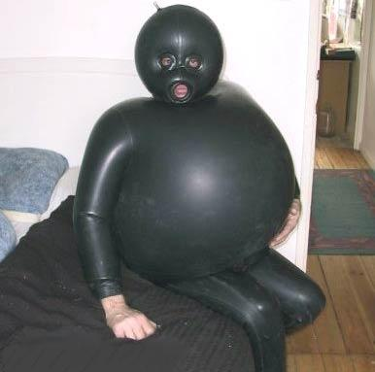
All over similar pressure is not so good (and at a given circumferential point is unlikely): But from distal to proximal there must be a pressure gradient

Slide 19
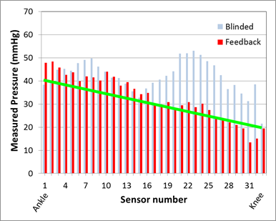
Pressure gradient achievement by trained professionals using bandaging - they got the gradient wrong without pressure sensor feedback !
Problem area mid calf

Slide 20
So what’s it all mean?
We must think carefully about optimal pressures for what we want to compress
We have to consider variations in pressure at each point around a limb
We have to consider the location and type of the vessels we want to compress
We have to ensure we get the pressures we want and expect !
The wrong pressure may cause further DVT or worsen PTS symptoms !

Slide 21
Gaining the best outcomes
Use ICG imaging to show functional lymphatics and areas of poor lymphatic drainage
  More portable and compact equipment now available
Apply anatomical knowledge and the patients history to be aware where the functional vessels are if can’t image them
Think carefully about pressure at a given circumference point.

Slide 22
Is the Risk too high? Do we leave compression from any PTS treatment plan?
Its our call – but:
1 Keep the lymphatics in mind !
2 Consider the location of the vessels you will compress
3 Allow for the shape effect of limb on pressure in the tissues

Slide 23
References
Parkinson K, van Zanten, M Piller, N Arkwright J (2017). High resolution tape sensor improves the accuracy of applied pressure profiles during lower leg bandaging- results from a study using a fibre-optic sensing tape. International Wound Journal doi 10.1111/iwj.12741
Piller, N Green, T, Parkinson, L, Mosti,G, Lee,BB (2019) Feeling the pressure?: How can we be sure we are getting it right? Journal of Lymphoedema 14(1) 52-55

Slide 24
Did you Feel the Pressure ?

