Slide 1

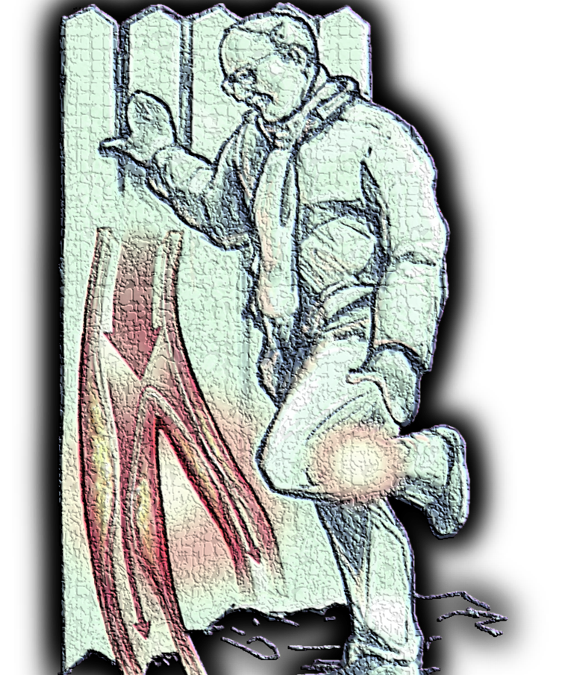




compression or no compression in arterial patients
Jan Schuren, RgN, OTc, MSc, PhD

Slide 2


conflict of
interest:
retired employee
no relationships can be perceived
as potential conflict of interest
compression or no compression in arterial patients
Jan Schuren, RgN, OTc, MSc, PhD

Slide 3
why this controversy ?
where is the evidence ?
is compression safe in arterial patients ?
is compression effective in arterial patients ?
compression or no compression in arterial patients

Slide 4
" ... in the 'instructions for use' of most commercially available compression bandages and systems, one can read that these products should not be used on patients with an ABPI below 0.8 "
why this controversy ?
from:
Schuren J.
Compression unravelled.
Margreff Druck GmbH, Essen, Germany; 2011: 140.

Slide 5

in addition:
... a large number of confusing recommendations can be found on compression for patients
with mixed venous/arterial ulcers
why this controversy ?
from:
Schuren J.
Compression unravelled.
Margreff Druck GmbH, Essen, Germany; 2011: 140.

Slide 6
it is recommended to not compress with low abpi's
it is recommended to not compress ≤ 0,9
it is recommended to not compress ≤ 0,8
it is recommended to not compress ≤ 0,7
it is recommended to not compress ≤ 0,6
it is recommended to not compress ≤ 0,5
it is recommended to reduce pressure
it is recommended to reduce pressure to ≤ 30 mmHg
it is recommended to reduce pressure to ≤ 20 mmHg
it is recommended to use short stretch bandages
it is recommended to use long stretch bandages
it is recommended to modifiy compression systems
long stretch bandages require minor training
inelastic compression may be preferred
≤ 0,9: extra padding should be used
patients deserve more detailed study
further research is needed
why this controversy ?
from:
Schuren J.
Compression unravelled.
Margreff Druck GmbH, Essen, Germany; 2011: 140.

Slide 7


why this controversy ?

Slide 8

... in 2016, a total of 436 Canadian clinicians with experience in the care of mixed venous/arterial ulcers participated in a survey on knowledge, attitude and practice in the management of these ulcers
why this controversy ?
Woo K, Sears K.
Knowledge, attitude and practice in the management of mixed arteriovenous leg ulcers.
The International Journal of Lower Extremity Wounds 2016; 15(1): 52-57.

Slide 9
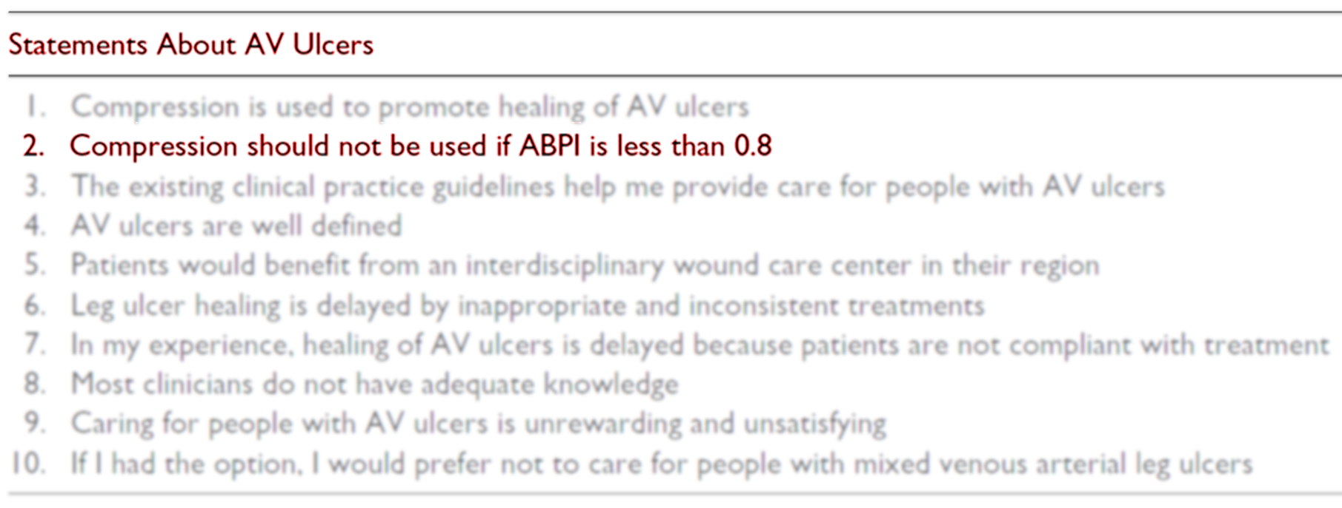
why this controversy ?
from:
Woo K, Sears K.
Knowledge, attitude and practice in the management of mixed arteriovenous leg ulcers.
The International Journal of Lower Extremity Wounds 2016; 15(1): 52-57.

Slide 10



statement 2:
compression should not be used if ABPI is less than 0.8
why this controversy ?
from:
Woo K, Sears K.
Knowledge, attitude and practice in the management of mixed arteriovenous leg ulcers.
The International Journal of Lower Extremity Wounds 2016; 15(1): 52-57.

Slide 11
" ... in spite of decades of continuous attention, there is still a dearth of hard data to support evidence-based clinical decisions on the use of compression therapy for venous
leg ulcer patients with low ABPI's "
why this controversy ?

Slide 12
arterial patients

Slide 13
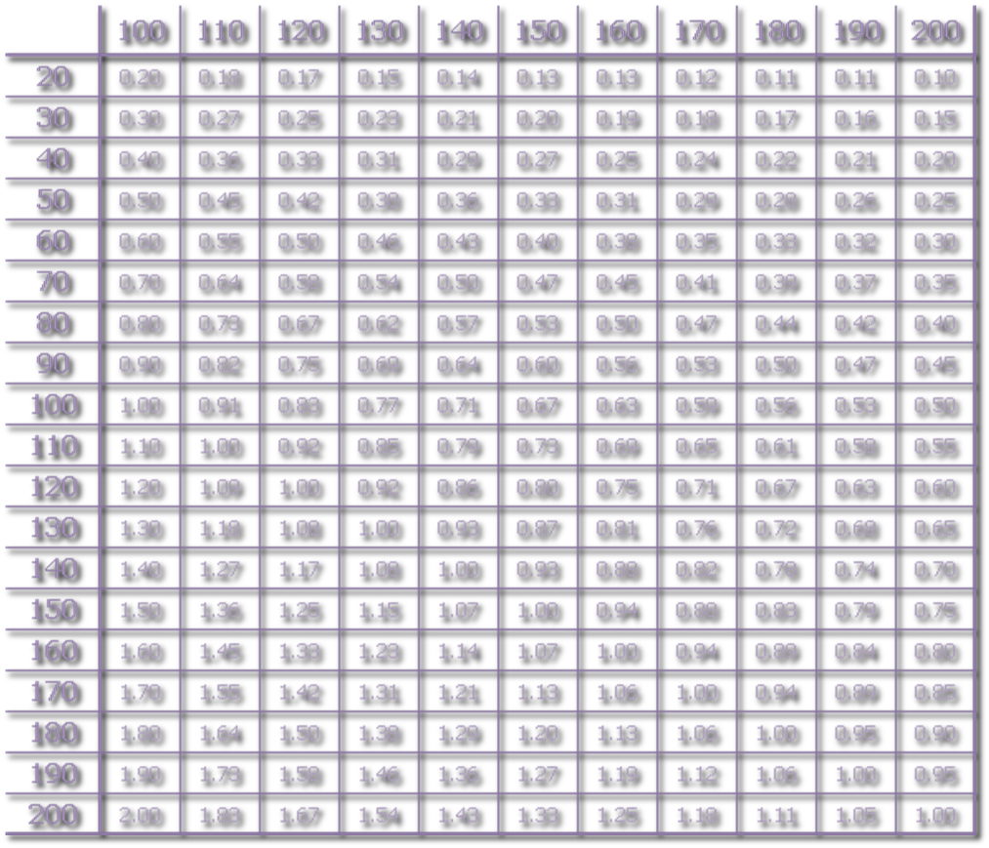




20
40
15
30
10
20
5
10
0
0
41 - 50
51 - 60
61 - 70
71 - 80
> 80
age
41 - 50
51 - 60
61 - 70
71 - 80
> 80
number of patients with leg ulcers
per 1000 head of population
number of patients (± %)
with an ABPI < 0,9
modified from:
Cornwall JV, Doré CJ, Lewis JD.
Leg ulcers: epidemiology and aetiology.
Br J Surg 1986; 73: 693-696.
based on data from:
Callam MJ, Harper DR, Dale JJ, Ruckley CV.
Arterial disease in chronic leg ulceration:an underestimated hazard?
Br Med J 1987; 294: 929-931.

Slide 14

20
40
15
30
10
20
5
10
0
0
41 - 50
51 - 60
61 - 70
71 - 80
> 80
age
41 - 50
51 - 60
61 - 70
71 - 80
> 80
number of patients with leg ulcers
per 1000 head of population
number of patients (± %)
with an ABPI < 0,9
modified from:
Cornwall JV, Doré CJ, Lewis JD.
Leg ulcers: epidemiology and aetiology.
Br J Surg 1986; 73: 693-696.
based on data from:
Callam MJ, Harper DR, Dale JJ, Ruckley CV.
Arterial disease in chronic leg ulceration:an underestimated hazard?
Br Med J 1987; 294: 929-931.

Slide 15

20
40
15
30
10
20
5
10
0
0
41 - 50
51 - 60
61 - 70
71 - 80
> 80
age
41 - 50
51 - 60
61 - 70
71 - 80
> 80
number of patients with leg ulcers
per 1000 head of population
number of patients (± %)
with an ABPI < 0,9
modified from:
Cornwall JV, Doré CJ, Lewis JD.
Leg ulcers: epidemiology and aetiology.
Br J Surg 1986; 73: 693-696.
based on data from:
Callam MJ, Harper DR, Dale JJ, Ruckley CV.
Arterial disease in chronic leg ulceration:an underestimated hazard?
Br Med J 1987; 294: 929-931.

Slide 16

ABPI ≤ 0,5
(n=31 = 2%)
ABPI 0,5 - 0,85
(n=193 = 14%)
20
15
10
5
ABPI > 0,85
n=1154 - 84%
0
41 - 50
51 - 60
61 - 70
71 - 80
> 80
age
number of patients with leg ulcers
per 1000 head of population
ABPI distribution (n = 1378)
modified from:
Cornwall JV, Doré CJ, Lewis JD.
Leg ulcers: epidemiology and aetiology.
Br J Surg 1986; 73: 693-696.
based on data from:
Humphreys M, Stewart A, Gohel M, Taylor M, Whyman M, Poskitt K.
Management of mixed arterial and venous ulcers
Br J Surg 2007; 94: 1104-1107.

Slide 17
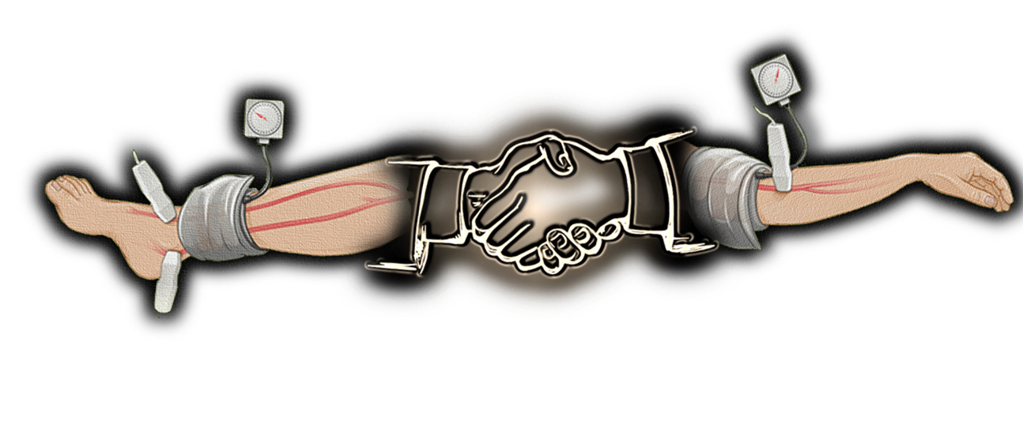


arterial patients

Slide 18

" ... evaluation of the peripheral arterial circulation of the lower limb, including measuring the ABPI, is essential in the treatment of venous leg ulceration when compression therapy is indicated "
arterial patients
from:
Harding K, Dowsett C, Fias L, Jelnes R, Mosti G, Öien R, Partsch H, Reeder S, Senet P, Verdú Soriano J, Vanscheidt W.
Simplifying venous leg ulcer management: consensus recommendations.
Wounds International: 2015.

Slide 19
" ... patients with claudicatio intermittens usually have an
ABPI between 0,5 and o,9 "
" ... in patients with restpain
and a threatening gangrene,
the ABPI is mostly < 0,5 "
arterial patients
from:
Callam MJ, Harper DR, Dale JJ, Ruckley CV.
Arterial disease in chronic leg ulceration: an underestimated hazard? Lothian and Forth Valley leg ulcer study.
Br Med J 1987; 294: 929-931.

Slide 20
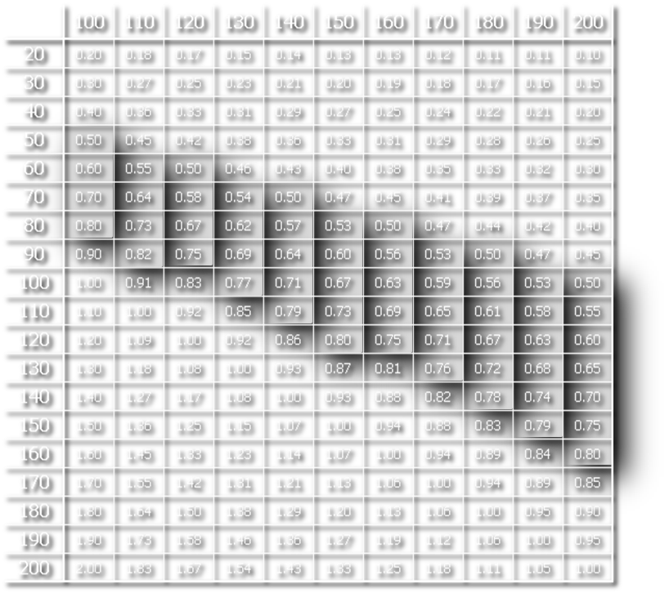

arterial patients

Slide 21
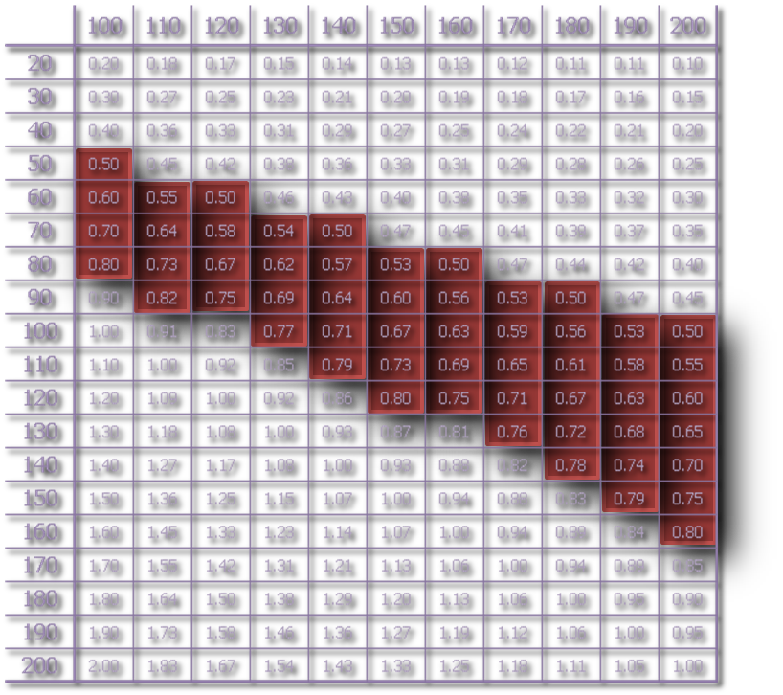

where is the evidence ?

Slide 22

exclusion criteria
where is the evidence ?

Slide 23

20
15
10
5
0
where is the evidence ?
from:
Schuren J.
Compression unravelled.
Margreff Druck GmbH, Essen, Germany; 2011: 140.

Slide 24


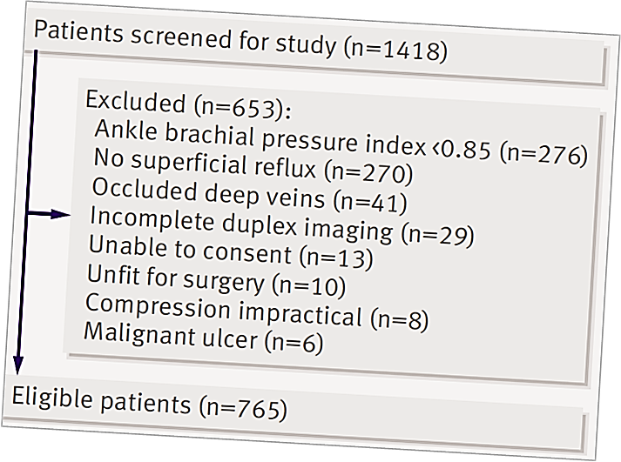


20
15
10
5
0
where is the evidence ?
from:
Gohel M, Barwell J, Taylor M. Chant T, Foy C, Earnshaw J, Heather B, Mitchell D, Whymann M, Poskitt K.
Long term results of compression therapy alone versus compression plus surgery in chronic venous ulceration (ESCHAR): randomised controlled trial
BMJ 2007; 335: 1-6.

Slide 25


is compression safe in arterial patients ?

Slide 26
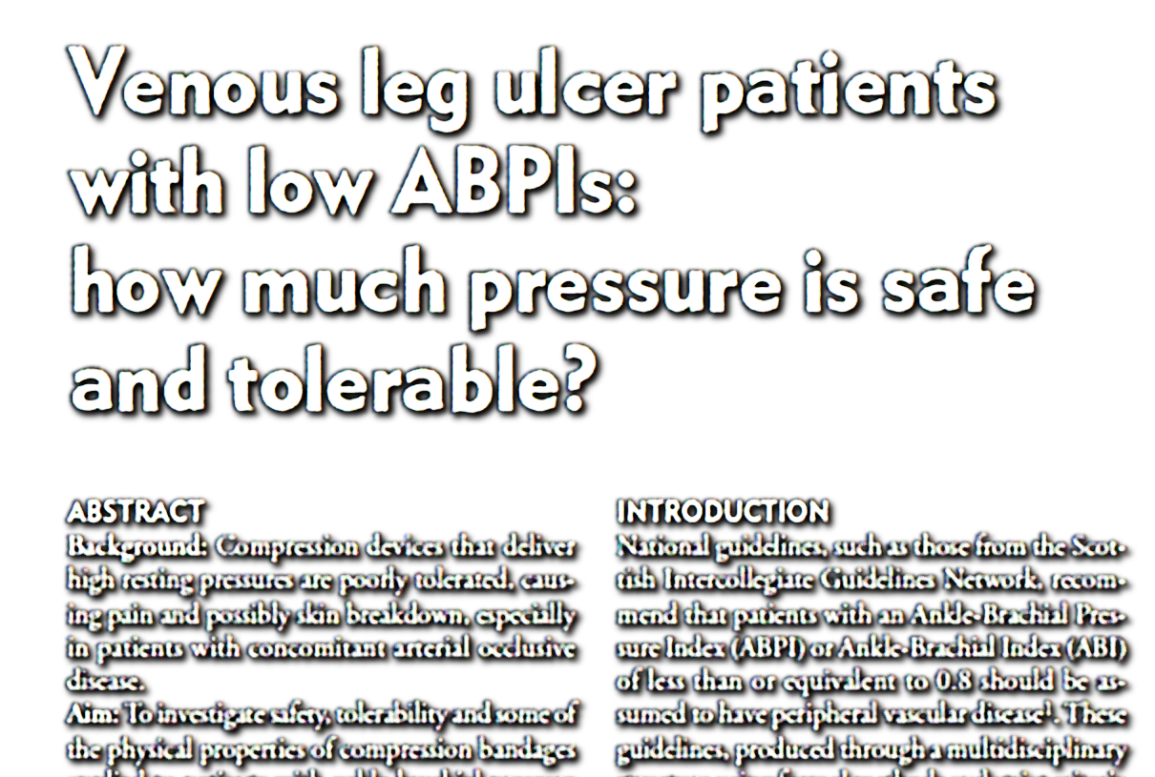
is compression safe in arterial patients ?
Schuren J, Vos A, Allen J.
Venous leg ulcer patients with low ABPI's: how much pressure is safe and tolerable ?
EWMA J 2010; 10(3): 29-34.

Slide 27
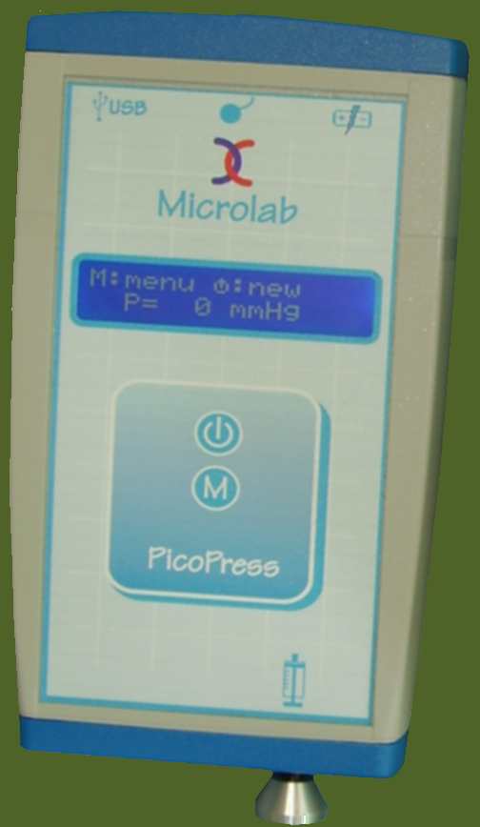

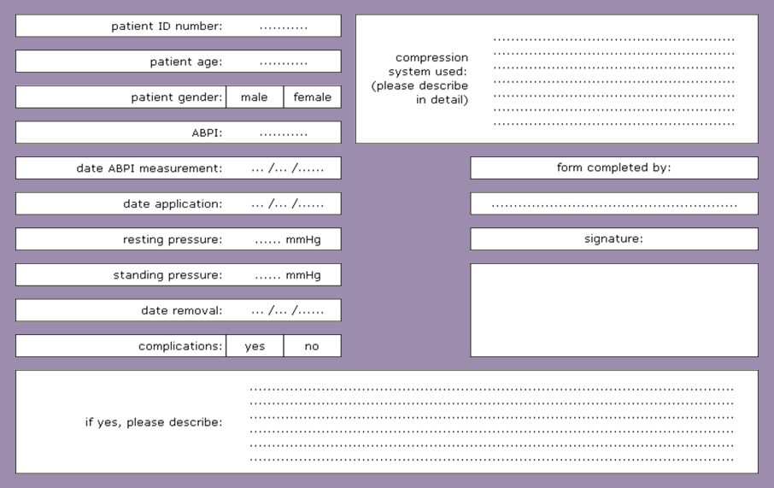
compression for patients with ABPI's between 0.5-0.8
observational study
8 centres in Canada & the Netherlands
all routinely used bandages were applied by
experienced wound care nurses
is compression safe in arterial patients ?
from:
Schuren J, Vos A, Allen J.
Venous leg ulcer patients with low ABPI's: how much pressure is safe and tolerable ?
EWMA J 2010; 10(3): 29-34.

Slide 28
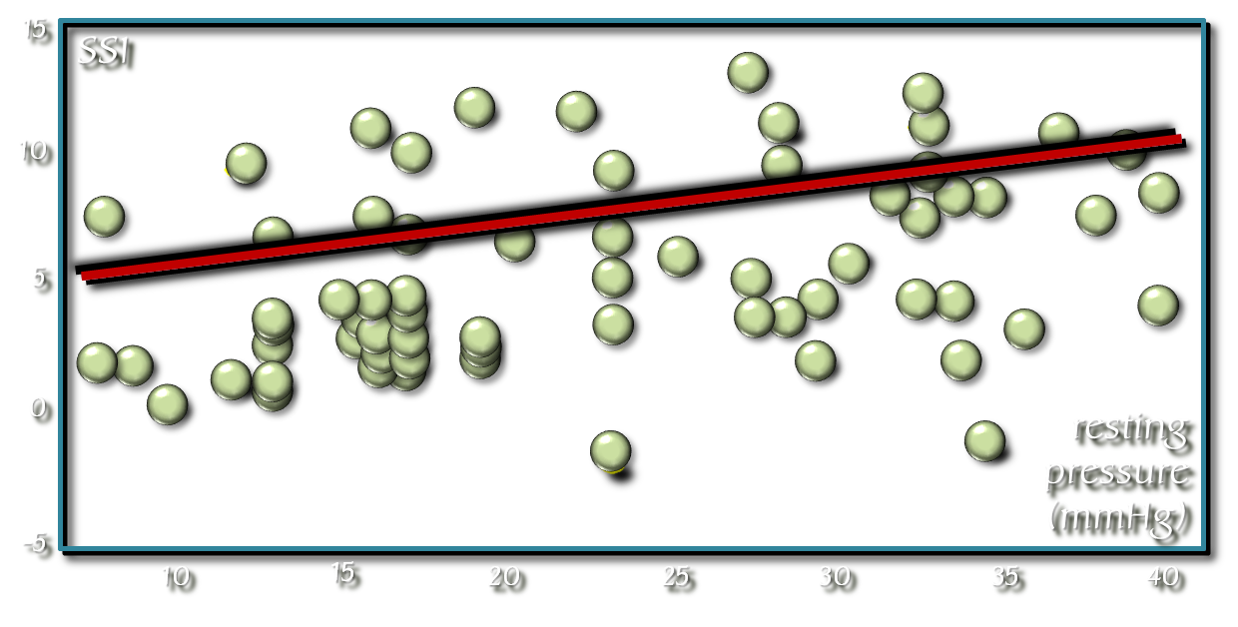
compression for patients with ABPI's between 0.5-0.8
140 applications on 87 patients
average ABPI: 0.68 (range: 0.5 - 0.79)
average wear time: 3.7 days (range: 1 - 7)
average resting pressure: 24.9 mmHg (range: 6-40)
average SSI: 7.2 (range: -3 - 14)
is compression safe in arterial patients ?
modified from:
Schuren J, Vos A, Allen J.
Venous leg ulcer patients with low ABPI's: how much pressure is safe and tolerable ?
EWMA J 2010; 10(3): 29-34.

Slide 29
compression for patients with ABPI's between 0.5-0.8
two adverse events were reported, both being pain in the foot
  one (ABPI 0,76) was solved with some extra padding
  one (ABPI 0,71) was referred to a vascular surgeon
strong correlation between resting pressure and SSI (p=0.001)
1 mmHg increase in resting pressure results in a SSI increase of 1.2
is compression safe in arterial patients ?
modified from:
Schuren J, Vos A, Allen J.
Venous leg ulcer patients with low ABPI's: how much pressure is safe and tolerable ?
EWMA J 2010; 10(3): 29-34.

Slide 30
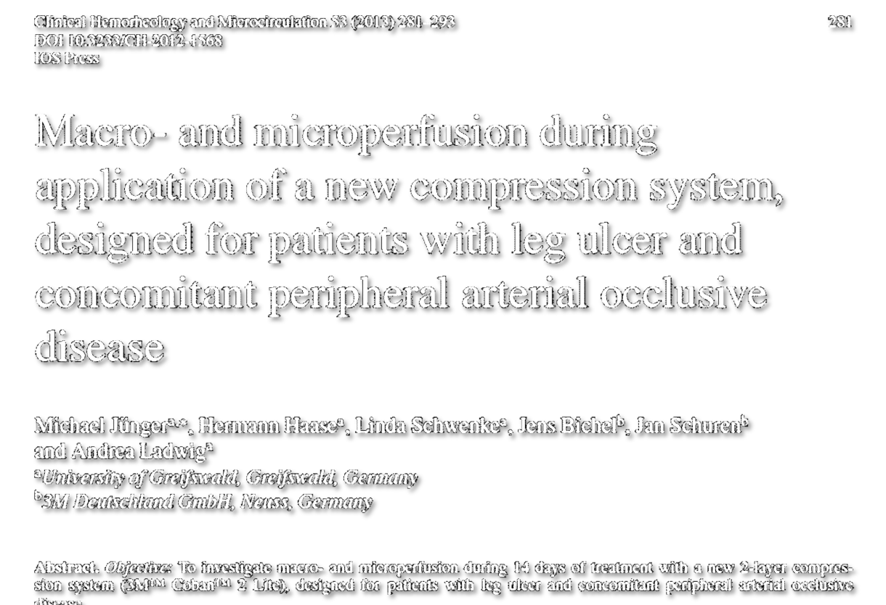
is compression safe in arterial patients ?
Jünger M, Haase H, Schwenke L, Bichel J, Schuren J, Ladwig A.
Macro- and microperfusion during application of a new compression system,
designed for patients with leg ulcer and concomitant peripheral arterial occlusive disease.
Clin Hemorheology and Microcirculation 2013; 53(3): 281-293.

Slide 31
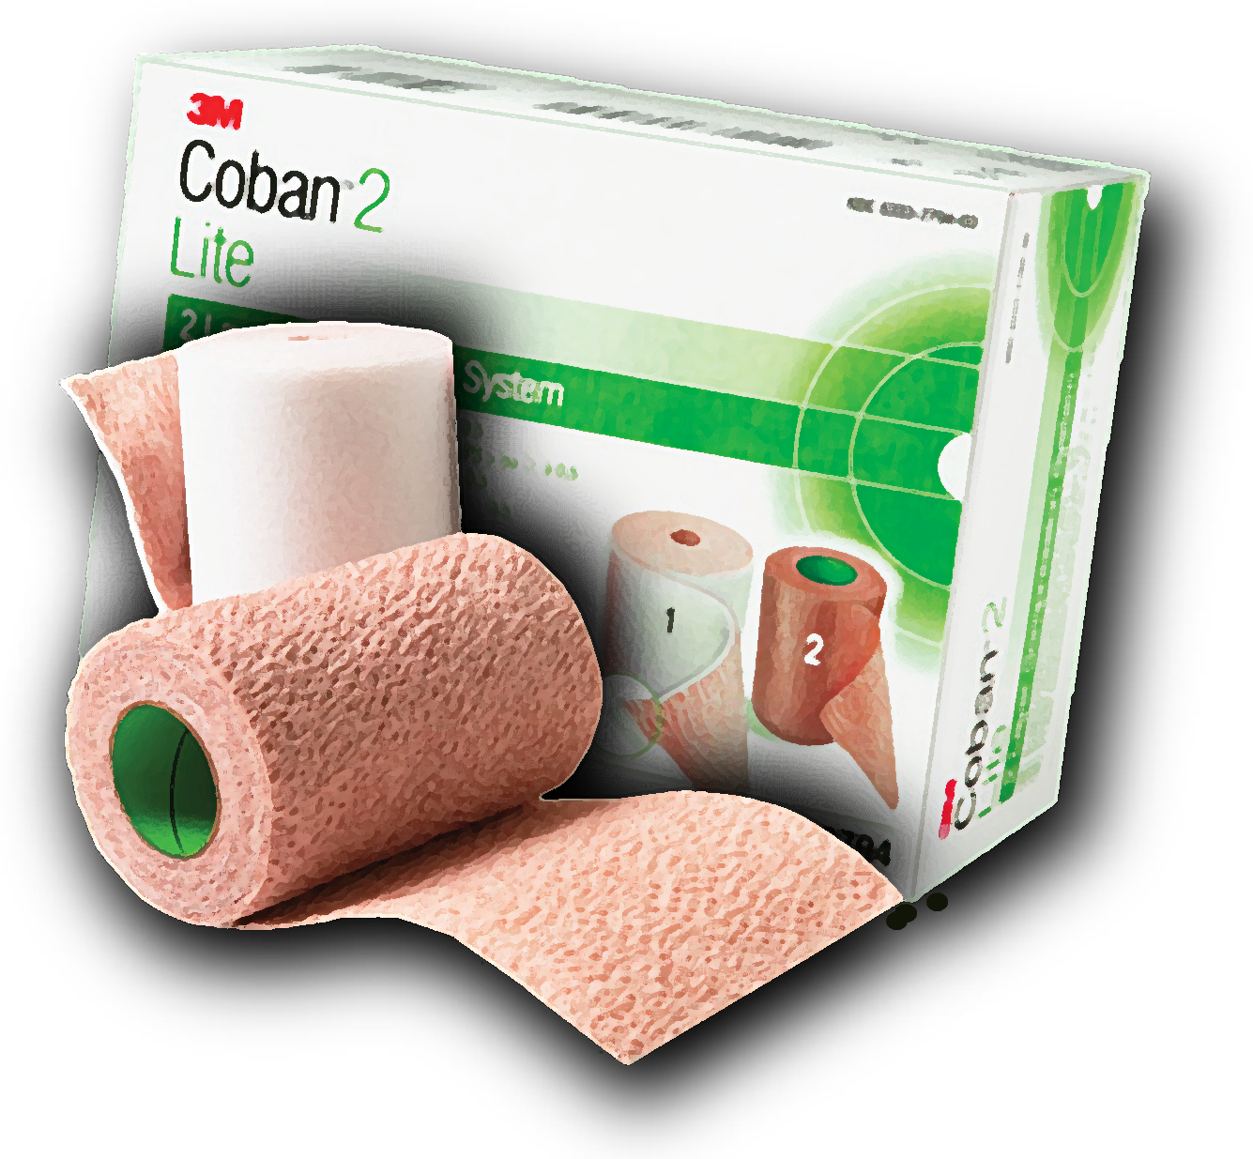
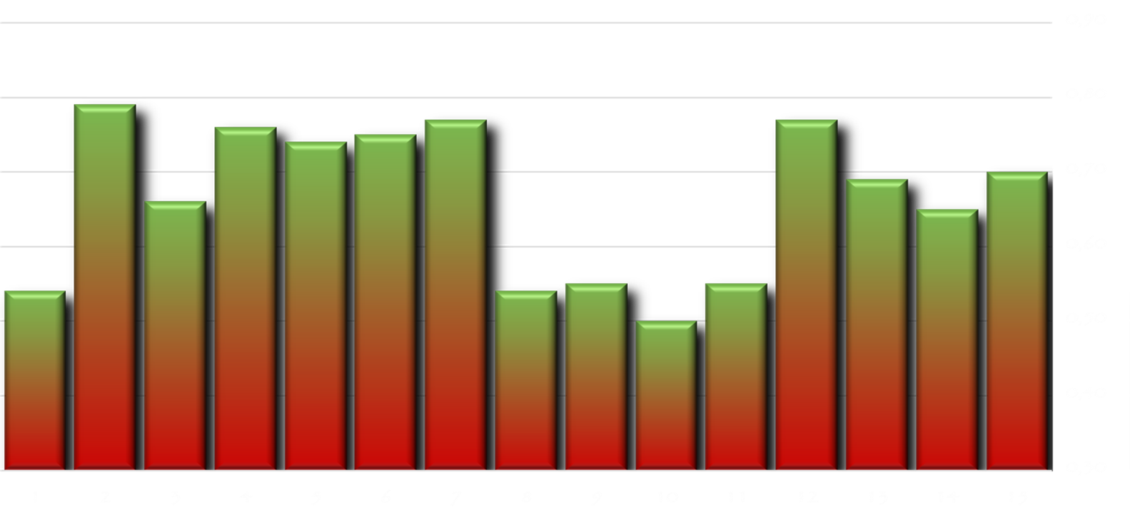
15 patients with PAOD
≈ ABPI between 0.5 - 0.8
≈ 2 weeks voluntary Coban 2 Lite compression
≈ mean pressure after application < 30 mmHg
is compression safe in arterial patients ?
modified from:
Jünger M, Haase H, Schwenke L, Bichel J, Schuren J, Ladwig A.
Macro- and microperfusion during application of a new compression system,
designed for patients with leg ulcer and concomitant peripheral arterial occlusive disease.
Clin Hemorheology and Microcirculation 2013; 53(3): 281-293.

Slide 32
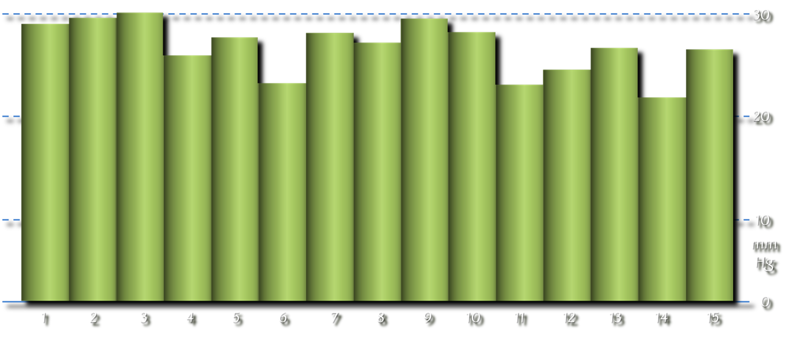
15 patients with PAOD
≈ ABPI between 0.5 - 0.8
≈ 2 weeks voluntary Coban 2 Lite compression
≈ mean pressure after application < 30 mmHg
is compression safe in arterial patients ?
modified from:
Jünger M, Haase H, Schwenke L, Bichel J, Schuren J, Ladwig A.
Macro- and microperfusion during application of a new compression system,
designed for patients with leg ulcer and concomitant peripheral arterial occlusive disease.
Clin Hemorheology and Microcirculation 2013; 53(3): 281-293.

Slide 33
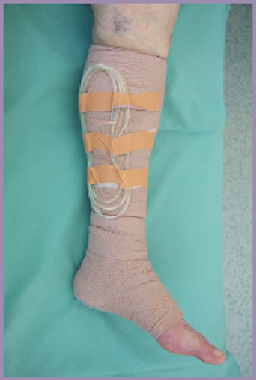
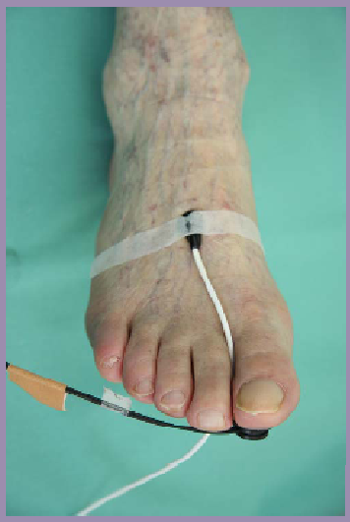
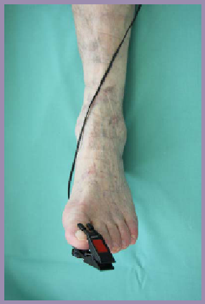

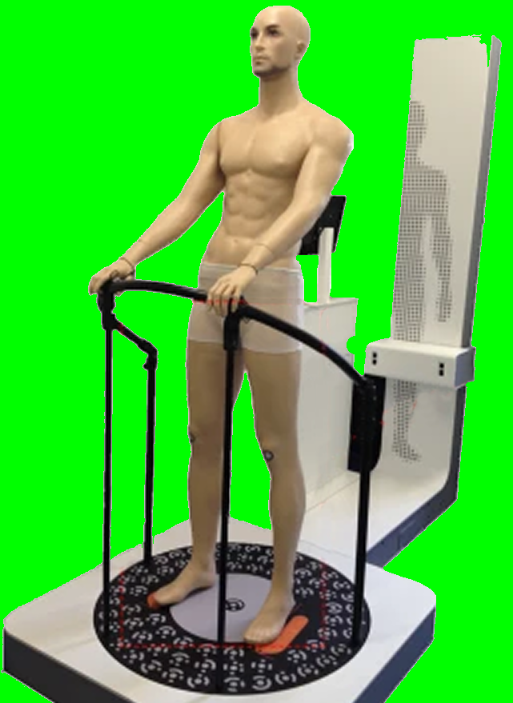
15 patients with PAOD
≈ pressure measurements (B1);
≈ laser Doppler fluxmetry (forefoot);
≈ acral pulsation (hallux);
≈ volumetry (8 patients)
is compression safe in arterial patients ?
modified from:
Jünger M, Haase H, Schwenke L, Bichel J, Schuren J, Ladwig A.
Macro- and microperfusion during application of a new compression system,
designed for patients with leg ulcer and concomitant peripheral arterial occlusive disease.
Clin Hemorheology and Microcirculation 2013; 53(3): 281-293.

Slide 34
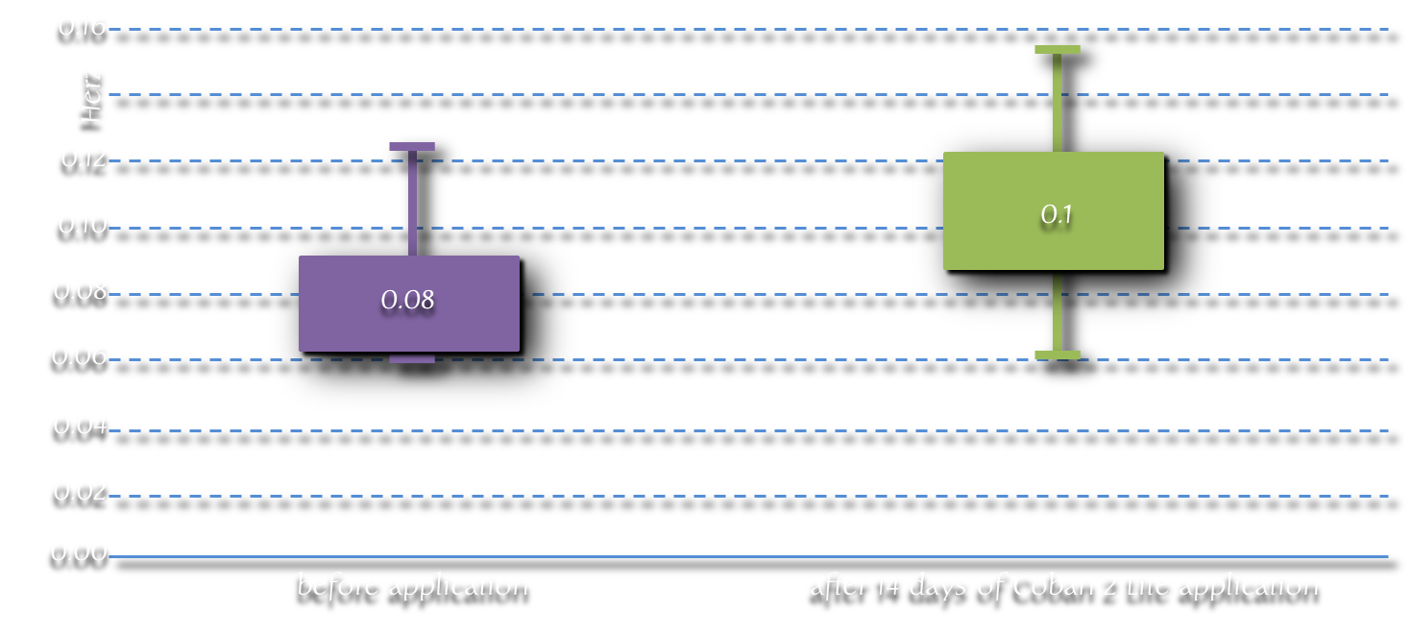
15 patients with PAOD
laser Doppler fluxmetry indicated significant
improvements of the microcirculation (p=0.01)
is compression safe in arterial patients ?
modified from:
Jünger M, Haase H, Schwenke L, Bichel J, Schuren J, Ladwig A.
Macro- and microperfusion during application of a new compression system,
designed for patients with leg ulcer and concomitant peripheral arterial occlusive disease.
Clin Hemorheology and Microcirculation 2013; 53(3): 281-293.

Slide 35


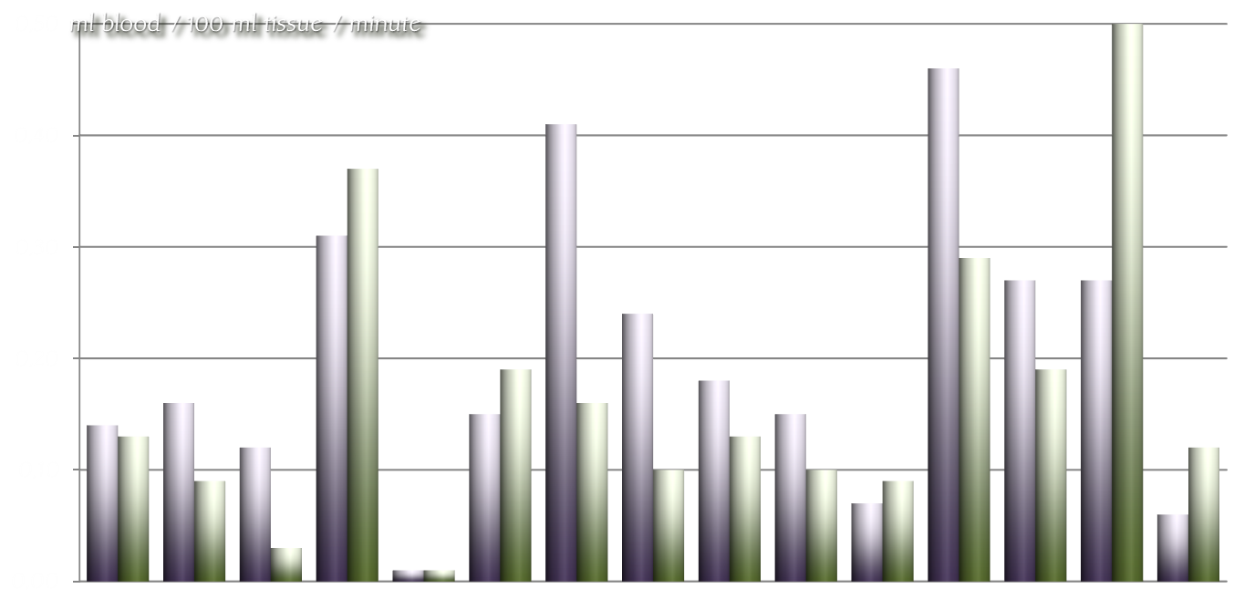
15 patients with PAOD
with the technique of acral oscillography used in this study, a clear
trend towards an advantage or disadvantage caused by compression,
could not be provided
without compression
ml blood / 100 ml tissue / minute
with compression
is compression safe in arterial patients ?
graph based on data from:
Jünger M, Haase H, Schwenke L, Bichel J, Schuren J, Ladwig A.
Macro- and microperfusion during application of a new compression system,
designed for patients with leg ulcer and concomitant peripheral arterial occlusive disease.
Clin Hemorheology and Microcirculation 2013; 53(3): 281-293.

Slide 36
15 patients with PAOD
volumetry performed on 8 patients revealed
an average volume reduction of 7.3% (p=0.03)
is compression safe in arterial patients ?
graph based on data from:
Jünger M, Haase H, Schwenke L, Bichel J, Schuren J, Ladwig A.
Macro- and microperfusion during application of a new compression system,
designed for patients with leg ulcer and concomitant peripheral arterial occlusive disease.
Clin Hemorheology and Microcirculation 2013; 53(3): 281-293.

Slide 37

15 patients with PAOD
in addition:
no pain or skin problems
comfortable compression
good tolerance
is compression safe in arterial patients ?
modified from:
Jünger M, Haase H, Schwenke L, Bichel J, Schuren J, Ladwig A.
Macro- and microperfusion during application of a new compression system,
designed for patients with leg ulcer and concomitant peripheral arterial occlusive disease.
Clin Hemorheology and Microcirculation 2013; 53(3): 281-293.

Slide 38
15 patients with PAOD
conclusions:
the presence of intact skin without any pressure-
related injury, provided the essential clinical proof
that the microcirculation in the dermal capillary
system remained sufficient.
The absence of hypoxy-related pain confirmed
these results.
It could be shown that there were beneficial effects
on the microcirculation.
is compression safe in arterial patients ?
modified from:
Jünger M, Haase H, Schwenke L, Bichel J, Schuren J, Ladwig A.
Macro- and microperfusion during application of a new compression system,
designed for patients with leg ulcer and concomitant peripheral arterial occlusive disease.
Clin Hemorheology and Microcirculation 2013; 53(3): 281-293.

Slide 39

is compression effective in arterial patients ?

Slide 40
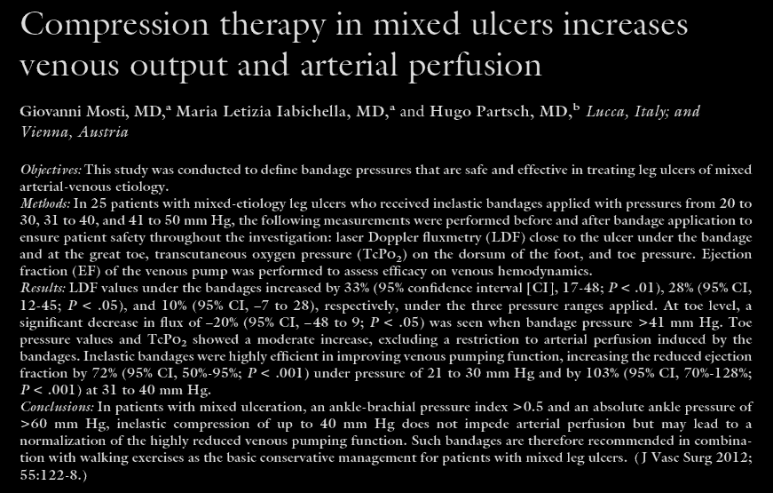
is compression effective in arterial patients ?
Mosti G, Iabichella ML, Partsch H.
Compression therapy in mixed ulcers increases venous output and arterial perfusion
J Vasc Surg 2012; 55: 122-128.

Slide 41
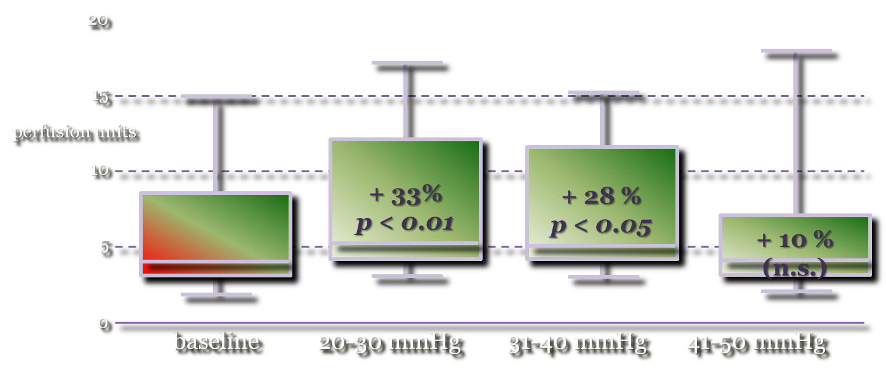
25 patients with PAOD (mean ABPI: 0.58; range: 0.5-0.65)
Inelastic compression of up to 40 mmHg (B1):
increases the arterial perfusion of the compressed part of the leg
does not detoriate the arterial perfusion distal to the bandage
significantly increases transcutaneous oxygen pressure on the forefoot
significantly improves the reduced venous pump function (EF)
laser Doppler flux sub-bandage (peri-wound skin)
is compression effective in arterial patients ?
modified from:
Mosti G, Iabichella ML, Partsch H.
Compression therapy in mixed ulcers increases venous output and arterial perfusion
J Vasc Surg 2012; 55: 122-128.

Slide 42
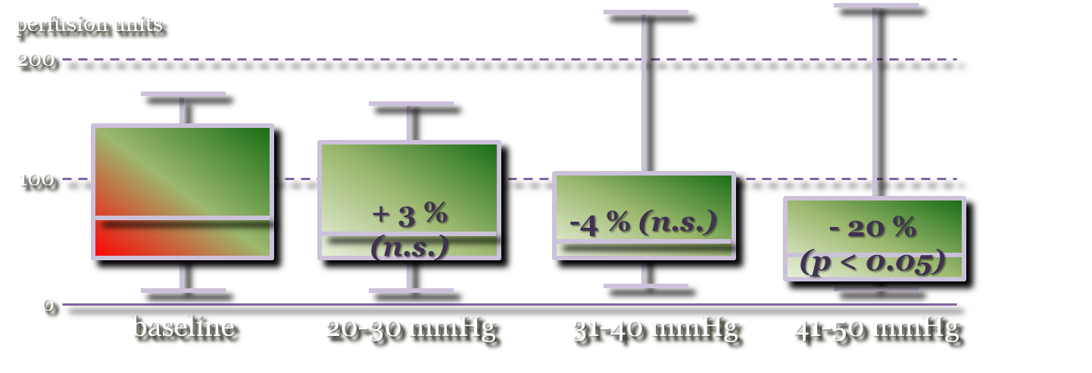
25 patients with PAOD (mean ABPI: 0.58; range: 0.5-0.65)
Inelastic compression of up to 40 mmHg (B1):
increases the arterial perfusion of the compressed part of the leg
does not detoriate the arterial perfusion distal to the bandage
significantly increases transcutaneous oxygen pressure on the forefoot
significantly improves the reduced venous pump function (EF)
laser Doppler flux distal to the bandage (toe)
is compression effective in arterial patients ?
modified from:
Mosti G, Iabichella ML, Partsch H.
Compression therapy in mixed ulcers increases venous output and arterial perfusion
J Vasc Surg 2012; 55: 122-128.

Slide 43
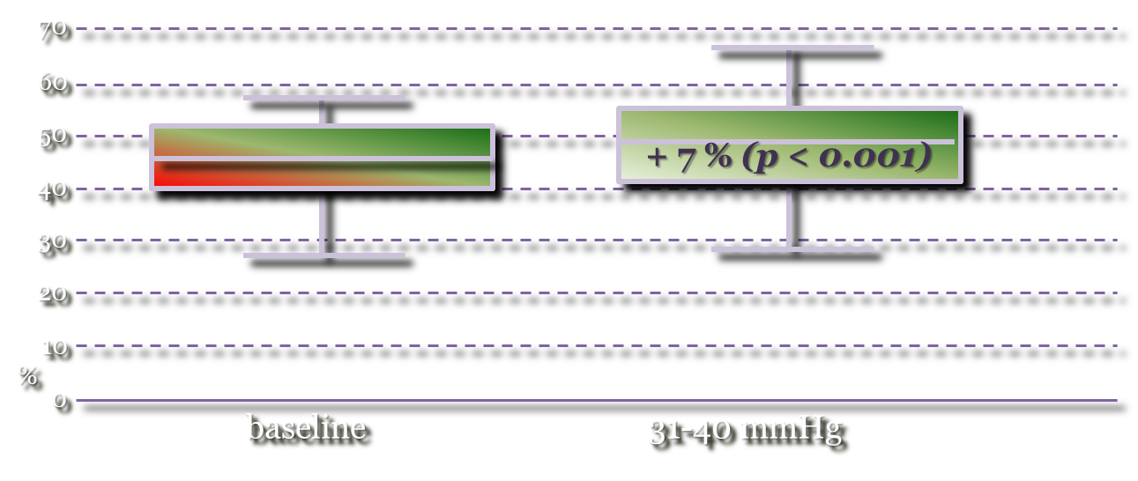
25 patients with PAOD (mean ABPI: 0.58; range: 0.5-0.65)
Inelastic compression of up to 40 mmHg (B1):
increases the arterial perfusion of the compressed part of the leg
does not detoriate the arterial perfusion distal to the bandage
significantly increases transcutaneous oxygen pressure on the forefoot
significantly improves the reduced venous pump function (EF)
TcPO₂ measurements (Periflux system 5000)
is compression effective in arterial patients ?
modified from:
Mosti G, Iabichella ML, Partsch H.
Compression therapy in mixed ulcers increases venous output and arterial perfusion
J Vasc Surg 2012; 55: 122-128.

Slide 44
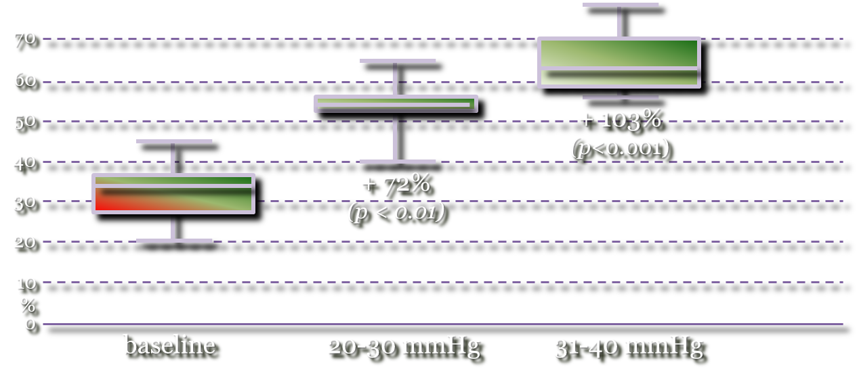
25 patients with PAOD (mean ABPI: 0.58; range: 0.5-0.65)
Inelastic compression of up to 40 mmHg (B1):
increases the arterial perfusion of the compressed part of the leg
does not detoriate the arterial perfusion distal to the bandage
significantly increases transcutaneous oxygen pressure on the forefoot
significantly improves the reduced venous pump function (EF)
Ejection fraction (strain-gauge plethysmography)
is compression effective in arterial patients ?
modified from:
Mosti G, Iabichella ML, Partsch H.
Compression therapy in mixed ulcers increases venous output and arterial perfusion
J Vasc Surg 2012; 55: 122-128.

Slide 45
25 patients with PAOD (mean ABPI: 0.58; range: 0.5-0.65)
Inelastic compression of up to 40 mmHg (B1):
increases the arterial perfusion of the compressed part of the leg
does not detoriate the arterial perfusion distal to the bandage
significantly increases transcutaneous oxygen pressure on the forefoot
significantly improves the reduced venous pump function (EF)
Ejection fraction (strain-gauge plethysmography)
normal range
is compression effective in arterial patients ?
modified from:
Mosti G, Iabichella ML, Partsch H.
Compression therapy in mixed ulcers increases venous output and arterial perfusion
J Vasc Surg 2012; 55: 122-128.

Slide 46
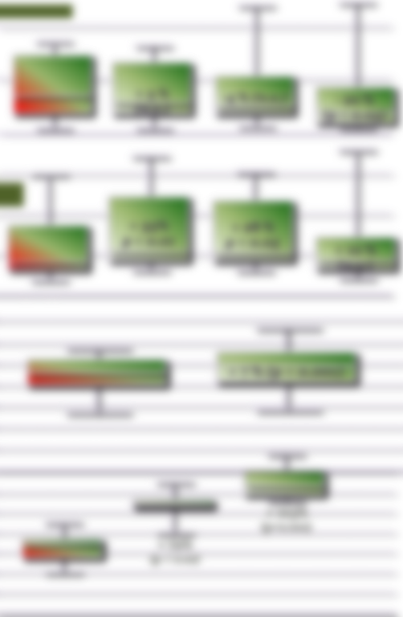
25 patients with PAOD (mean ABPI: 0.58; range: 0.5-0.65)
Inelastic compression of up to 40 mmHg (B1)
conclusions:
... patients with mixed ulcers show a
signiﬁcant improvement of reduced venous
pumping function when inelastic bandages
with a pressure up to 40 mmHg are applied
... an increase of the arterial perfusion of
the compressed part of the leg and no
deteriorating effect on the areas distal to
the bandage could be demonstrated
is compression effective in arterial patients ?
from:
Mosti G, Iabichella ML, Partsch H.
Compression therapy in mixed ulcers increases venous output and arterial perfusion
J Vasc Surg 2012; 55: 122-128.

Slide 47
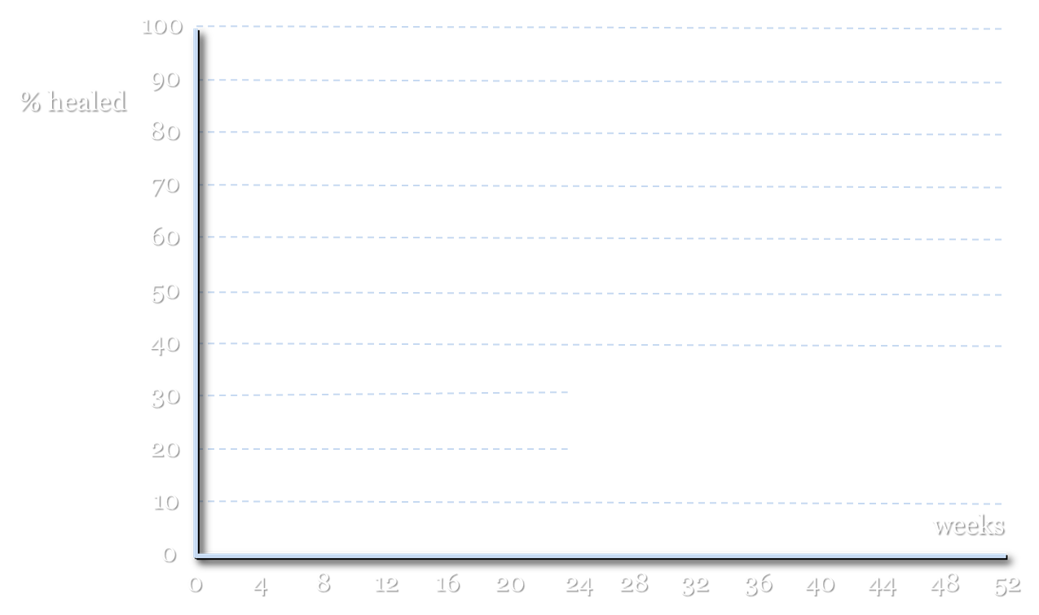
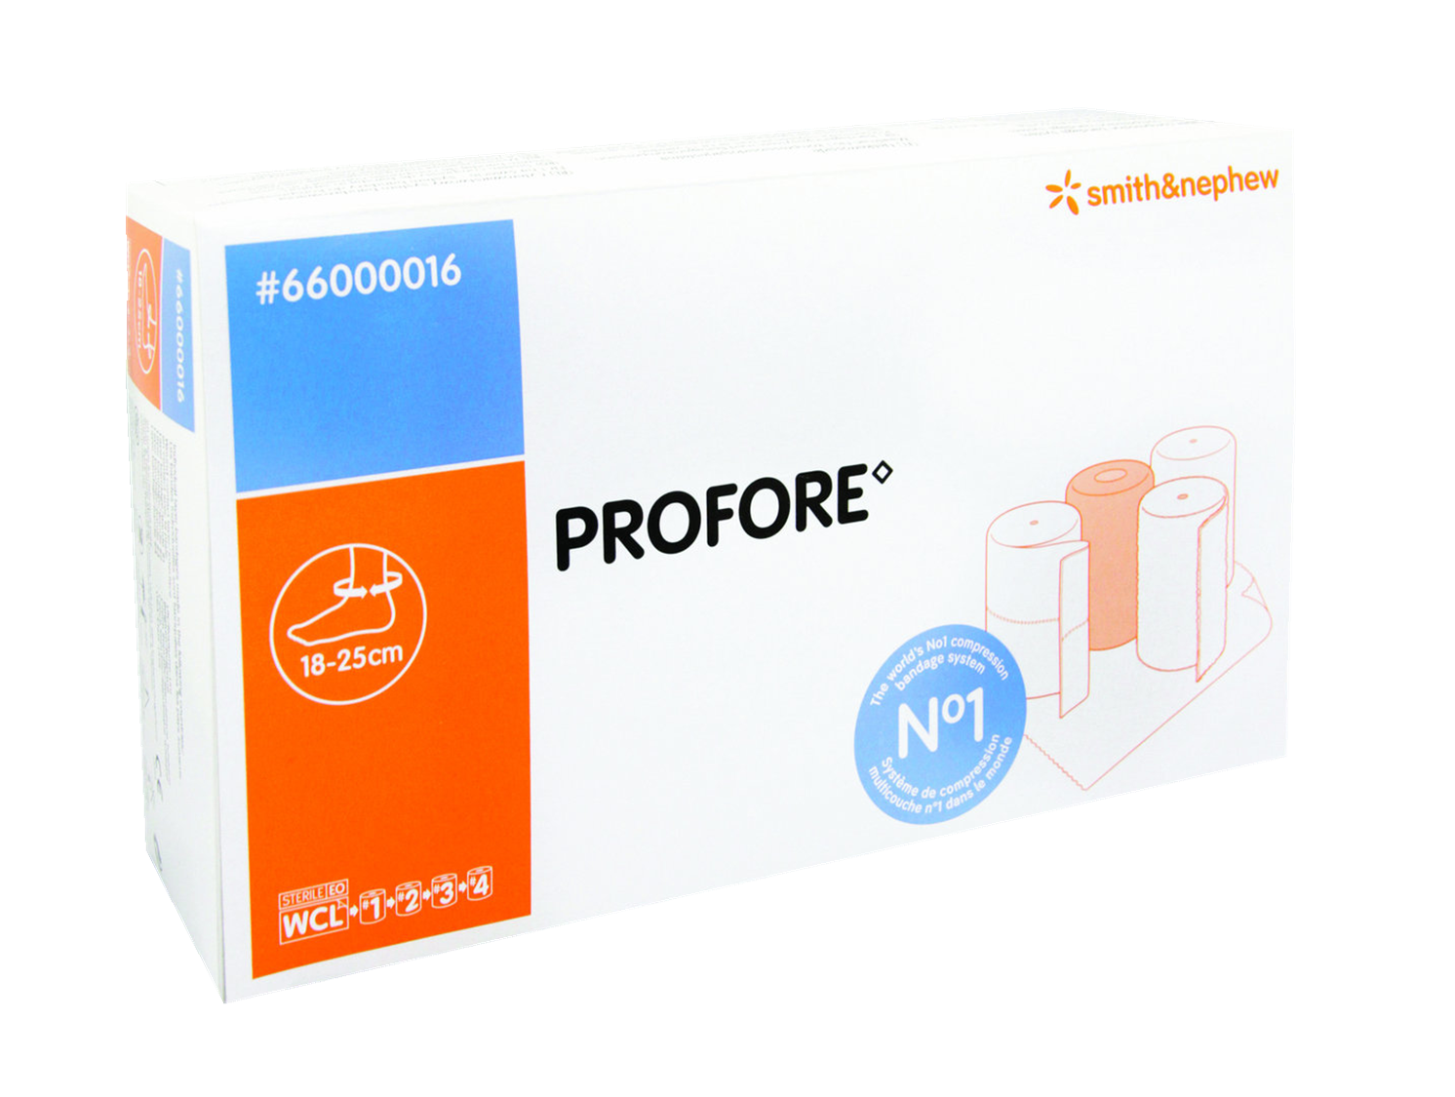

254 patients with chronic venous leg ulceration
applied
at 25%
stretch
ABPI > 0,85 (n = 221)
ABPI 0.5 - 0.85 (n = 33)
is compression effective in
arterial patients ?
modified from:
Ghauri A, Nyamekye I, Grabs A, Farndon J, Poskit K.
The diagnosis and management of mixed arterial/venous leg ulcers in communitybased clinics.
Eur J Vasc Endovasc Surg 1998; 16: 350-355.

Slide 48

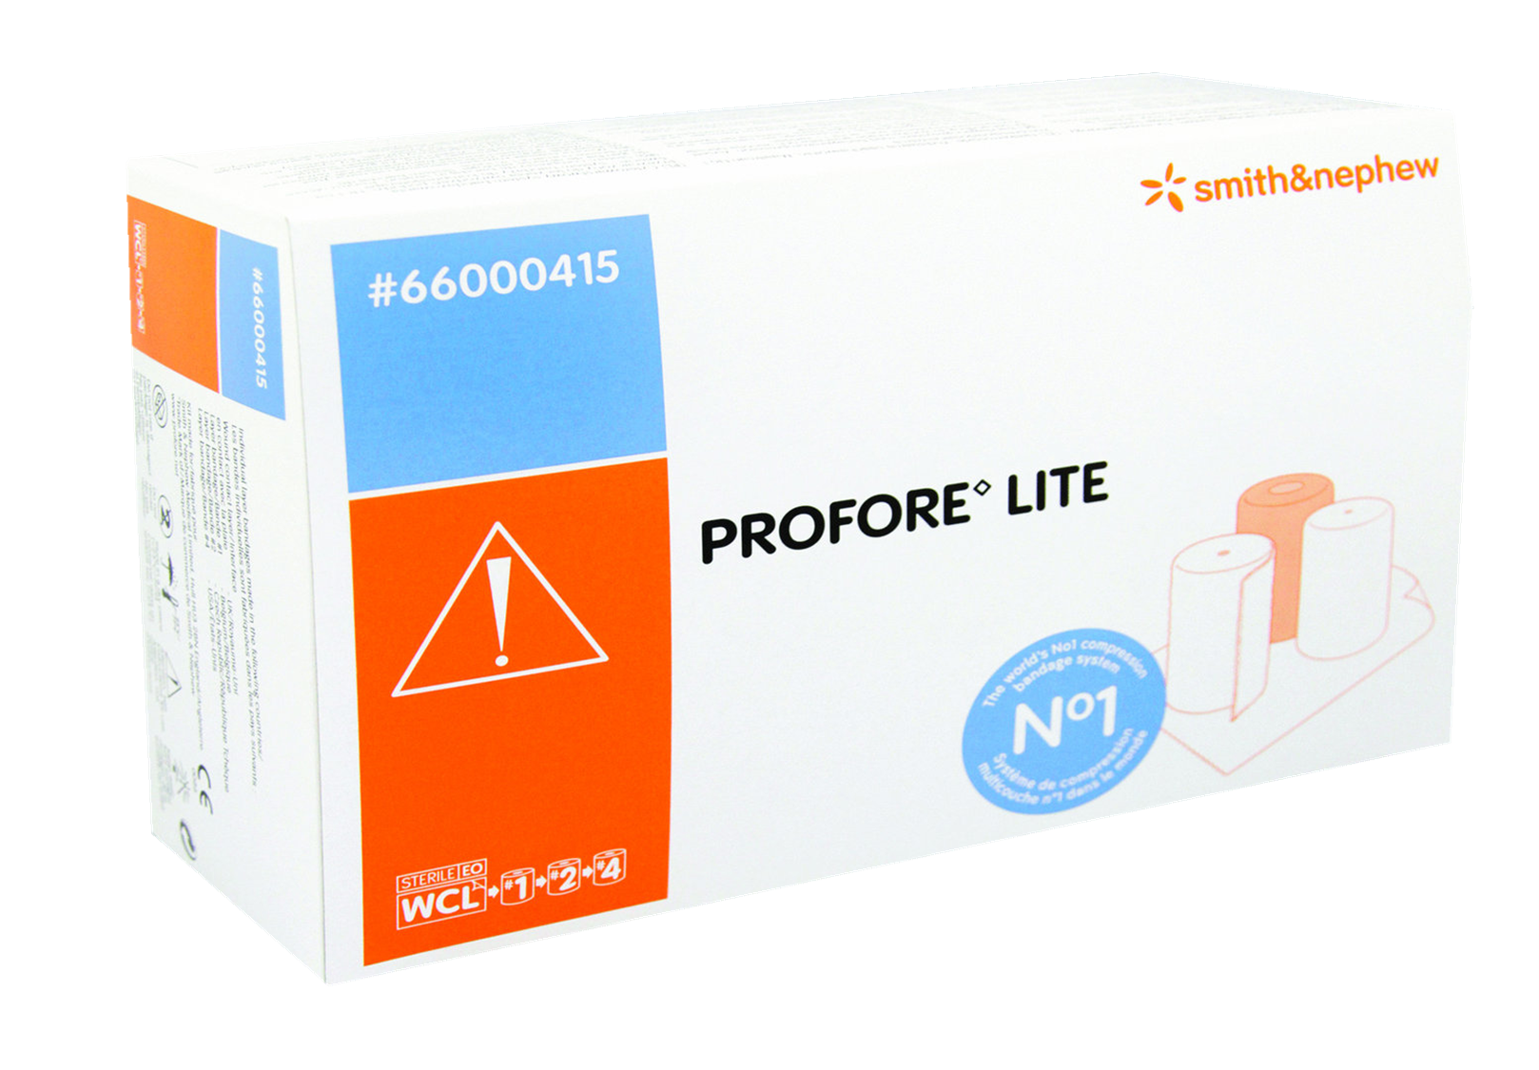
242 patients with chronic venous leg ulceration
ABPI > 0,8 (n = 208)
ABPI 0.5 - 0.8 (n = 34)
is compression effective in
arterial patients ?
modified from:
Marston WA, Carlin RE, Passman MA, Farber MA, Keagy BA.
Healing rates and cost efficacy of outpatient compression treatment for leg ulcers associated with venous insufficiency.
J Vasc Surg 1999; 30: 491-498.

Slide 49

1347 patients with chronic venous leg ulceration
ABPI > 0,85 (n = 1154)
ABPI 0.5 - 0.85 (n = 193)
is compression effective in
arterial patients ?
modified from:
Humphreys M, Stewart A, Gohel M, Taylor M, Whyman M.
Management of mixed arterial and venous leg ulcers.
Br J Surg 2007; 94: 1104-1107.

Slide 50
conclusion
compression or no compression in arterial patients

Slide 51
... based on the presented findings, it can be concluded that compression can be
used safely and effectively in arterial patients with chronic venus ulceration
conclusion
compression or no compression in arterial patients

Slide 52


...on behalf of all the patients with mixed arterial/venous leg ulcers who could benefit effective compression:
...on behalf of all the patients with mixed arterial/venous leg ulcers who could benefit effective compression:
thank you for your attention
compression or no compression in arterial patients

Slide 53
compression or no compression in arterial patients

