Slide 1
COMPRESSION OR NO COMPRESSION, THAT IS THE QUESTION
Compression therapy in erysipela: in favor of no compression
Dr Salma ADHAM – ICC Meeting Amsterdam
2022/05/14
Notes:
Goodmorning! I am Dr Salma ADHAM, I am a vascular medicine specialist and I work with Pr Isabelle QUERE in Montpellier.
I would like to thank the organizers of the ICC meeting for this invitation to speak about compression therapy in erysipela and here I will try to be in favor of no compression.

Slide 2
Notes:
First thing I did is go on Google and look for recommandations or articles supporting no compression in leg erysipela. Unfortunately, the first article I found was this one, where the authors searched for complications due to compression therapy in cellulitis… and they found none. I thought this was quite annoying. How was I going to do this topic ???
So I decided to start from scratch, meaning oedema, pseudocellulitis and erysipela.

Slide 3
ERYSIPELA
Non-necrotizing bacterial dermo-hypodermal cellulitis
Streptococcal infection
Complication of chronic lymphedema
In 20-30% of cases
Sudden fever and shivering
Inflammatory plaque, promoted by lymph stasis
Notes:
So, what are we talking about?
We are talking about erysipela, a non-necrotizing bacetrial dermohypodermal cellulitis. It is often due to Streptococcal infection. It is a well known complication of chronic oedema and particularly of chronic lymphedema where it can occur in up to 30% of the patients.
Clinically, the patients have sudden fever, they shiver, they have an inflammatory plaque on their limb.

Slide 4
ERYSIPELA - TREATMENT
Amoxicillin
50mg/kg/day
Associated measures
Pain-killers
Ice
Limb elevation
To relieve local discomfort
Treatment of entry site (fungal infection…)
Notes:
The FIRST treatment, and maybe the only one if you had to chose, is ANTIBIOTICS, more precisely AMOXICILLIN 50mg per kg per day.
You can associate pain killers, ice, limb elevation… to relieve local discomfort. And of course you have to treat the entry site.
So, remembering the photograph I put in the previous slide, and knowing how much painful erysipela is, I would not want to put any pressure on the limb… but let’s go on.

Slide 5
PSEUDO-CELLULITIS
Stasis dermatitis
Non-infectious dermo-hypodermal inflammation
Notes:
Now, this is pseudo-cellulitis, a differential diagnosis of erysipela. We have all seen patients referred to us with a painful red limb and no fever, mistaken for erysipela while it was a pseudo-cellulitis… However, pseudo-cellulitis is an inflammatory stasis of edema without any infection.

Slide 6
Notes:
So I looked at the problem in another way. If compression therapy was painful in erysipela, how could we prevent erysipela ?
I found a first article published in the New England Journal of Medicine 2 years ago : COMPRESSION THERAPY TO PREVENT RECURRENT CELLULITIS OF THE LEG

Slide 7
Notes:
This was a single center randomized non blinded trial where participants were randomized in a 1 to 1 ratio to receive either leg compression therapy and education or education only.

Slide 8
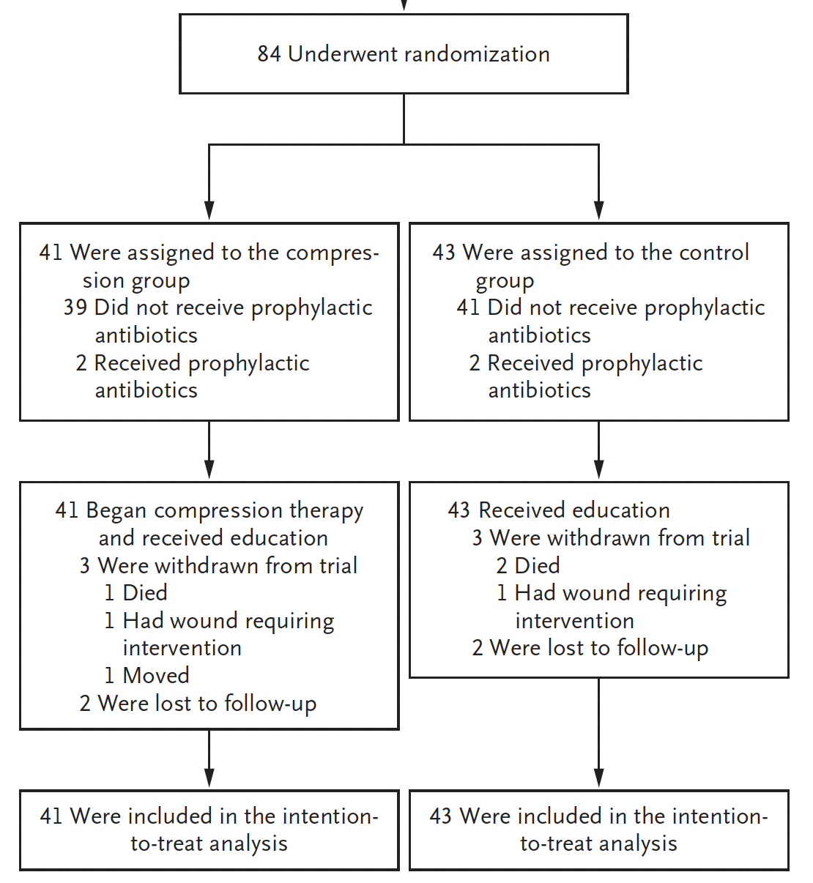
Notes:
Here we have a very nice flowchart of the study, but most important is that the study was stopped prematurely due to the very important number of cellulitis in the control group.

Slide 9
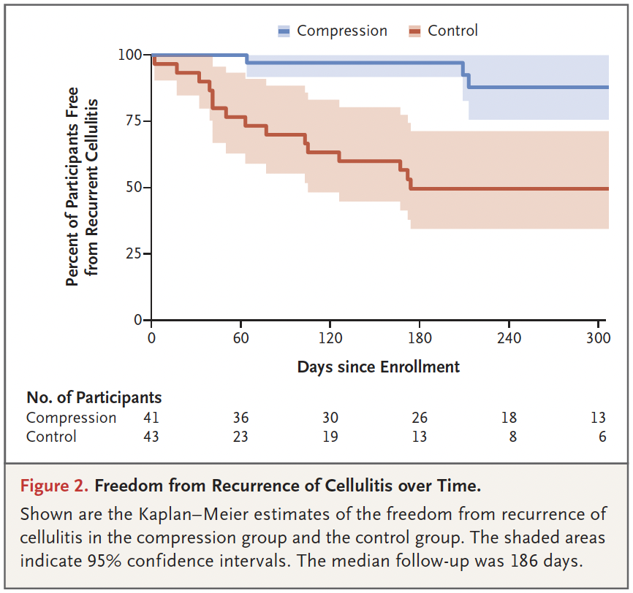
Notes:
So here we have the primary outcome of the study, which was cellulitis recurrence leading to stop the trial for efficacy as you can see the relative risk of 0.37 favoring compression.
Most importantly I think, was the Kaplan Meier analysis, demonstrating that patients with compression were free from cellulitis recurrence over time in comparison with the control group.

Slide 10
Notes:
Another very interesting study was published last year in the British Journal of Dermatology : CELLULITIS IN CHRONIC OEDEMA OF THE LOWER LEG, AN INTERNATION CROSS SECTIONAL STUDY

Slide 11
Notes:
What we already know is that there is a very well known association between chronic oedema an cellulitis.
Guidelines also suggest that control of oedema is important to reduce the risk of recurrent cellulitis but with limited evidence.
So this study was aimed to invetigate the prevalence and risk factor of cellulitis.

Slide 12
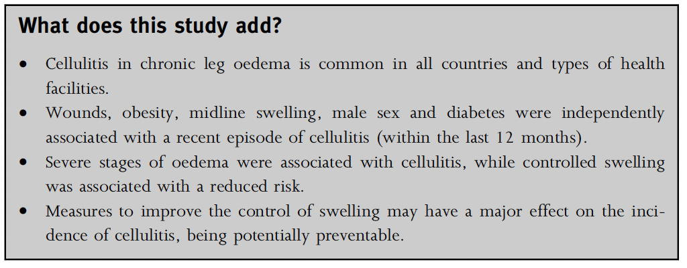
Notes:
For me, the most interesting result is the last one, at the very bottom of the table: uncontrolled swelling led to more erysipela. In fact, controlled swelling is a protective factor for erysipela with a 0.51 OR.
On the contrary, the more severe the lymphedema is, the more patients are at risk for cellulitis. So cellulitis might be prevented by effective compression therapy.

Slide 13
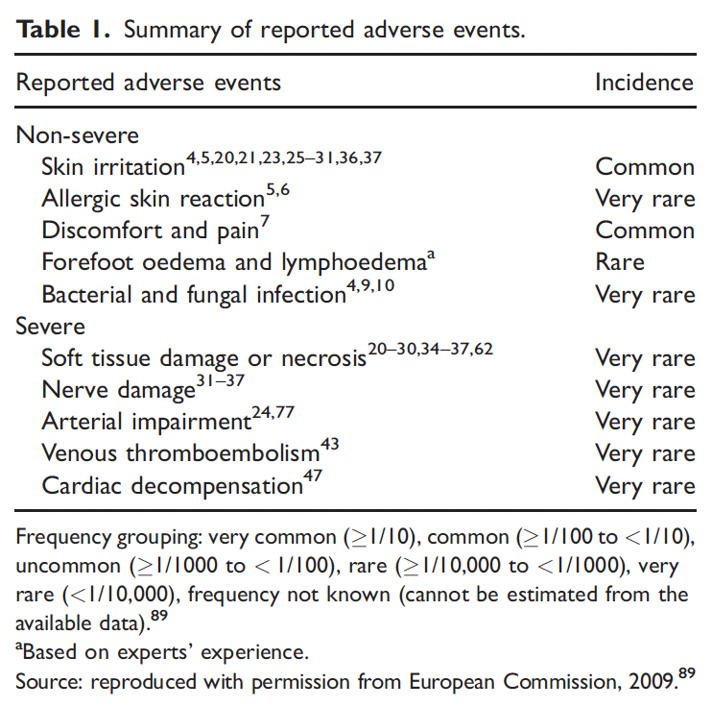
COMPRESSION

Slide 14
COMPRESSION
From a pragmatic standpoint, considering the events in inflammation, it is advisable to avoid vigorous compression therapy during the first two weeks of treatment.
Pr Loic Vaillant, Phlebolymphology.org
Notes:
What about compression then? As it has been said before, compression is always better than no compression…
But in some cases, it is just not possible to apply compression, especially in very painful patients… meaning at the beginning of an erysipela.

Slide 15
No compression then compression, that is the answer
Erysipela treatment recipe
Start with Amoxicillin
Add: Analgesics and cold packs
Add: Bed rest and limb elevation
Don’t forget: Entry site treatment
As soon as possible, long-term compression
Notes:
Finally, I think that the best answer could be « no compression at first then compression as soon as possible » to reduce the augmentation of oedema due to infection and inflammation and to prevent recurrent episodes of cellulitis. However, the first treatment still remains amoxicillin and the entry site treatment.
I thank you for your attention.

