Slide 1
Research Project THERAFOLG-KOMP
Digital Therapy Success Determination
in the Field of Compression Therapy
Dr. Ferdinand Tamoue¹, Dr. Michael Klöppels²,
Dr. Peggy Schneider³, Prof. Dr. Dr. Andrea Ehrmann⁴, Dr. Birgit Schwetlick⁵, Mathias Stolze⁵, Dirk Unsenos⁶
¹ KOB GmbH, Wolfstein, Germany
² BÖSL Medizintechnik GmbH, Aachen, Germany
³ Bauerfeind AG, Zeulenroda, Germany
⁴ Bielefeld University of Applied Sciences, Faculty of Engineering and
Mathematics, Bielefeld, Germany
⁵ Klinikum Altenburger Land, Altenburg, Germany
⁶ ISIS-IC GmbH, Wesel, Germany
No conflicts of Interest

Slide 2
THERAFOLG-KOMP
„
The aim of the project was to use new measurement methods to provide digital data that monitor success of therapy when using compression aids. These data are used in an overall concept to support the people involved in the therapy in their actions. In this way, compression therapy can be made more effective and successful.
„
Project Duration: 2018-08-01 till 2022-09-30
6 Project Partners plus 1 Sub-contractor (Medical Center Südwestfalen)

Slide 3
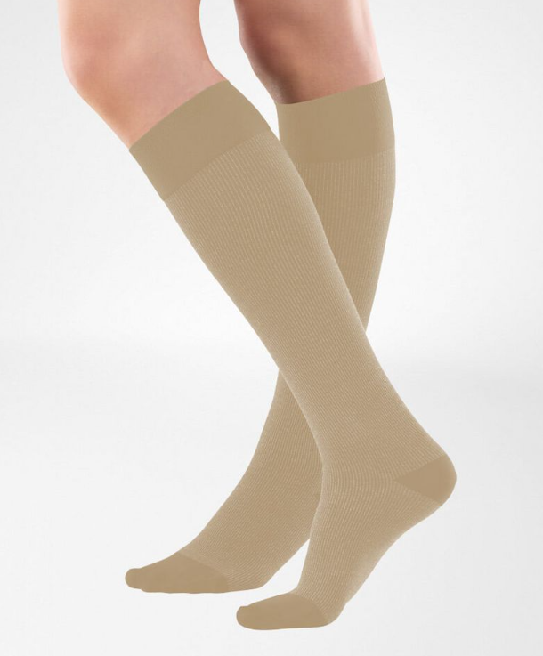
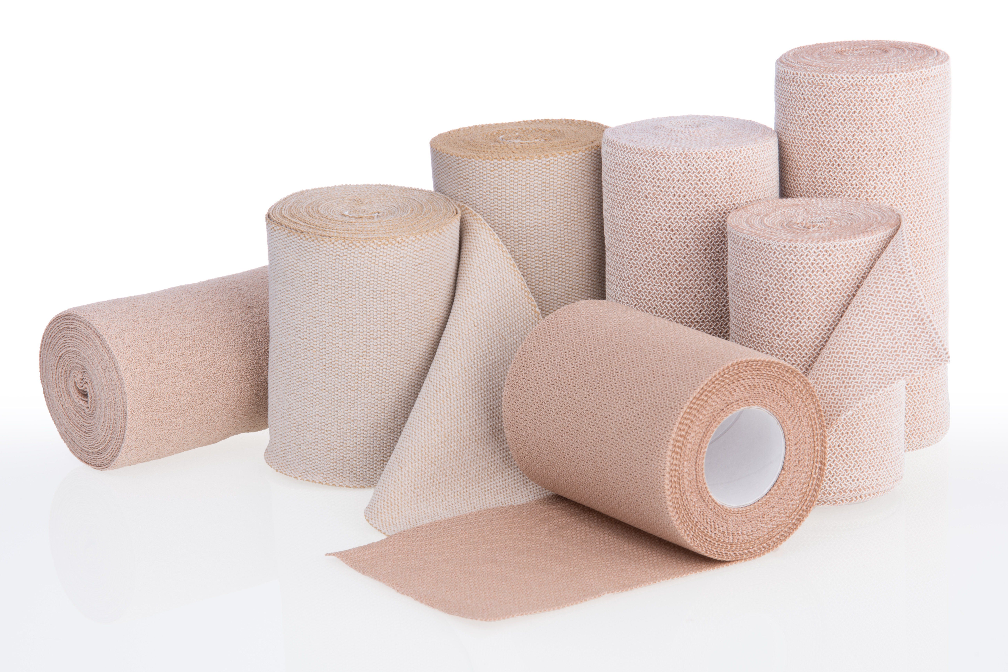
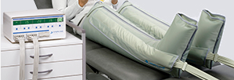
Compression therapy in Edema – Treatment Methods
Mobility Level
Compression
Bandage
Compression stOCKINGS
Mobile
VenoTrain® compression stockings“. o. J. Zugegriffen 31. March 2023. https://www.bauerfeind.de/de/produkte/kompressionsstruempfe
Intermittent
Pneumatic Compression
Immobile
„Bösl Medizintechnik“. o. J. Zugegriffen 10. Januar 2023. https://www.boesl-med.de/system/system.htm.
Phase of
therapy
Decongestion
Maintenance

Slide 4
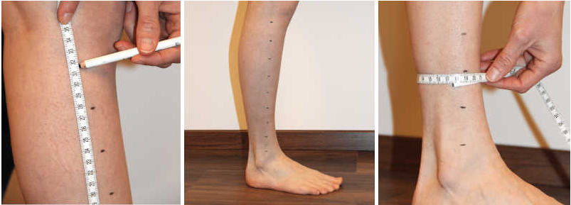
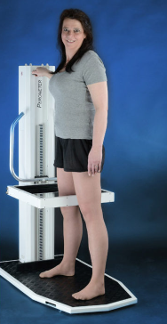
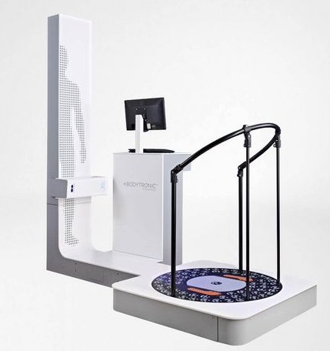
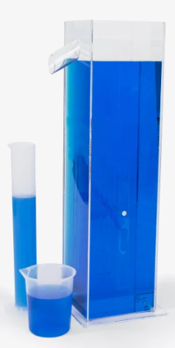
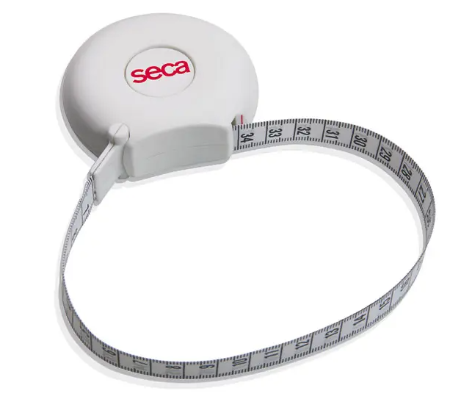
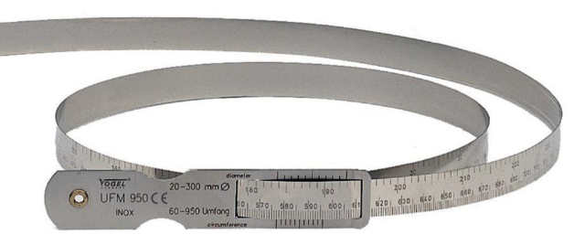
Actual evaluation of the effectiveness of the therapy
Circumference measurement according to KUHNKE | PEROMETER | BODYTRONIC | VOLUMETER (WATER)
Themes, Studio. 2019. „Volumenmessung nach Kuhnke zur Ödembestimmung | VASOprime“. 26. März 2019. https://vasoprime.ch/volumenmessung-nach-kuhnke/.
„Ergonomisches Umfangsmessband seca 201 | Diaprax“. o. J. https://www.diaprax.de/. Zugegriffen 9. Januar 2023. https://www.diaprax.de/praxisbedarf/waagen/messgeraete/ergonomisches-umfangsmessband-seca-201.html.
„Vogel Germany • Produkte • Kataloge und Prospekte • Edition“. o. J. Zugegriffen 9. Januar 2023. https://www.vogel-germany.de/produkte-kataloge-prospekte-edition.html#.
„Perometer 400 NT – Pero-System“. o. J. Zugegriffen 9. Januar 2023. https://pero-system.de/perometer-400-nt/.
„BODYTRONIC® 600“. o. J. Zugegriffen 9. Januar 2023. https://www.bauerfeind.de/de/haendler/digitale-messtechnik/details?tx_bfproducts_productdisplay%5Balias%5D=bodytronic-600&cHash=bd5c34b8b303e33b5a707485ccd38cb3.
„Arm-Volumeter-Set-413505“. o. J. Zugegriffen 9. Januar 2023. https://premium-therapie.de/de/befund-diagnostik/oedem-schmerz/arm-volumeter-set.

Slide 5
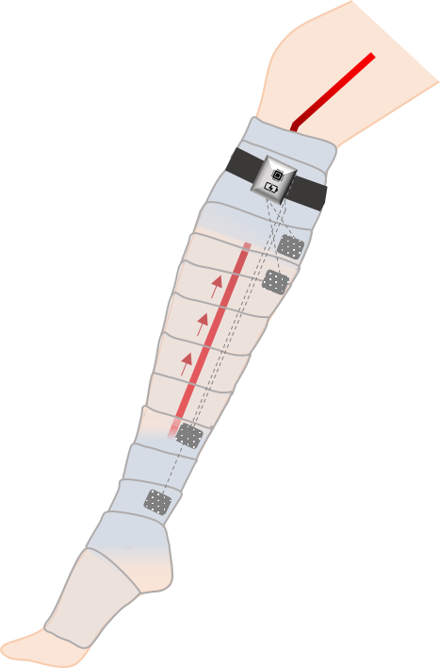
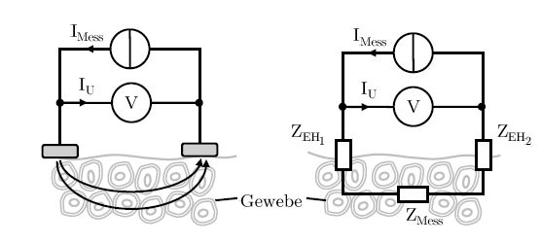
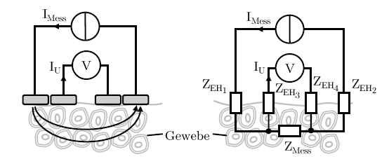
Bioimpedance – Novel approach for Compression therapy
$UM$_{ess} = $\text{(}Z_{EH1}+Z_{Mess}+Z_{EH2})∙IMess$
J. Schneider: System zur Erfassung kardialer Aktivität mittels Impedanzplethysmographie am Handgelenk, Diss., 08.04.2019, KIT-Fakultät für Elektrotechnik und Informationstechnik des Karlsruher Institut für Technologie
$IU∙\left(ZEH1+ZEH2\right)≪IMess$ $∙$ $ZMess$
J. Schneider: System zur Erfassung kardialer Aktivität mittels Impedanzplethysmographie am Handgelenk, Diss., 08.04.2019, KIT-Fakultät für Elektrotechnik und Informationstechnik des Karlsruher Institut für Technologie

Slide 6
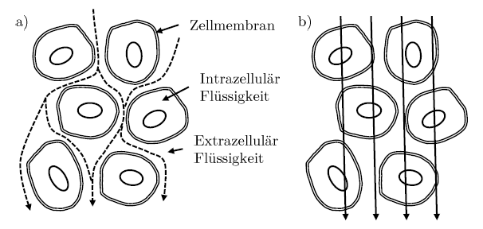
Bioimpedance of Bodytissue
Determination of the impedance as a function of the frequency of the alternating current
a) Very low Frequency (f→ 0 Hz)
Current flows through extracellular fluid. The conduction takes place via ionic shifts.
b) Very high Frequency (f→ ∞ Hz)
The impedance of the cell membrane becomes approximately zero and the current can pass through it almost unhindered.
J. Schneider: System zur Erfassung kardialer Aktivität mittels Impedanzplethysmographie am Handgelenk, Diss., 08.04.2019, KIT-Fakultät für Elektrotechnik und Informationstechnik des Karlsruher Institut für Technologie

Slide 7
Practical test with demonstrator - key data
Use of the demonstrator in a clinical setting :
Patients: 20
(female 17, male 3)
Age: 31 - 95 years
Weight: 45 - 174 kg
Measurement on the left lower leg :
Measurement: on the 1st, 3rd and
5th day respectively
Parallel measurement
Manual measurement according to Kuhnke
Perometer
Bodytronic 600
In each case before manual lymphatic drainage and Lympha-mat: Weight determination by means of scales

Slide 8
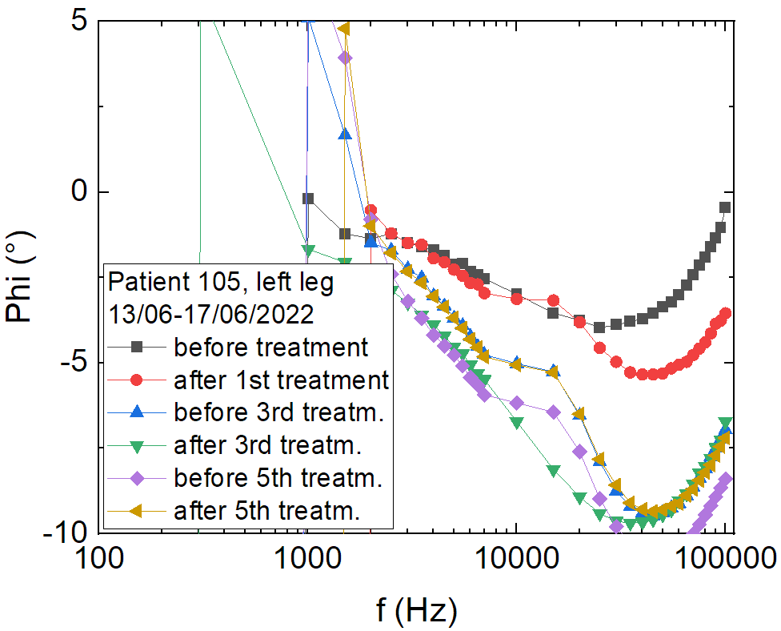
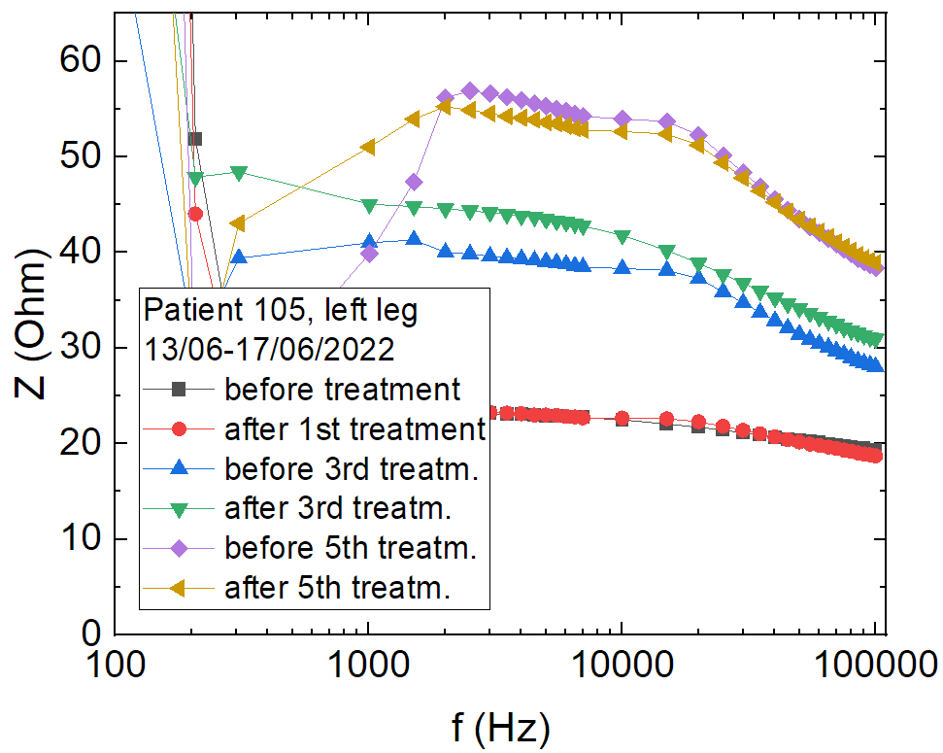
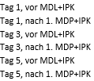
Practical test with demonstrator - results
Patient 105: Chronic lymphoedema, volume reduction: 660 - 1860 ml

Slide 9
New possibilities in therapy support
CONCLUSION
The verification of the functional measurement of bioimpedance with the demonstrator showed that it is possible to assess the effects of compression inside the leg.
The use of multiple frequencies by the demonstrator has proven to work reliably when testing on patients.
Bioimpedance can provide an effective means of monitoring compression therapy, as the impedance amplitude correlates with fluid reduction in the treated limb.
OUTLOOK
Improvement of the electrode and its transmission.
Development of mobile application monitoring device.
Development of an appropriate manufacturing process of compression device with incorporated electrodes.

