Slide 1
A high force 3 x 30 min compression method of foot and calf removes most edema fluid and enables immediate usage high compression garment
Marzanna T Zaleska, Waldemar L Olszewski
Dept. Applied Physiology, Polish Academy of Sciences, Warsaw, Poland
Central Clinical Hospital and Medical Research Center

Slide 2
INTRODUCTION
In advanced lymphedema of lower limbs, stage III and IV bandaging under the routinely applied pressure of 30-50mmHg takes time and is not always effective. This is caused by stiffness of skin and subcutaneous tissue due to fibrosis. Edema fluid accumulates in multiple “lakes” that can be seen on the ICG lymphography. Evacuation of the stagnant fluid requires high external compression force and subsequent adjustment of non-stretch stockings to the decreased limb size.

Slide 3
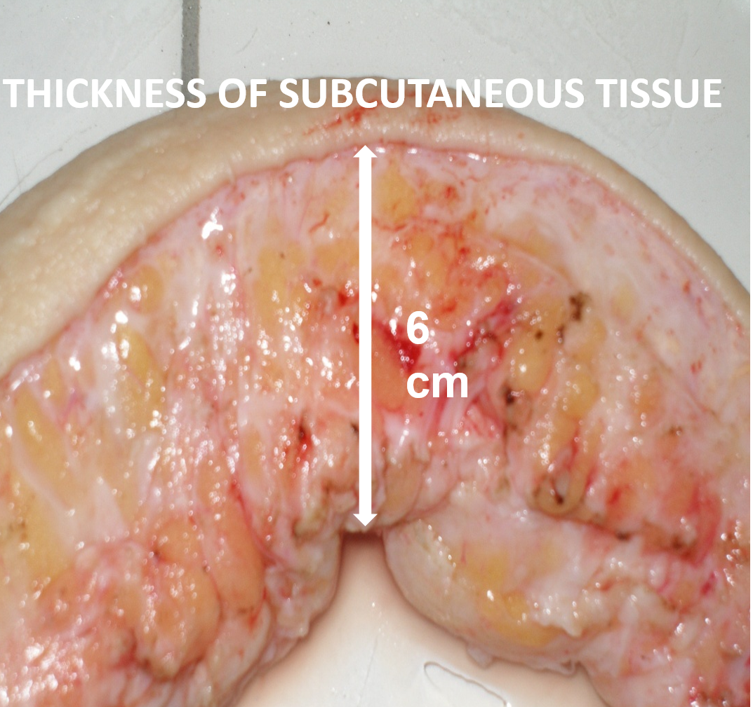
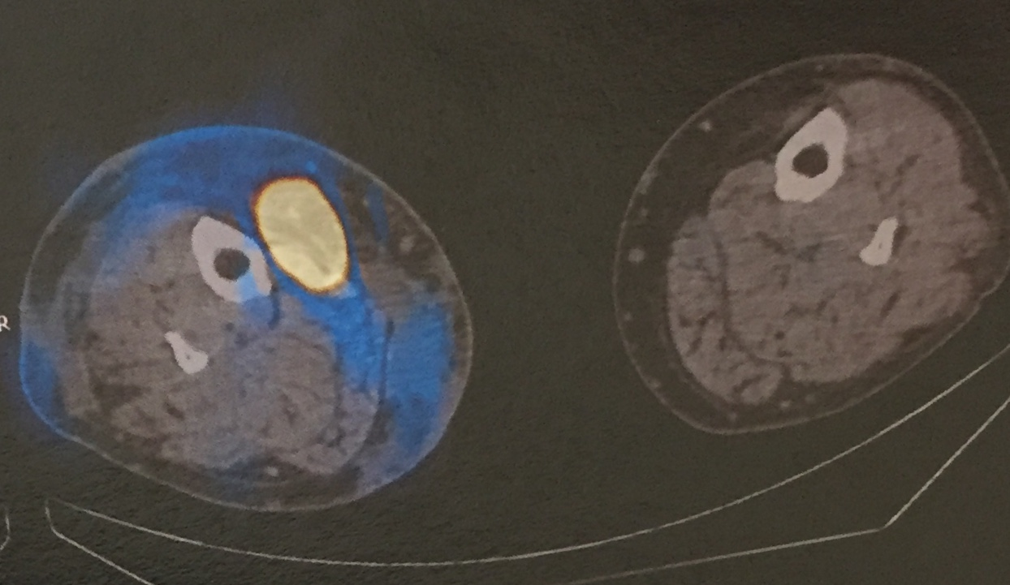
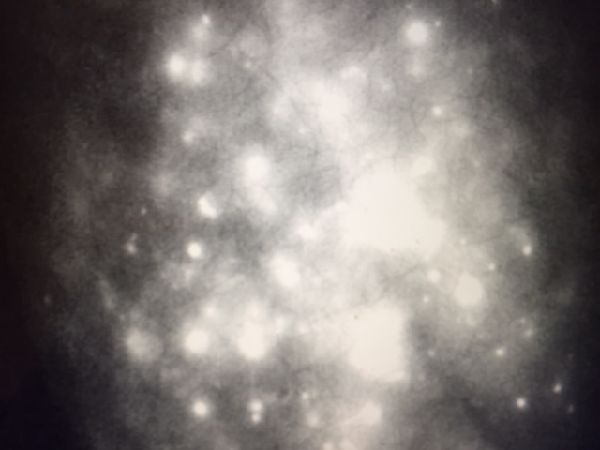

Slide 4
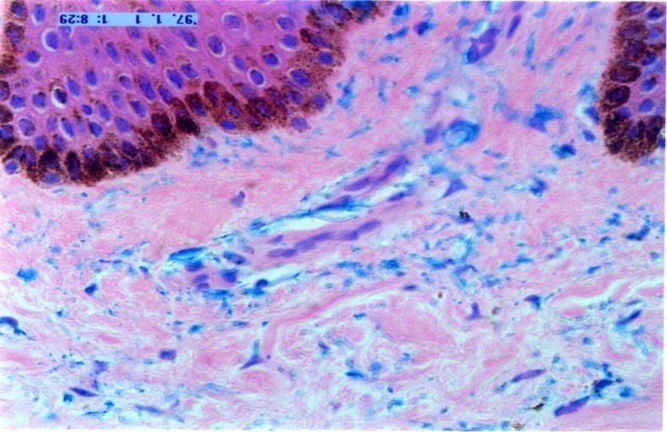
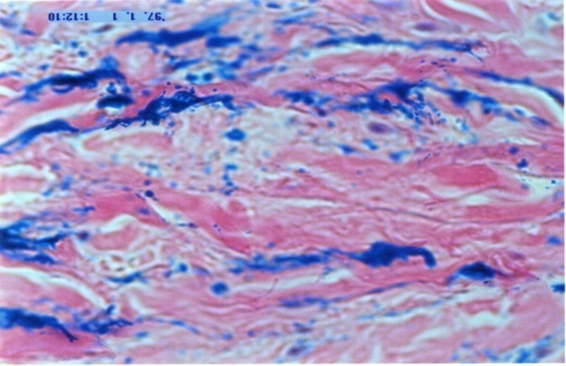
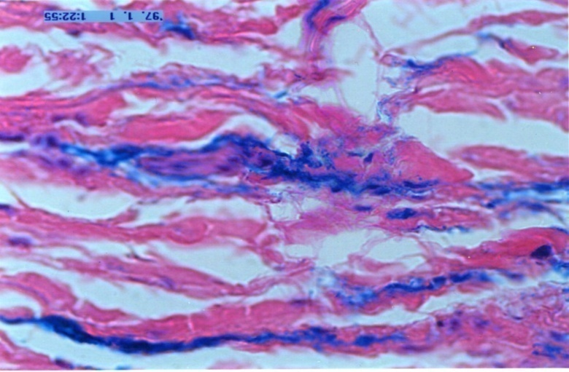
Epidermis
Superficial
plexus
Subcutis
30 mmHg
Fascia
Perimuscular
space

Slide 5
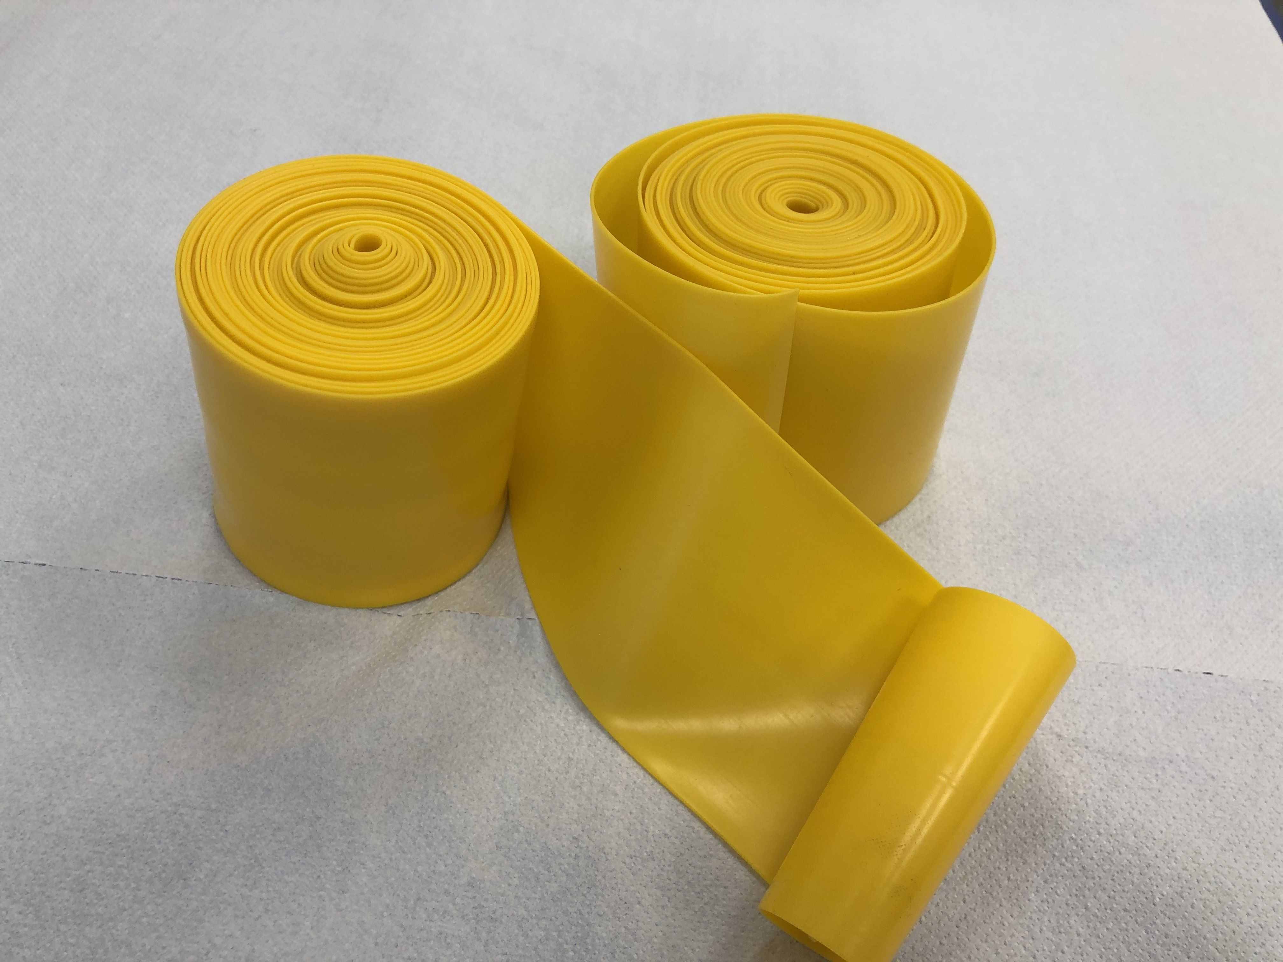
AIM
To apply rubber bandages on foot and calf under the pressure of 60 to 125mmHg for 30 min on 3 consecutive days and evaluate the changes in circumference, skin water concentration, skin and subcutaneous tissue stiffness, and fluid evacuation volume on plethysmography

Slide 6
MATERIAL and METHODS
Thirty lower limbs in 21 patients with lymphedema stage III of post-inflammatory type were included. Patients with acute inflammatory symptoms, venous thrombosis, profuse varices, obesity and cardiac insufficiency edema were excluded. A 10 cm wide rubber bandage was applied to foot and calf for 30 min. The interface pressure on Picopress was 60 to 130 mmHg. After 30 min of rubber bandage the short stretch bandages were applied until next day (Mobiderm +Biflexideal, Thuasne). Limb circumference, skin water concentration, deep tissue tonometry, skin durometry and drop of interface pressure were measured. Ultrasound examination and strain gauge plethysmography were done before and after compression in some patients.

Slide 7
Interface Pressure (n=26)
mmHg
*

Slide 8
Limb circumferences (cm), n= 30
cm
*

Slide 9
Skin water concentration (%), (n= 8)
*
*
*
*
%

Slide 10
Skin and Subcutaneous Tissue Stiffness (kg/cm²), (n=29)
Kg/cm²
*
*
*
*

Slide 11
Durometry (skin stiffness), (N), n= 9
N
*
*
*

Slide 12
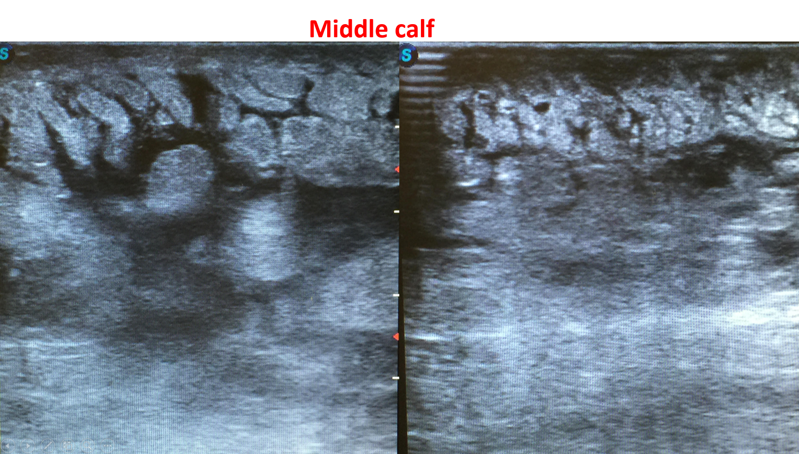
befor
after

Slide 13
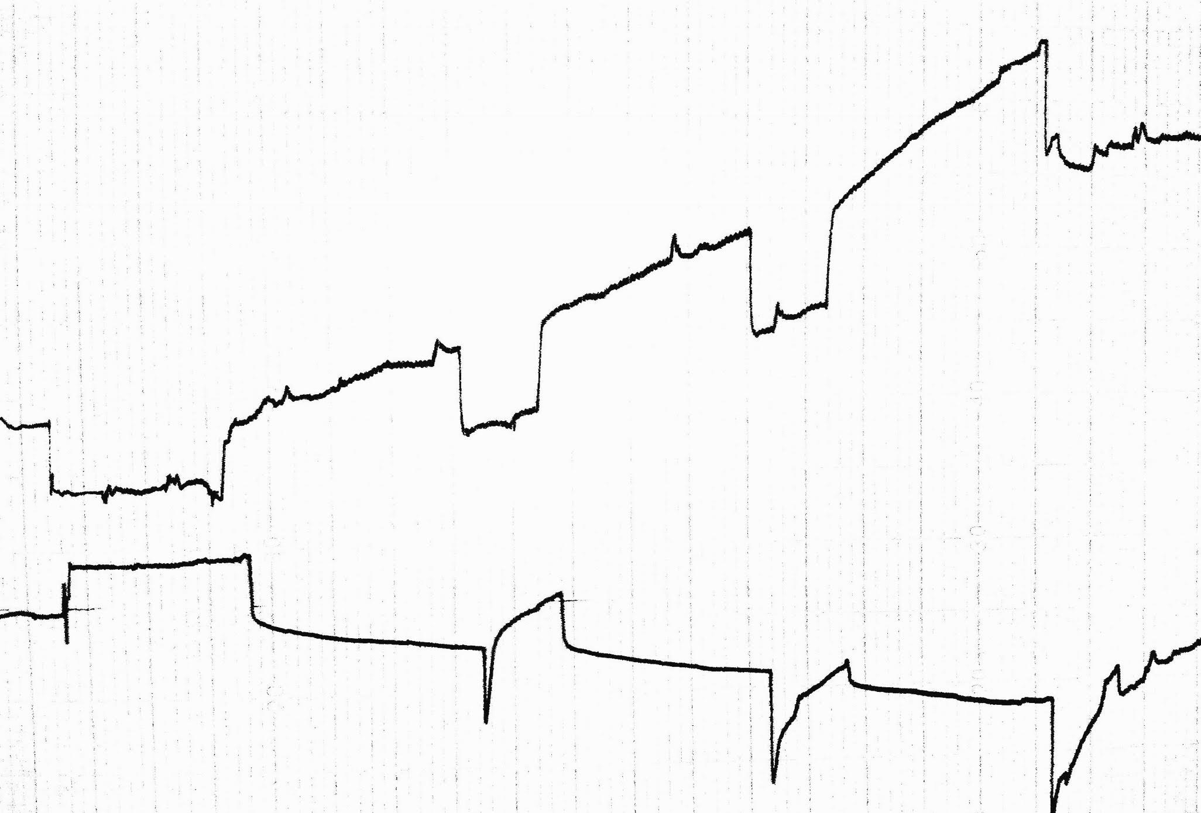
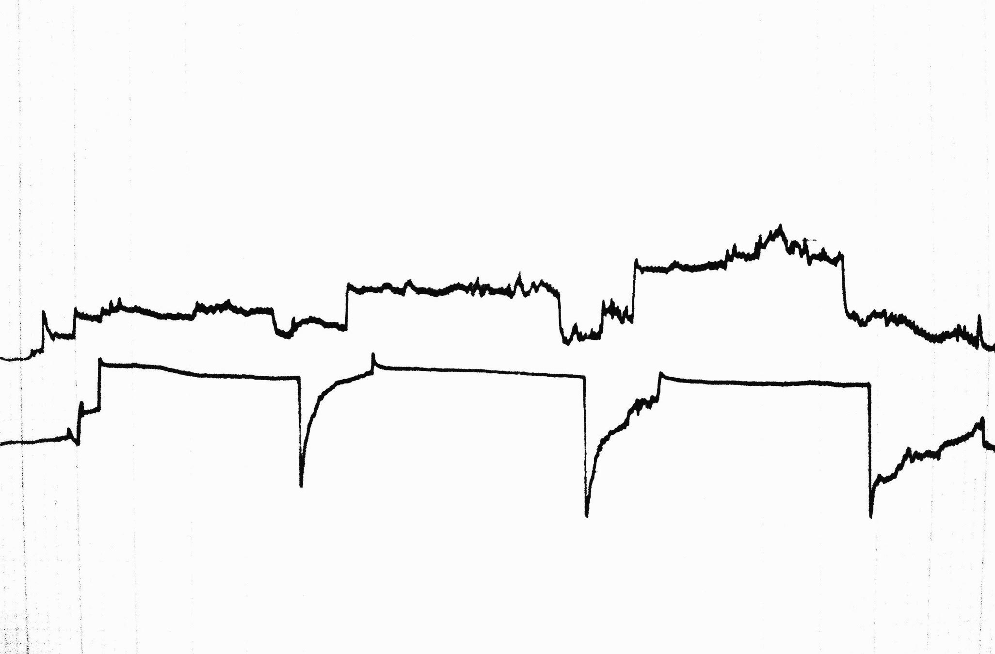
Inflated cuff edema fluid movement
Before
120
After
80
50 80 120
50

Slide 14
SUMMERY
After three consecutive days of high-pressure compression followed by short-stretch bandaging :
· Interface pressure dropped by 32.6% on day I, 22.4% on day II, and 11.2% on day III
Limb circumference decreased by 16.2% in the ankle, 15.9% in the middle calf, and 10.7% below the knee
Skin water concentration decreased by 31.9% in the ankle, 43.8% in the middle calf, and 22.5% below the knee
Deep tissue stiffness decreased by 46.1% in the ankle, 58.9% in the middle calf, and 45.3% below the knee
Skin stiffness decreased by 50% in the foot, 37.9% in the ankle, 69.6% in the middle calf, and 27.7% below the knee
Plethysmography and US images showed less mobile fluid in the lower limb tissues.

Slide 15
CONCLUSIONS
High pressure 30 min leg compression can remove excess edema fluid within three days and enable adjustment of non-stretch compression stockings. This method is (in some cases and some circumstances) more effective at the beginning of therapy than the standard 30-50mmHg bandaging as it provides an immediate effect.

Slide 16
THANK YOU

