Slide 1
Compression or no compression in venous post-procedures In favor of no compression
May 14, 2022
Amsterdam
Jean-Patrick Benigni
Paris, France

Slide 2
I have no conflict of interest

Slide 3
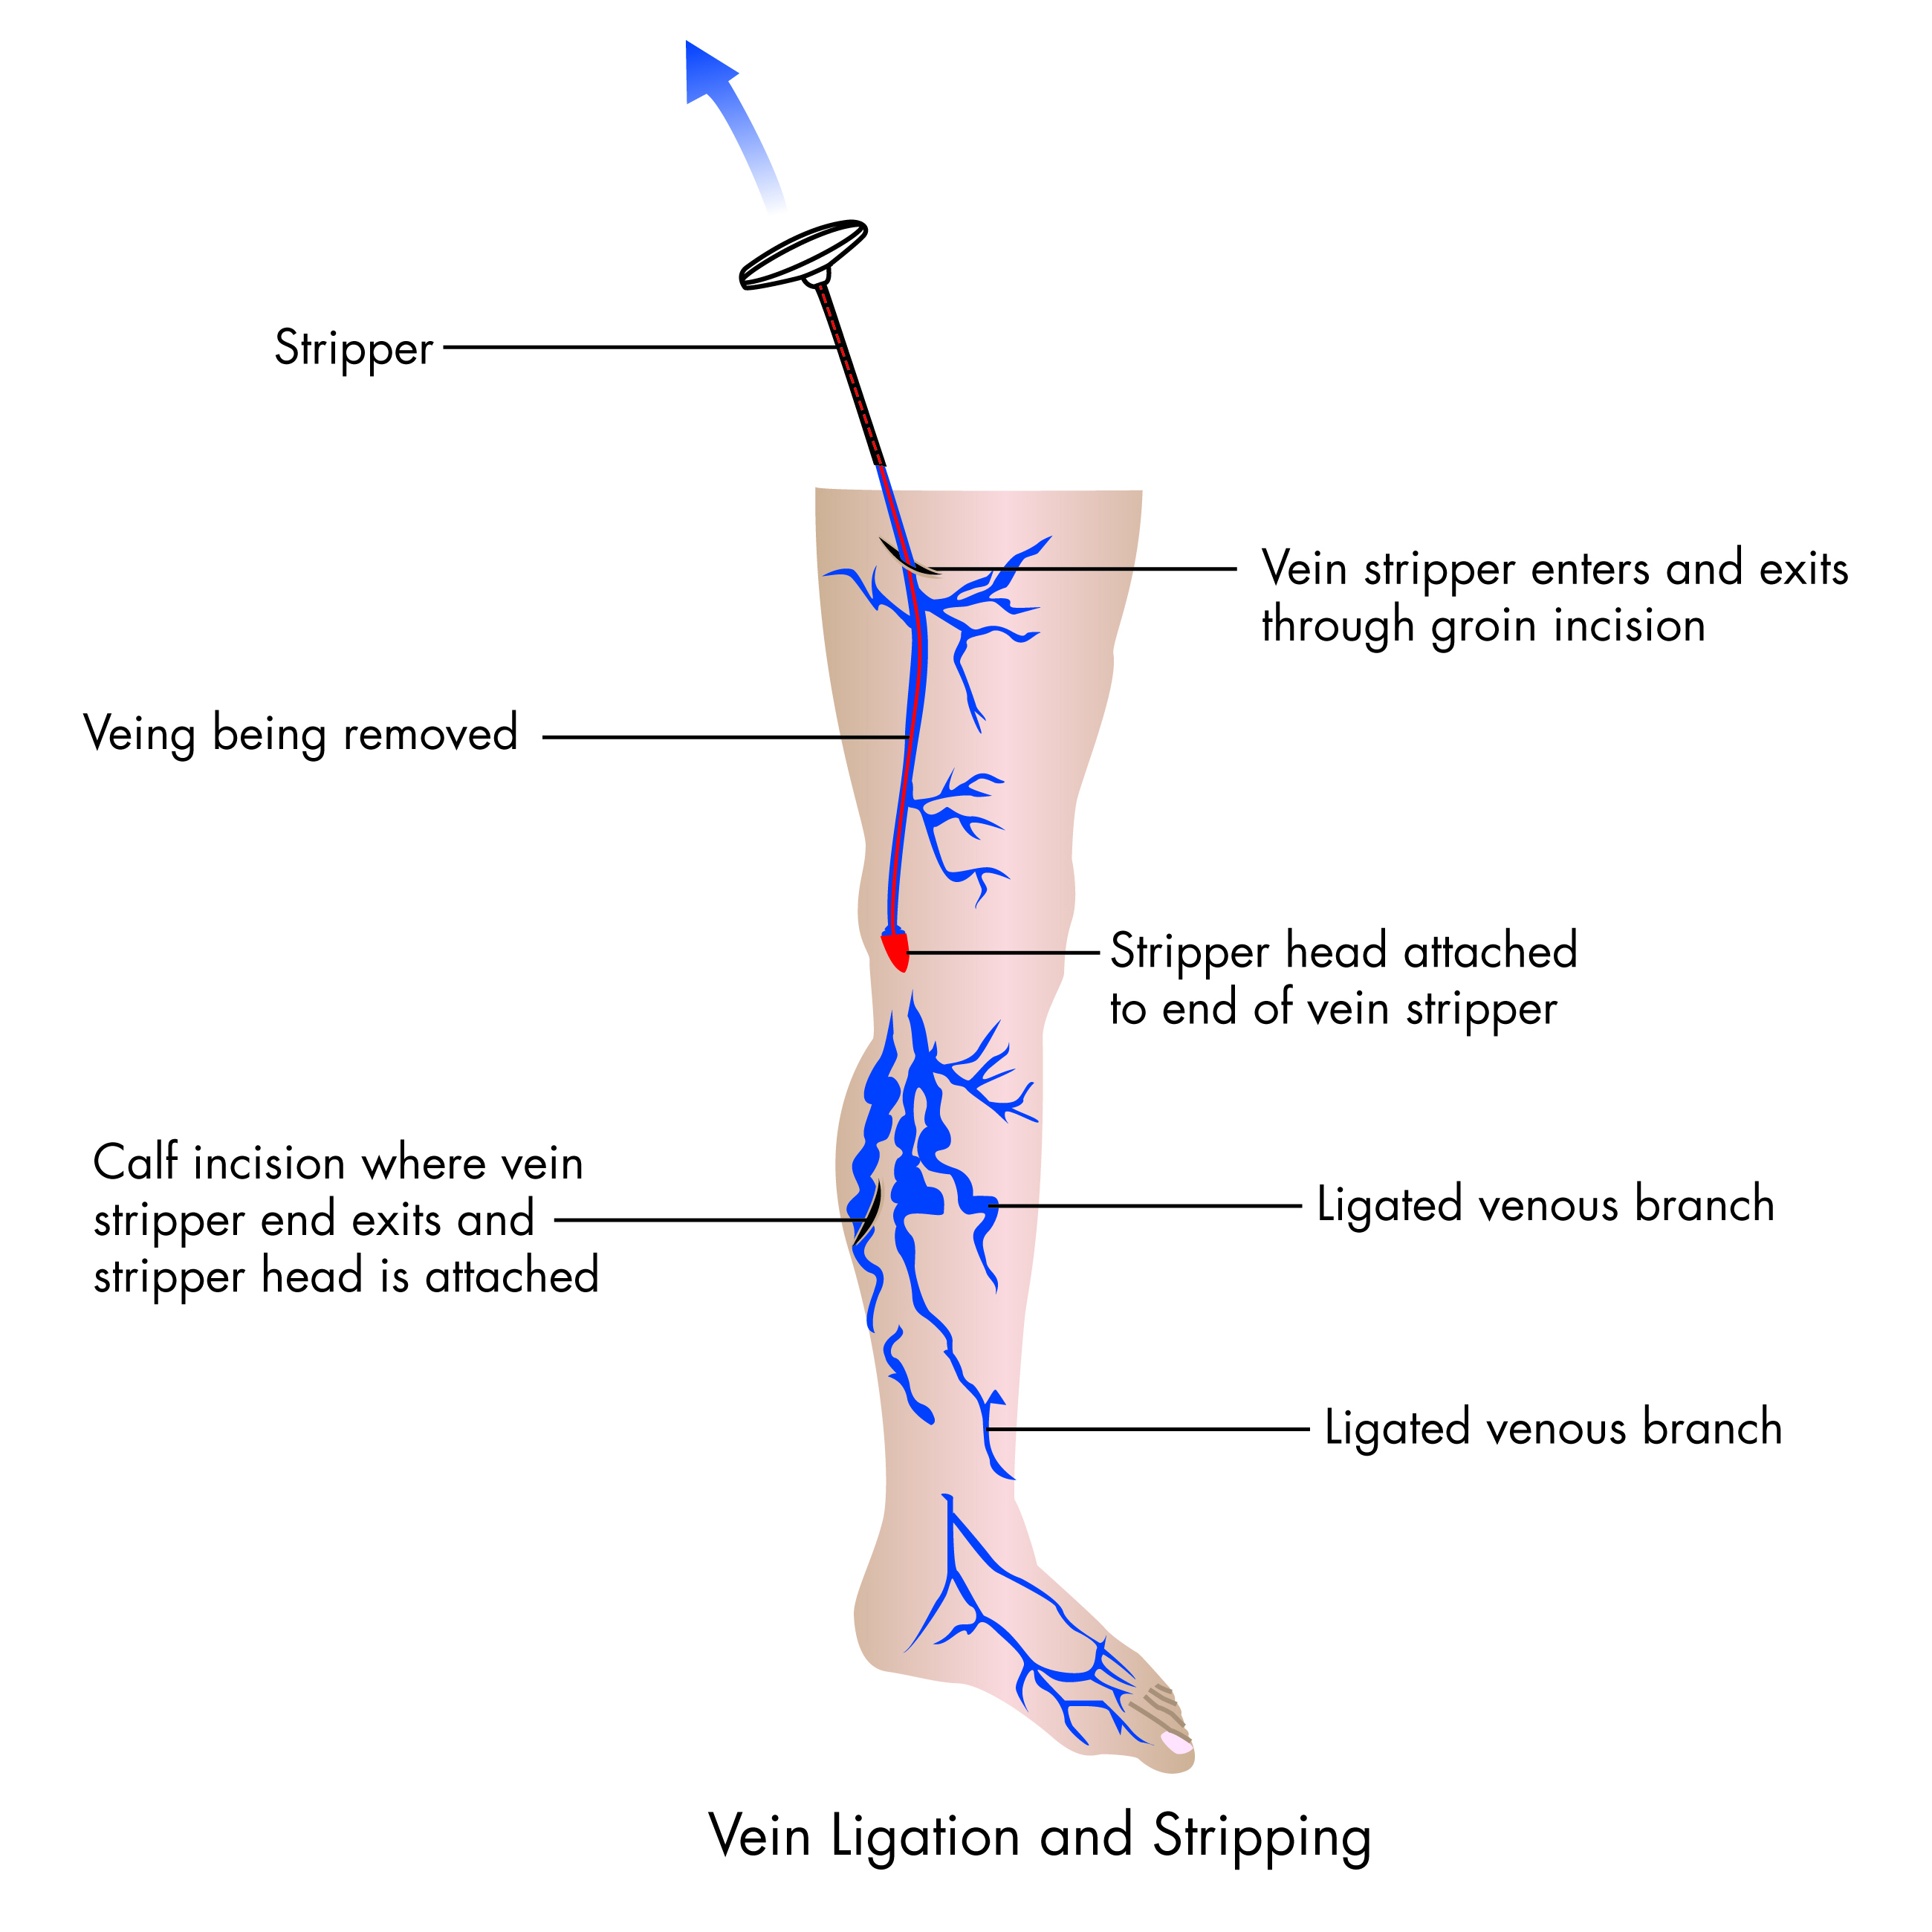
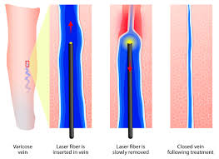
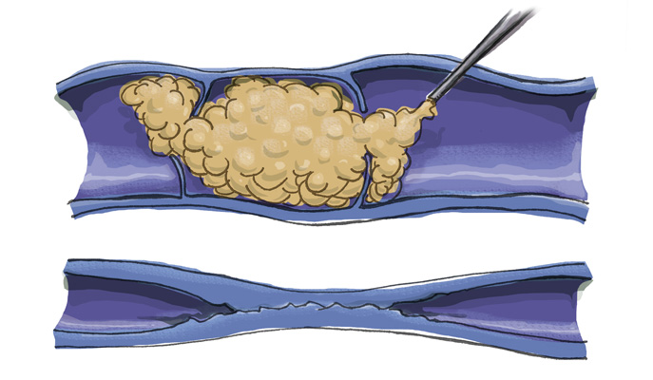
Compression or no compression in venous post-procedures
Venous post-procedures
Surgery (stripping and high ligation)
Endovenous Laser or RX frequency
Ultrasound guided foam sclerotherapy
Glue, steam, moca…
VaricoseVeins.org
Courtesy La Jolla Vein Care

Slide 4
Compression or no compression in venous post-procedures
Rationale for using a compression after an endovenous procedure
To minimise pain, discomfort and inflammation
To reduce bruising, hematoma, bleeding
To prevent thrombosis and clots in situ
To reduce recovery time and time off work
To facilitate healing or fusion of vein walls
To prevent re-canalization and neo-vascularization
J. Cabrera

Slide 5
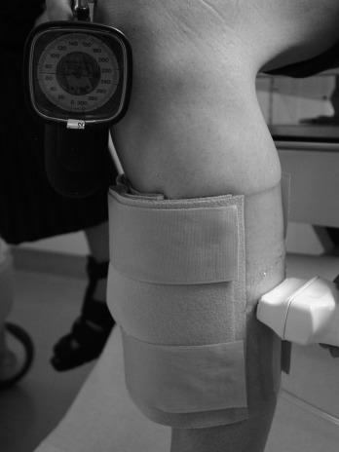
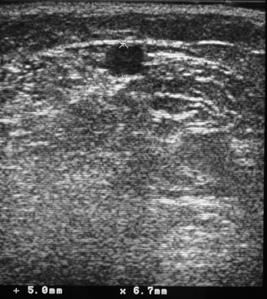
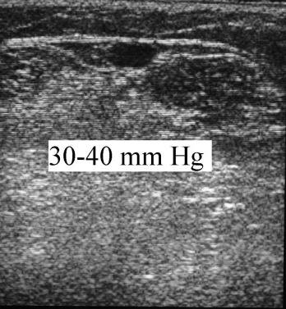
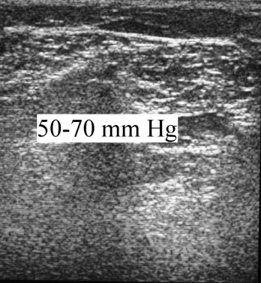
Effects of compression On superficial veins (small saphenous vein)
Partsch B. Partsch H.
Calf compression pressure required to achieve venous closure from supine to standing positions
JVS 42, 4, 2005 : 734-738

Slide 6
Compression or no compression in venous post-procedures
. Theoretical pressures to occlude superficial veins
in the calf and thigh
Thigh | > 40 mmHg (Standing position)
Mid-calf | > 70 mmHg (Standing position)
Does thigh compression improve venous hemodynamics in chronic venous insufficiency? Hugo Partsch, Gabriele Menzinger, Barbara Borst-Krafek, Eveline Groiss. JVS 2002

Slide 7
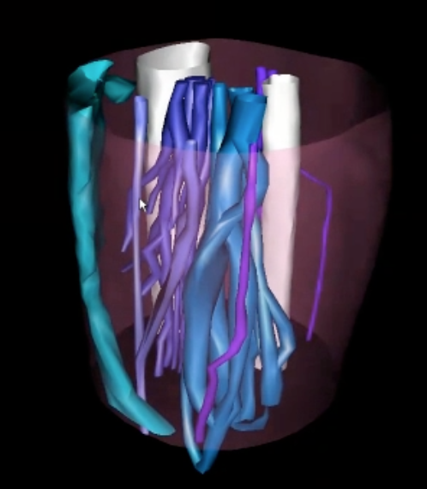
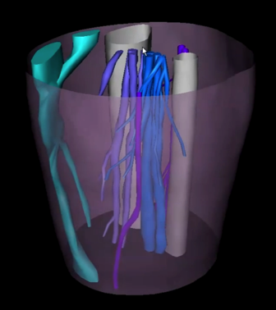
Effects of compression
On deep calf venous system (debated)
Standing position
No compression
22 mmHg
1) Uhl JF, Benigni JP, Cornu-Thenard A, Fournier J, Blin E.
Relationship between medical compression and intramuscular pressure as an explanation of a compression paradox Phlebology. 2015 Jun;30(5):331-8.
2) Partsch H, Mosti G, Mosti F. Narrowing of leg veins under compression demonstrated by magnetic resonance imaging (MRI). Int Angiol 2010; 29: 408-10.

Slide 8
Compression or no compression in venous post-procedures
Interface pressure MCS in standing position even with superimposition
One 15-20 mmHg MCS →
8 mmHg at thigh
Two 15-20 mmHg MCS →
14 mmHg at thigh
One 20-36 mmHg MCS →
15 mmHg at thigh

Slide 9
To compress or not to compress : The eternal question of the place of compression after endovenous procedures¹
1) To compress or not to compress: The eternal question of the place of compression after endovenous procedures
R Bootun, S Onida, TRA Lane, AH Davies - 2016 - journals.sagepub.com

Slide 10
In favor of no compression
Glue
Not required in 1981 glue endovenous procedures¹…
Not required according a meta analysis² : 1057 patients comparing laser, RX frequency. No use of compression bandages
No use of compression stockings³ in a meta analysis of 1457 patients except in the point of puncture.
1) Dimech AP, Cassar K.
Efficacy of Cyanoacrylate Glue Ablation of Primary Truncal Varicose Veins Compared to Existing Endovenous Techniques: A Systematic Review of the Literature.
Surg J (N Y). 2020 Jun 19;6(2):e77-e86.
2) García-Carpintero E, Carmona M, Chalco-Orrego JP, González-Enríquez J, Imaz-Iglesia
Systematic review and meta-analysis of endovenous cyanoacrylate adhesive ablation for incompetent saphenous veins.
I.J Vasc Surg Venous Lymphat Disord. 2020 Mar;8(2):287-296
3) Guo J, Zhang F, Guo J, Guo L, Gu Y, Huang Y.
A systematic review and meta-analysis comparing the efficacy of cyanoacrylate ablation over endovenous thermal ablation for treating incompetent saphenous veins.
Phlebology. 2021 Sep;36(8):597-608.

Slide 11
In favor of no compression
Steam, Moca
No data available

Slide 12
In favor of no compression
High ligation + stripping
Intermittent Pneumatic Compression
RCT 186 patients with high ligation + Stripping for GSV or anterior accessory saphenous vein or great saphenous vein redux
Effects on the leg volume and patient comfort after surgery after IPC at 40 mm Hg for 45 minutes directly after surgery.
No difference at D1 and D7
Korina Kappa-Markovi , Houman Jalaie , Hilal Özhan-Hasan , Monika Deges , Knuth Rass
Intermittent pneumatic compression after varicose vein surgery J Vasc Surg Venous Lymphat Disord. 2021 Nov;9(6):1526-1534.

Slide 13
No studies in favor of no compression
Varicose vein surgery
Compression stockings: no additional benefit following elastic bandaging for 3 days ¹
After mini-invasive surgery, no benefit of CS beyond the first postoperative day²
No benefit in wearing compression stockings for more than one week³
CS (35-40 mmHg) > bandages at D7 ⁴
At D7 significant reduction of mobility with Panelast bandages compared with two other dressings⁵
Houtermans-Auckel JP, van Rossum E, Teijink JA, Dahlmans AA, Eussen EF, Nicolaï SP, Welten RJ.
To wear or not to wear compression stockings after varicose vein stripping: a randomised controlled trial. Eur J Vasc Endovasc Surg. 2009 Sep;38(3):387-91.
2) Pittaluga P, Chastanet S. Value of postoperative compression after mini-invasive surgical treatment of varicose veins J Vasc Surg Venous Lymphat Disord 2013 Oct;1(4):385-91.
3) S Biswas , A Clark, D A Shields. Randomised clinical trial of the duration of compression therapy after varicose vein surgery Eur J Vasc Endovasc Surg. 2007 May;33(5):631-7.
4) Mariani F, Marone EM, Gasbarro V, et al. Multicenter randomized trial comparing compression with elastic stocking versus bandage after surgery for varicose veins. J Vasc Surg. 2011;53:115-122.
5) Bond R, Whyman MR, Wilkins DC, Walker AJ, Ashley S. A randomised trial of different compression dressings following varicose vein surgery. Phlebology. 1999;14:9-11.

Slide 14
In favor of no compression
UGFS : C. Hamel Desnos¹
A randomised study 60 patients treated for GSV or SSV incompetence
Compression stockings (15-20 mmHg) post-foam sclerotherapy vs no CS
No differences at 14 and 28 days
pain scores, inflammation, ecchymosis, induration, pigmentation or matting.
Compliance was an issue with only 40% of patients wearing compression stockings everyday.
1) Hamel-Desnos, CM, Guias, BJ, Desnos, PR. Foam sclerotherapy of the saphenous veins: randomised controlled trial with or without compression. Eur J Vasc Endovasc Surg 2010; 39: 500–507.

Slide 15
In favour of no compression
UGFS
In overweight patients¹
RCT : 72 limbs with elastic compression (pressure ?) and 63 limbs to the control group.
No differences in the
Number of procedures or the mean foam volume per procedure.
Reflux rate at either 3 weeks or 3 months.
For major complications (3%) in both groups
Greater reduction of venous diameter in GSV diameter in patients treated with compression.
Campos Gomes CV, Prado Nunes MA, Navarro TP, Dardik A.J
Elastic compression after ultrasound-guided foam sclerotherapy in overweight patients does not improve primary venous hemodynamics outcomes.
Vasc Surg Venous Lymphat Disord. 2020 Jan;8(1):110-117

Slide 16
In favour of no compression
UGFS
French survey: 366 vascular physicians on the use of compression
2/3 of the vascular physicians used UGFS
Less than 1/3 of the vascular physicians regularly used elastic compression and when they did, it was usually compression stockings of 15-20 mmHg, for 1 week or less.
Usefulness ?
Tripey V, Monsallier JM, Morello R, Hamel-Desnos C.
French sclerotherapy and compression: Practice patterns.
Phlebology. 2015 Oct;30(9):632-40

Slide 17
In favour of no compression
UGFS + Phlebectomy
7 days/24 h/day
group A. group B
Pressure 23 mmHg 35 mmHg
Pain p=.046
Ambulation p=.046
Tolerance p=.006
Skin healing p=.0012
It was shown a better improvement in group B 35 mmHg
Indirect evidence of the relative uselessness of low pressure
Cavezzi A., Mosti G et al
Compression with 23 mmHg or 35 mmHg stockings after saphenous catheter foam sclerotherapy and phlebectomy of varicose veins. Phlebology 2019

Slide 18
In favour of no compression
UGFS
Objectives :
to assess by biological markers the consequences of foam sclerotherapy of saphenous veins
to compare results of two randomized groups: compression (15-20 mmHg) vs no post-treatment compression
Results :
Minimal effects on inflammation and coagulation, with or without post-treatment compression.
Conclusion:
Interest of compression ?
Hamel-Desnos CM, Desnos PR, Ferre B, Le Querrec A
In vivo biological effects of foam sclerotherapy..
Eur J Vasc Endovasc Surg. 2011 Aug;42(2):238-45.

Slide 19
In favour of no compression
RX Frequency on saphenous trunk + foam on tributaries
Post-procedural Compression vs. No Compression : A Randomised Controlled Non-inferiority Trial
177 Patients C2-C4
Compression stockings (pressure ?) continuously for two days, and then, during the daytime for five days
No compression was non-inferior to post-operative compression, in terms of safety and efficacy
Toni Pihlaja , Pekka Romsi , Pasi Ohtonen , Janne Jounila , Matti Pokela
Post-procedural Compression vs. No Compression After Radiofrequency Ablation and Concomitant Foam Sclerotherapy of Varicose Veins: A Randomised Controlled Non-inferiority Trial
Eur J Vasc Endovasc Surg. 2020 Jan;59(1):73-80.

Slide 20
In favour of no compression
RX Frequency on saphenous trunk
Post-procedural Compression vs. No Compression : A Randomised Controlled Trial
100 Patients C2-C6
Compression stockings (pressure ?) two weeks vs no compression
The clinical and patient reported outcomes following RFA without compression are not worse than with compression
Madu Onwudike, Kazim Abbas , Paula Thompson, Damien M. McElvenny
Role of Compression After Radiofrequency Ablation of Varicose Veins: A Randomised Controlled Trial
Journal of Vascular and Endovascular Surgery, https://doi.org/10.1016/j.ejvs.2020.03.014

Slide 21
In favour of no compression
Endovenous laser
The role of compression after endovenous ablation of varicose veins
Electronic databases
734 patients
Compression therapy wearing from 2 hours to 15 days vs non compression
In an only one study : a benefit to pain and quality of life with extended compression therapy.
The other studies did not.
No significant difference in terms of bruising, recovery time, and leg swelling.
Flaws :No data on the used fiber, endovenous ablation technology, pressure applied
Flaws: different methodologies
Julien AL, SJulien AL, Shakarchi, Michael Wall, JeremyNewman, RajivPathak, Satiq Rehman, Andrew Garnham, Simon Hobbs
The role of compression after endovenous ablation of varicose veins
Journal of Vascular Surgery: Venous and Lymphatic Disorders ; 6 ; 4, 2018: 546-550
hakarchi, Michael Wall, JeremyNewman, RajivPathak, Satiq Rehman, Andrew Garnham, Simon Hobbs
The role of compression after endovenous ablation of varicose veins
Journal of Vascular Surgery: Venous and Lymphatic Disorders ; 6 ; 4, 2018: 546-550

Slide 22
In favour of no compression
Endovenous laser
RCT 400 patients (200 patients in each group) for non-complicated VV
CS vs no CS
Effects on symptoms
No data in pressure of CS and laser probe used or laser wavelenght
After 2 weeks, no difference
in the quality of life or in the mean time to return to work.
for pain and edema. Only a difference after 1 week
Ye K, Wang R, Qin J, Yang X, Yin M, Liu X, Jiang M, Lu X.Post-operative Benefit of Compression Therapy after Endovenous Laser Ablation for Uncomplicated Varicose Veins: A Randomised Clinical Trial. Eur. J Vasc Endovasc Surg. 2016 Dec;52(6):847-853.

Slide 23
In favour of no compression
Endovenous laser
Effects of compression after the endovenous laser ablation (EVLA) of 150 GSV
1470 nm diode laser (Ceralas E 1470 nm, biolitec)
2ring radial fiber (ELVeS Radial 2ring™, biolitec)
Compression
A: No compression
B: Thigh-length graduated compression stocking (23–32 mmHg) for 7 days
C: the same stocking for 28 days.
No additional phlebectomies or sclerotherapies
Results
Very low reduction of pain the first week vs no compression
Post-treatment compression not be necessary if no additional phlebectomies or sclerotherapies.
Fischer L, Maurins U, Rabe E, Rits J, Kadiss A, Prave S, Vigants R, Pannier F.
Effect of Compression Stockings after Endovenous Laser Ablation of the Great Saphenous Vein with a 1470 nm Diode Laser Device and a 2ring Fiber.
J Clin Med. 2021 Aug 27;10(17):3861

Slide 24
In favour of no compression
Endovenous laser : Main publications
218 patients treated for GSV incompetence + phlebectomies if necessary
1470-nm ELVes Radial 2ring Fiber®, energy density of 100 J/cm
First night, an elastic bandage and thigh-high, 20 mmHg at the ankle; Ansilk II®
2 groups
Short duration : 2 days or less (98 patients)
Long duration : 1 to 4 weeks (99 patients)
Results
No difference for pain, analgesics
No difference for recurrence
Compression stocking beyond 2 days after EVLA is not necessary.
Mii S, Guntani A, Yoshiga R, Matsumoto T, Kawakubo E, Okadome J.
Optimal Duration of Compression Stocking Therapy after Endovenous Laser Ablation Using a 1470-nm Diode Dual-Ring Radial Laser Fiber for Great Saphenous Vein Insufficiency.
Ann Vasc Dis. 2021 Jun 25;14(2):122-131.

Slide 25
In favour of no compression
Endovenous laser
Authors Date | Type of trials | Laser and probe | Compression | Usefulness (Pain Analgesics QOL)
Fischer 2021 | RCT | 1470 nm | 23-32 mmHg | No
Mii 2021 | RCT | 1470 nm | Bandage+ 20 mmHg | No after 2 days
Julien 2018 | Meta an. | ? | CS P unknown | No after 2 days
Elderman 2014 | RCT | ? | CS P unknown | Yes at 2 weeks
Bootun 2021 | RCT | ? | CS P unknown | Positive 1 week
Bakker 2013 | RCT | ? | CS P unknown | Yes after 7 days
Ye 2016 | RCT | ? | CS P unknown | No
Ayo 2016 | RCT | ? | 30-40 mmHg | No

Slide 26
In favour of no compression
Conclusion n°1
Treatment of the saphenous trunks
Glue : no need of compression (except in the point of puncture)
Moca, steam : no data
UGFS : no effect of light compression ( data)
RX frequency : no difference between compression and no compression except in the case of vein perforation (+++)

Slide 27
In favour of no compression
Conclusion n°2
Treatment of the saphenous trunks
Laser : with the 1470 nm lasers and the Radial 2ring fibers , compression is not necessary except in the case of associated phlebectomies or perforations,
Surgery : No publication in favour of no compression at all even Pittaluga’s publication
Many flaws in the different studies (bandages or CS , protocol and pressure under compression, no complete description of the procedure used)
No compression when using :
. lasers with new wavelengths and tumescence;
. or foam with low concentration.

