Slide 1
Compression or no compression in sport activities: In favor of no compression
Eberhard Rabe
Bonn
Germany

Slide 2
Sport compression
compression in sports
compression in phlebology
Indicated for
improvement of performance
Faster recovery after performance
Improved proprioreception
Standardisation
no
Pressure profile
degressive
Progressive
Foot
with or without foot
Production
Round knitted
Woven
combined
Indicated for
improvement or prophylaxis
of venous symptoms
of venous signs
Standardisation
Yes
Pressure profile
degressive
Foot
with foot
Production
Round knitted
Flat knitted

Slide 3
Different classification systems for compression stockings (from Bergan)
Compression Class | EU (CEN) | USA | UK (BS 6612) | France | Germany
A | 10-14 (light)
I | 15-21 (mild) | 15-20 (moderate) | 14-17 (light) | 10-15 | 18-21 (light)
II | 23-32 (moderate) | 20-30 (firm) | 18-24 (medium) | 15-20 | 23-32 (medium)
III | 34-46 (strong) | 30-40 (extra firm) | 25-35 (strong) | 20-36 | 34-46 (strong)
IV | >49 (very strong) | 40+ |  | >36 | >49 (very strong)
The values indicate the compression exerted by the hosiery at a hypothetical cylindrical ankle

Slide 4
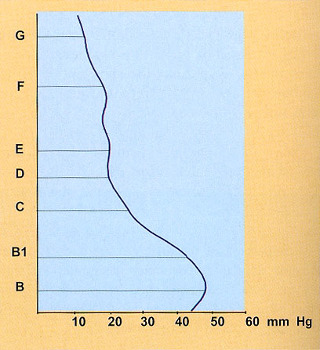
Hosy-Method, Hohenstein Germany
Pressure profile of a MCS calculated from the force- extension diagram.
Curves of this kind allow the calculation of pressure tolerance and pressure gradients with respect to measurement deviations.

Slide 5
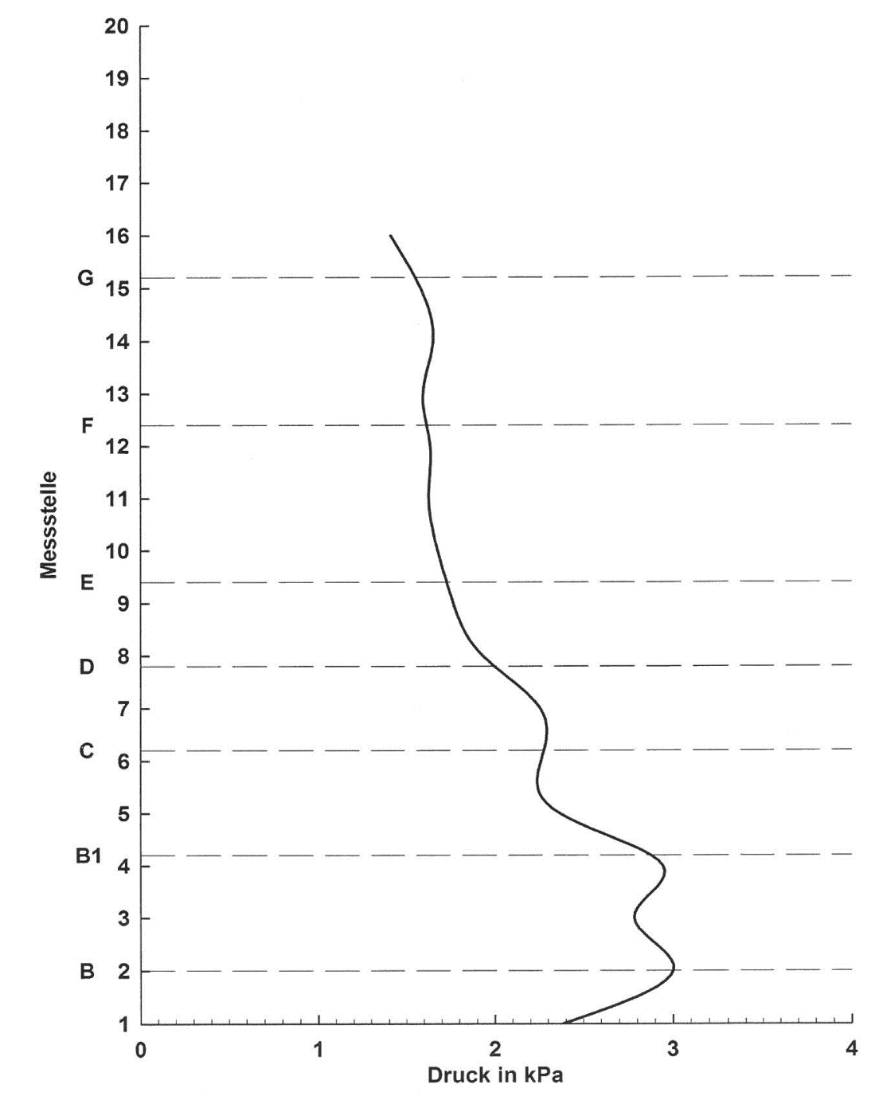
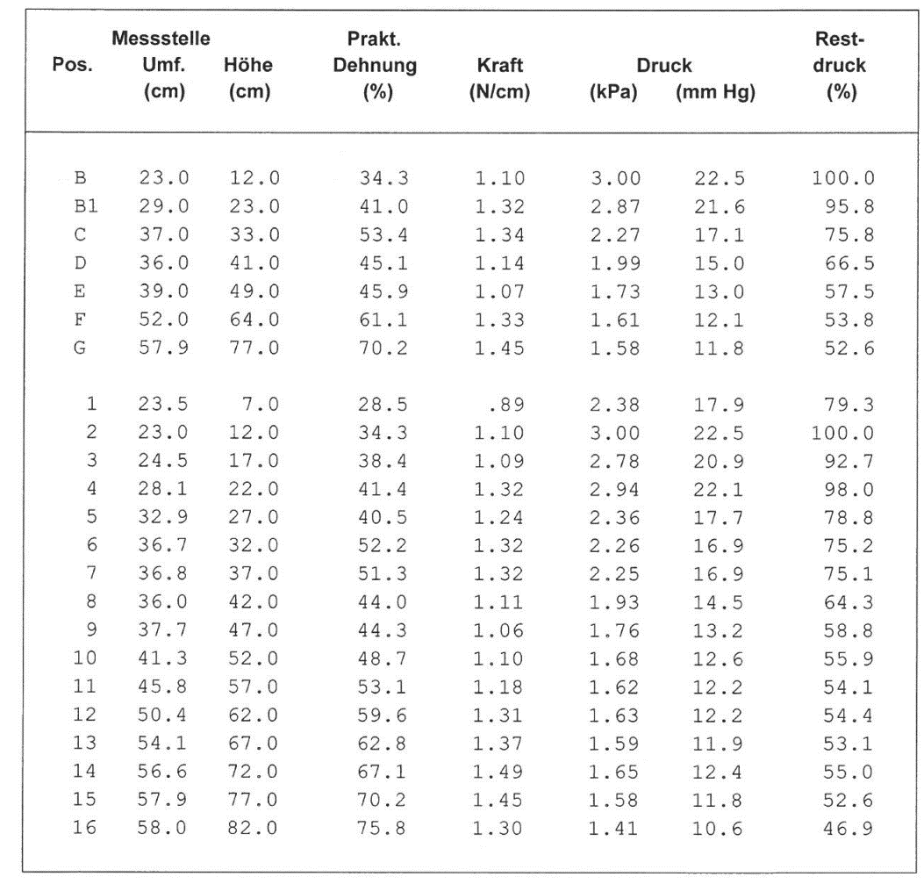
HOSY – Hohenstein System
CEP RECOVERY PRO TIGHTS

Slide 6
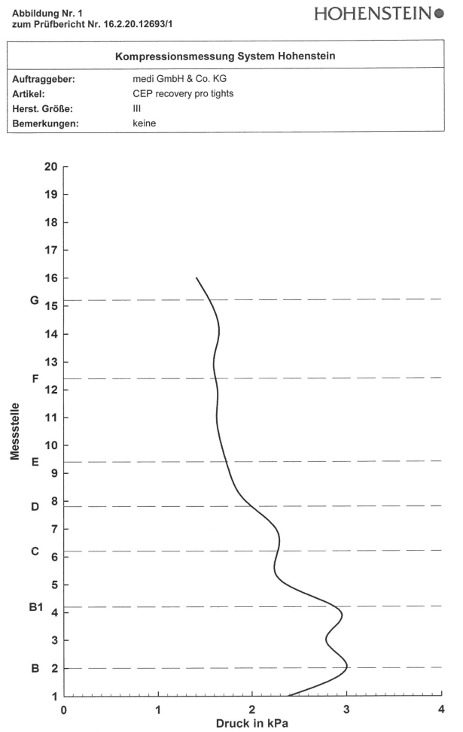
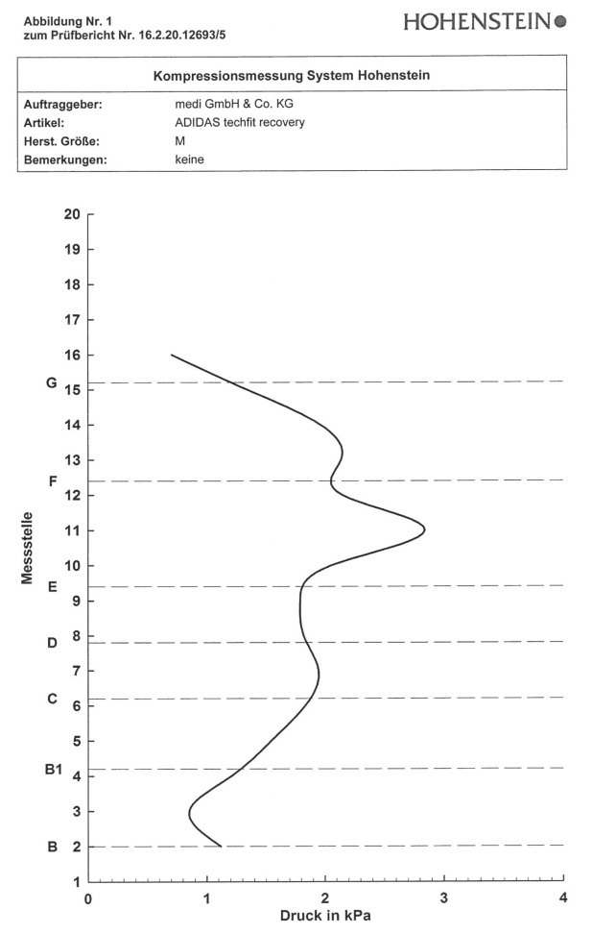
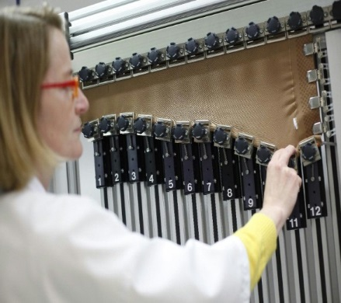
CEP vs. Adidas
Recovery Tights

Slide 7
Differences between medical compression stockings and compression sport socks
Medical compression stockings and compression sport socks feature different compression characteristics (one reason is different type of knitting machine)
The pressure can be considerably higher in medical compression products
Medical compression is more precise in the way that they address patients not healthy athletes covering a wider range of sizes & need more measurement points
Compression sport socks have padded zones designed for specific types of sports (e.g. for protection against pressure marks => foot part: Running, Outdoor shoes: ankle; Ski: shinbone)
Sport compression products (e.g. sleeves and tights) are very often produced of woven fabrics (not knitted) in a cut & sew manner requiring a seam or combining both technologies (CEP Run tights)

Slide 8
Engel FA , Holmberg H-C, Sperlich B. Is There Evidence that Runners can Benefit from Wearing Compression Clothing? Sports Med. 2016; 46: 1939-1952.
Objectives: To assess original research on the effects of compression clothing (socks, calf sleeves, shorts, and tights) on running performance and recovery.
Results: Compression garments exerted no statistically significant mean effects on
running performance (times for a (half) marathon, 15-km trail running, 5- and 10-km runs, and 400-m sprint),
maximal and submaximal oxygen uptake,
blood lactate concentrations,
blood gas kinetics,
cardiac parameters (including heart rate, cardiac output, cardiac index, and stroke volume),
body and perceived temperature, or the performance of strength-related tasks after running.
Small positive effect sizes were calculated for the
time to exhaustion (in incremental or step tests),
running economy (including biomechanical variables),
clearance of blood lactate, perceived exertion,
maximal voluntary isometric contraction and
peak leg muscle power immediately after running, and
markers of muscle damage and inflammation.
The body core temperature was moderately affected by compression, while the effect size values for post-exercise leg soreness and the delay in onset of muscle fatigue indicated large positive effects.

Slide 9
Diego Marqués-Jiménez et al. Are compression garments effective for the recovery of exercise-induced muscle damage? A systematic review with meta-analysis. Physiol Behav. 2016 Jan 1;153:133-48.
Purpose: The aim was to identify benefits of compression garments used for recovery of exercised-induced muscle damage.
Results: Most results obtained had high heterogeneity, thus their interpretation should be careful.
creatine kinase (standard mean difference=-0.02, 9 studies) was unaffected
blood lactate concentration was increased (standard mean difference=0.98, 5 studies).
compression reduced
lactate dehydrogenase (standard mean difference=-0.52, 2 studies),
muscle swelling (standard mean difference=-0.73, 5 studies) and
perceptual measurements (standard mean difference=-0.43, 15 studies).
Analyses of power (standard mean difference=1.63, 5 studies) and strength (standard mean difference=1.18, 8 studies) indicate faster recovery of muscle function after exercise.
Conclusions: These results suggest that the application of compression clothing may aid in the recovery of exercise induced muscle damage, although the findings need corroboration.

Slide 10
Compression and sports
Typical garments for compression in sports are not comparable with medical compression stockings
Materials and pressure curves are different and not standardized
There is no effect on venous hemodynamics
Effects of compression during performance are missing, small or questionable
In the recovery phase there is a small benefit for faster recovery after performance
Consequently those garments could be renamed:
- Recovery stockings -

