Slide 1
Compression Or No Compression In PTS In Favor Of Compression
ICC Annual Virtual Meeting 2022
Controversies In Compression Therapy
Joseph A. Caprini, MD, MS, FACS, RVT, DFSVS
Emeritus, NorthShore University Health System, Evanston, IL
Senior Clinician Educator, Pritzker School of Medicine, Chicago, IL

Slide 2
Disclosures
Sanofi - Honoraria
Arjo, Inc. Honoraria
Recovery Force-Consultant
Janssen Pharmaceuticals Advisory editorial

Slide 3
Meta-analyses
DOES THE SOX TRIAL REPRESENT A GAME CHANGER!!
Courtesy Fedor Lurie, MD, PhD, RPVI, RVT
R Subbiah 2016,

Slide 4
Kahn, SR et al: lancet;( 383): 880-888 2014

Slide 5
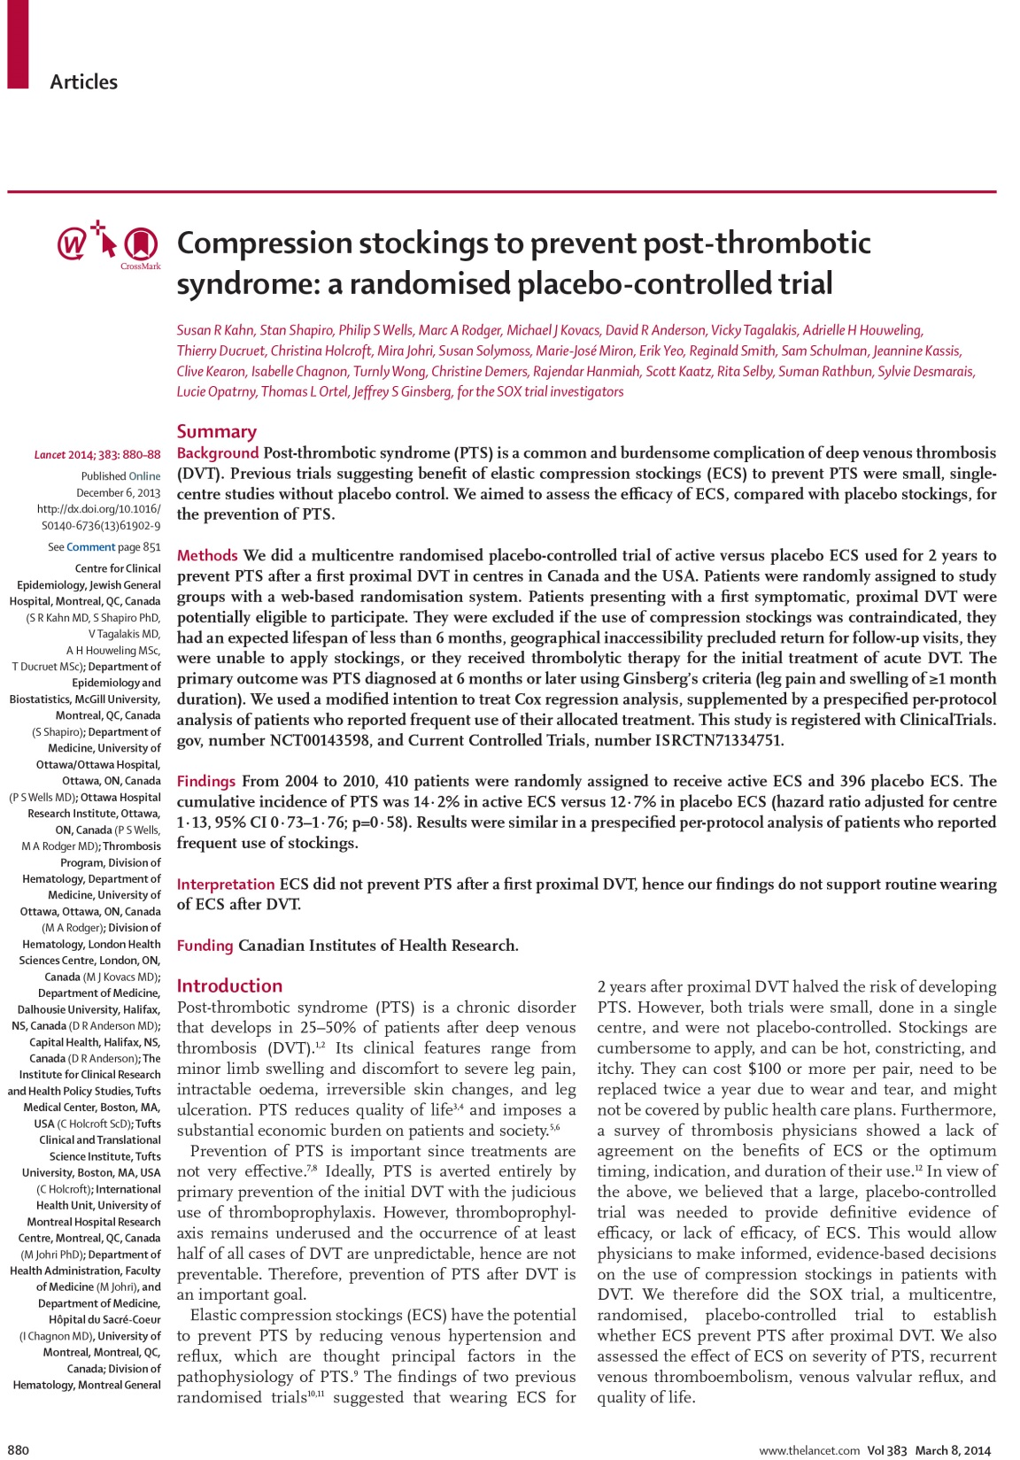
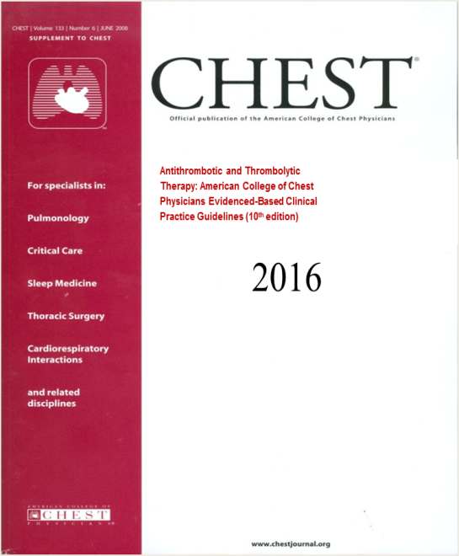
Has everyone forgotten the landmark data from Hugo Partsch MORE than 20 years ago demonstrating the benefits of early ambulation with appropriate compression following acute DVT
18. In patients with acute DVT of the leg, we suggest not using compression stockings routinely to prevent PTS (Grade 2B).
Remarks: This recommendation focuses on prevention of the chronic complication of PTS and not on the treatment of symptoms. For patients with acute or chronic symptoms, a trial of graduated compression stockings is often justified.
Courtesy Fedor Lurie, MD, PhD, RPVI, RVT

Slide 6
Compression Stockings To Prevent Post-thrombotic Syndrome: The SOX Trial
Compliance after 2 years was low, with only 55.6% of patients using compression stockings for 3 or more days per week.
Half of the patients swearing stockings half of the time is not an adequate test
Patients did not keep a daily dairy and the authors relied on their “quesstimate” as how often the stockings were used
Those of us seeing thousands of DVT patients notice marked improvement in signs and symptoms once appropriate stockings are worn especially within the first few weeks (Remember the Partsch data)
It is a great disservice to these patients to suggest that they do not need to wear the hose—in fact when patients are not compliant their symptoms and signs reappear. We face these non-compliant issues in our clinic DAILY
Patients with more severe PTS need flat-knit stockings, higher pressure stockings, or velcro devices.
Lavropoulos, N. et al: lancet;( 383): 130, July 12,2014

Slide 7
Compression Stockings To Prevent Post-thrombotic Syndrome: The SOX Trial
Critical measurements of the leg circumference both initially and subsequently in both groups are missing.
The Ginsberg criteria and the Villalta score do not at all quantitative edema since it is left to the discretion of the observer.
Relying on the patient's word is a very weak index of compliance. Clinical experience would indicate that patients exaggerate their use of compression therapy.
Since only half of the patient’s volunteer compliance at two years one might say that that represents a fatal flaw
Lavropoulos, N. et al: lancet;( 383): 130, July 12,2014

Slide 8
Compression Stockings To Prevent Post-thrombotic Syndrome: The SOX Trial
I have been wearing hose and teaching compression for 40 years and I cannot imagine not being able to tell whether I was wearing a no compression stocking verses an appropriate therapeutic compression garment
In the active ECS group, 202 (59%) of 345 patients, 300 (76%) of 394 research nurses, and 334 (87%) of 382 site investigators provided either a wrong guess or answered “uncertain” about whether patients were wearing active or placebo stockings, suggesting that they remained unaware of treatment allocation
HOW IS THAT POSSIBLE??
Fedor Lurie reminded us of the work of Partsch & Mosti that provides one possible explanation for this apparent paradox
Progressive external compression stockings(PECS) where the pressure at the ankle in lower than the pressure over the calf have been shown to be more effective than graduated compression stockings (GCS)
Low pressure PECS have shown equal efficacy compared to high pressure GCS to reduce swelling and provide symptomatic relief

Slide 9
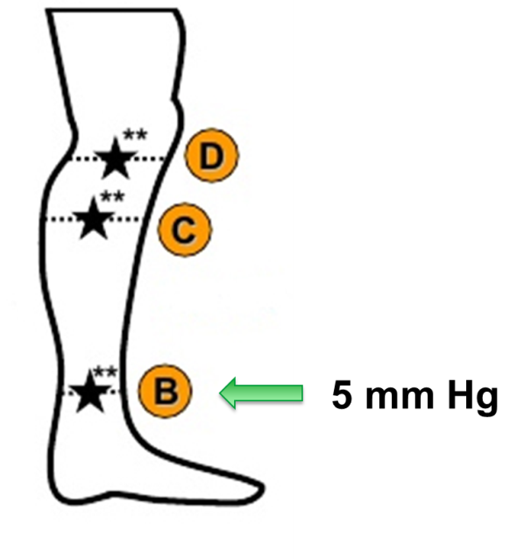
Limitations of RCT: 2. “placebo”
Low pressure anti-graduated stockings
7-8 mm Hg
Courtesy Fedor Lurie, MD, PhD, RPVI, RVT

Slide 10
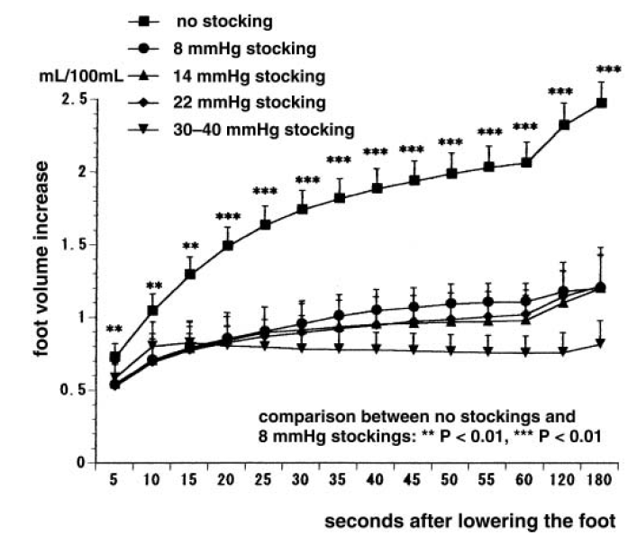
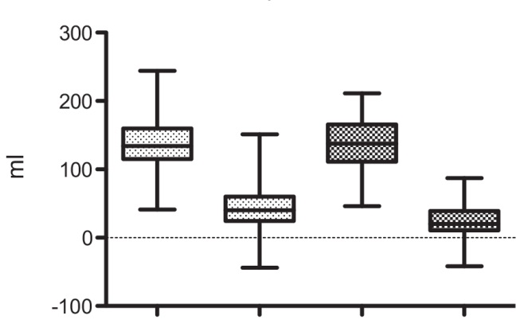
Low pressure and anti-graduated stockings can be as effective as higher pressure graduated stockings
GCS
AGCS
No stockings
8 mm Hg
15 mm Hg
22 mm Hg
Skin and Research Technology 2002;8:236-9
Courtesy Fedor Lurie, MD, PhD, RPVI, RVT
G. Mosti, H. Partsch EJVES 2013;45(5):523-7

Slide 11
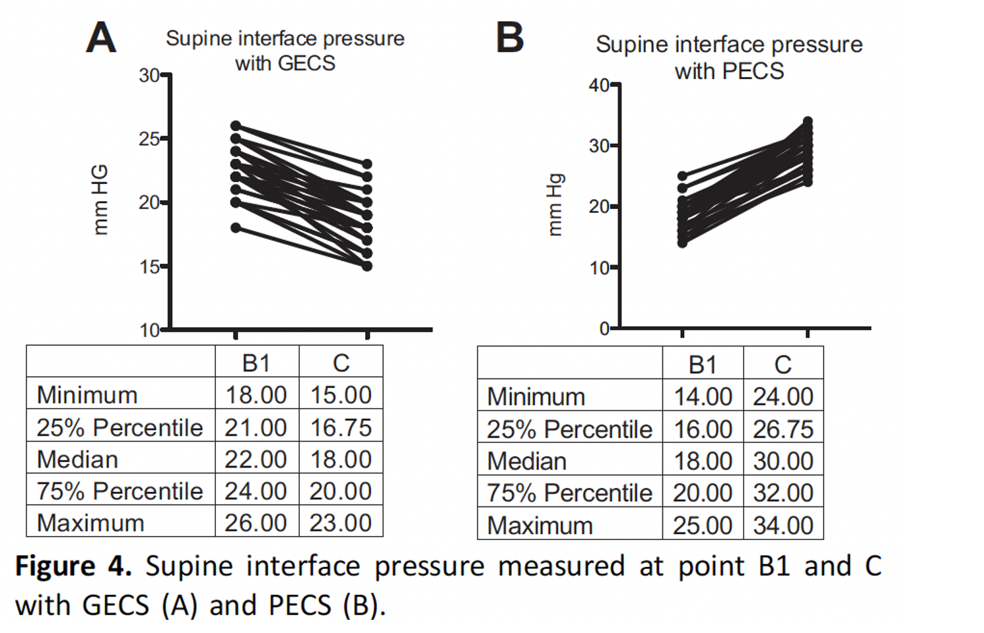
G. Mosti, H. Partsch EJVES 2013;45(5):523-7

Slide 12
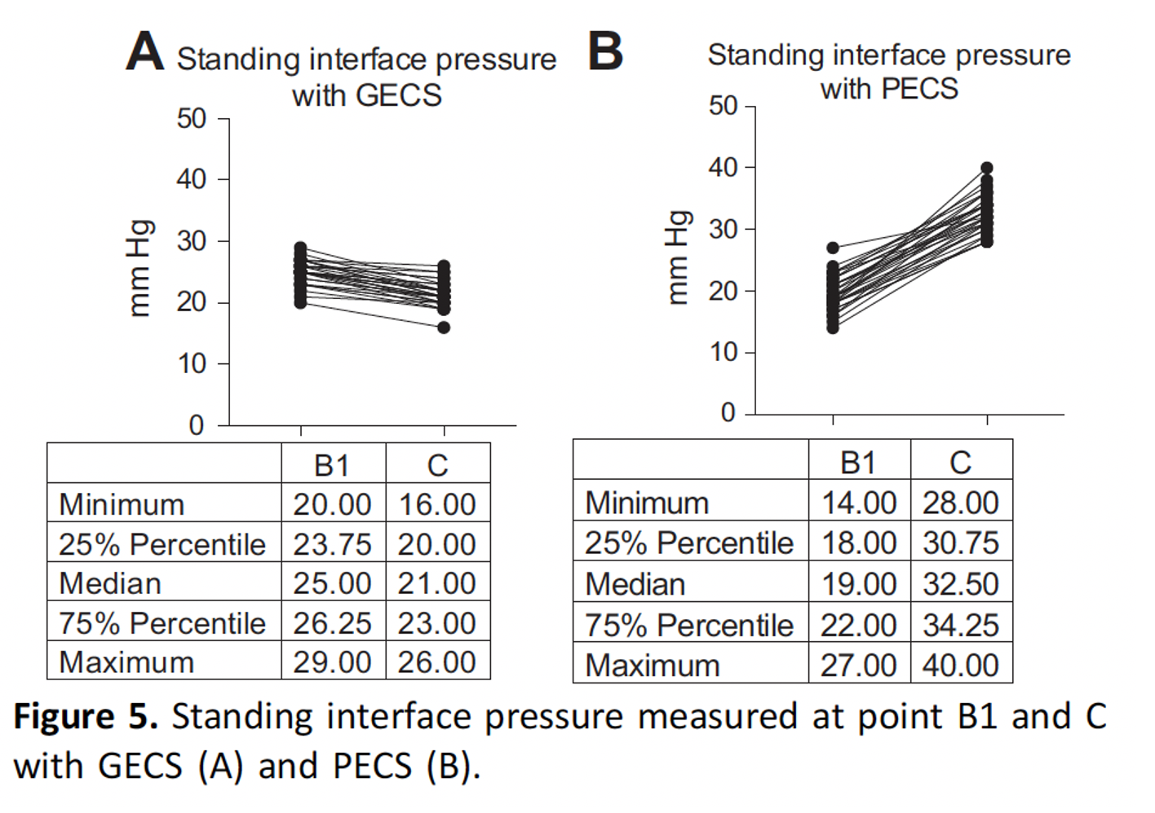
G. Mosti, H. Partsch EJVES 2013;45(5):523-7

Slide 13
Correct Interpretation:
Low pressure anti-graduated stockings prevent PTS after first proximal DVT at a similar rate compared to 30-40 mm Hg graduated compression stockings
Courtesy Fedor Lurie, MD, PhD, RPVI, RVT

Slide 14
Susan Kahn Reflections On The Sox Trial
However, the only double-blind trial of ECS found that the risk of PTS was not reduced by
ECS (HR 1.1 (0.73–1.8)) although compliance in this trial was suboptimal (56% of participants
wore stockings 3 or more days per week at two years).
The SOX trial did not show any benefit of ECS for treating early symptoms, but the first follow-up
occurred at 14 days (randomization occurred an average of 4.7 days after DVT diagnosis). This may
have been too far along from the acute phase to show a benefit
Regarding prevention of PTS, a substudy of the IDEAL-DVT study showed that
patients who were randomized in centers that applied ECS early, or within 24 h of diagnosis, had a
lower risk of residual venous obstruction [66], and those with reduced residual venous obstruction
had a lower risk of PTS.
Makedonov, I., S.R. Kahn, and J.P. Galanaud, Prevention and Management of the Post-Thrombotic Syndrome. J Clin Med, 2020.

Slide 15
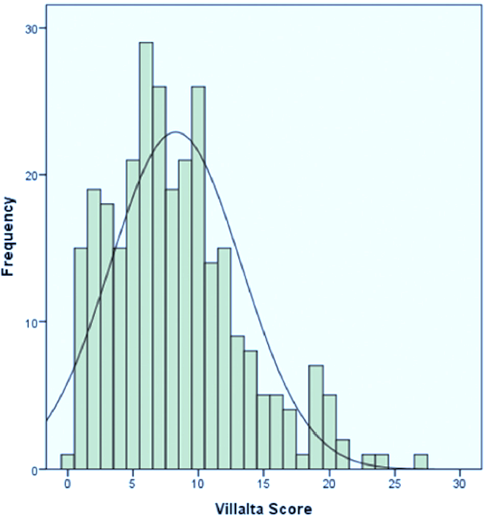
Limitations of RCT: Use of Villalta score
CONCLUSIONS
Use of Villalta Scale for defining PTS misclassify 42.3% of patients with primary CVD as having PTS
J Vasc Surg Venous Lymphat Disord. 2020 Nov;8(6):1025-1030
Courtesy Fedor Lurie, MD, PhD, RPVI, RVT

Slide 16
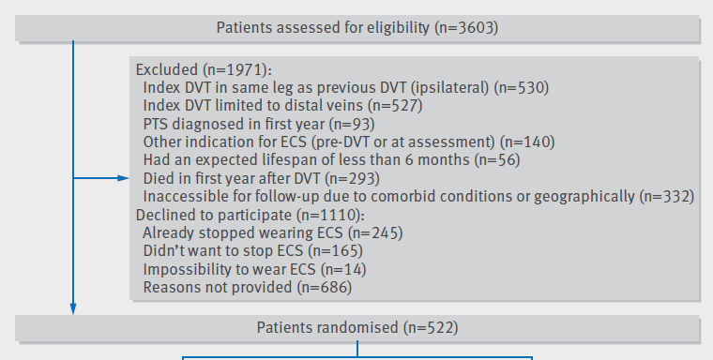
BMJ 2016;353:i2691
Eligible for study 3603 patients:
symptomatic, compression ultrasound proven, proximal deep venous thrombosis of the leg
had been treated with anticoagulants in accordance with applicable guidelines;
had received graduated ECS class III (34-46 mm Hg)
Courtesy Fedor Lurie, MD, PhD, RPVI, RVT

Slide 17
BMJ 2016;353:i2691
PTS 1-year prevalence 93/3603= 2.6%
1-year Compliance with compression 92.8%

Slide 18
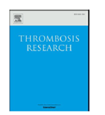
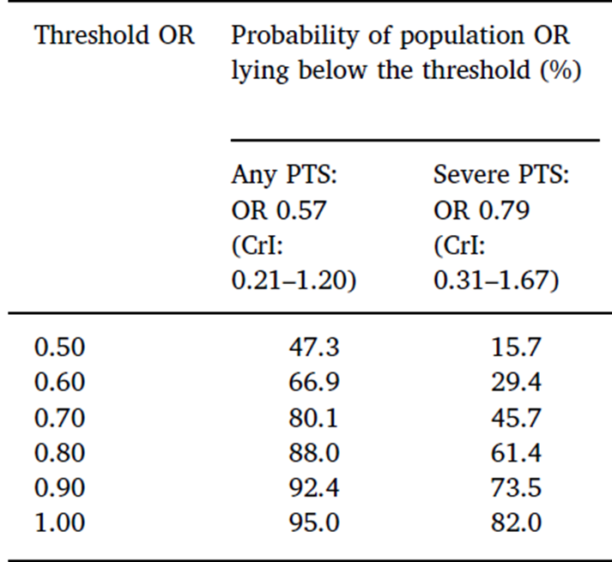
Patients can be informed that there is 95% probability of some reduction in the risk of PTS of any severity and 82% probability of observing some reduction in the risk of severe PTS If use compression therapy.
Large benefits are unlikely: the probability of reducing the odds of any PTS by half is≈ 50%, and the probability of reducing the odds of severe PTS by half is ≈16%.
Courtesy Fedor Lurie, MD, PhD, RPVI, RVT

Slide 19
Reduced Incidence Of Vein Occlusion And Post-thrombotic Syndrome After Immediate Compression For Deep Vein Thrombosis
This study consisted of 592 adult patients with objectively confirmed proximal leg DVT received no compression or multilayer bandaging or compression hosiery (355mm/hg) within 24 hours of diagnosis.
Presence of RVO confirmed with compression ultrasonography and the incidence of post-thrombotic syndrome with a Villalta score of at least 5 at 6 and 24months recorded.
Immediate compression therapy after DVT associated with a 20% absolute reduction of RVO. (66.7 vs 46.3%)
The reduction of residual thrombosis is associated with an 8% absolute reduction of post-thrombotic syndrome at 24 months.
The authors conclude that appropriate compression therapy should be prescribed immediately following a diagnosis of leg DVT
Amin, EE: et al; Blood. 2018;132(21):2298-2304

Slide 20
Elastic Compression Stockings To Prevent Post-thrombotic Syndrome In Proximal Deep Venous Thrombosis Patients Without Thrombus Removal
Study included 232 patients with iliofemoral or femoral-popliteal DVT treated with anticoagulants alone
Patients randomized to stockings vs no stockings and followed for 2 yrs. with the Villalta score, VEINES-QoL, and VEINES-QoL/Sym questionnaire
The incidence of PTS was 42.0% in the ECS group and 57.8% in the control group at 24 months using the Villalta score
The VEINES-QoL score was 63.7 in the ECS group, which was higher than in the control group (60.6; P < .001
VEINES-Sym scores revealed that patients in the ECS group reported better symptom relief than those in the control group (45.8 vs 43.8; P.= 014).
The authors conclude ECS can prevent PTS in patients with IFDVT and femoral popliteal venous thrombosis treated with anticoagulation alone.
Yang, X. et al; https://doi.org/10.1016/j.jvsv.2021.06.023

Slide 21
CONCLUSIONS
Compression therapy should be used for prevention of Secondary (post-thrombotic) CVD after DVT . [Best Practice]
Modalities include GEC or PECS using pressures tolerated by the patient
Carefully stocking fitting, application and removal techniques imperative for proper compliance
Velcro compression valuable for those unable to wear stockings
Immediate compression to control the pain, swelling, and discomfort associated with symptomatic DVT is a necessity to prevent chronic changes
Compression therapy should be used for treatment of C 3-6, CVD of any etiology (Ep, Esi, Ese, and their combinations). [Level of evidence A-B]
There is urgent need for RCTs that use:
Appropriate definitions (CEAP), Appropriate severity measures (VCSS, QOL), Appropriate follow-up time (≥ 5 years), Appropriate outcome measures (including DUS)
Courtesy Fedor Lurie, MD, PhD, RPVI, RVT

Slide 22
Thanks for watching

