Slide 1
Compression OR NO COMPRESSION IN VENOUS POSTPROCEDURES
In favor of compression
Jean-François UHL, Paris, France
ICC Annual Meeting 2021
Controversies in Compression Therapy
May 14, 2022 Amsterdam

Slide 2
I have no conflict of interest

Slide 3
After the detailed explanations of J.P Benigni it is clear that to act on the veins you need a sufficient pressure in standing position (> 50 mmHg)
This cannot be acheived with degressive
compression with MCS or bandages at thigh.
And SO….

Slide 4
Eccentric compression (PAD) is required to achieve a suffisant pressure to compress the superficial veins & so along the treated saphenous path…
In particular at the thigh level* +++
*Partsch H., Mosti G. Thigh compression. Phlebology 2008; 23: 252-8.

Slide 5
International recommandations
GUIDELINE 2
If compression dressings are to be used postprocedurally in patients undergoing ablation or surgical procedures on the saphenous veins, those providing pressures >20 mm Hg together with eccentric pads placed directly over the vein ablated or operated on provide the greatest reduction in postoperative pain. [GRADE - 2; LEVEL OF EVIDENCE - B]
J Vasc Surg Venous Lymphat Disord. 2019 Jan; 7(1):17-28.

Slide 6
Compression ? YES… ECCENTRIC
On the condition that the contraindications are respected

Slide 7
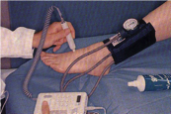
Contra-indication of compression
if IPS < 0.6 or ankle pressure < 60 mmHg.

Slide 8
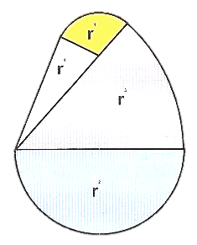
Compression with caution
In the elderly
Protect the tibial crest, instep and malleolas
P= T/r

Slide 9
Effect of eccentric compression
Caliber reduction of superficial veins with MCS*
2 MCS of 15-20 mmHg →
14 mmHg à la cuisse
1 MCS of 15-20 mmHg →
8 mmHg à la cuisse
*. Benigni et alPerspect Vasc Surg Endovasc Ther. 2011;23:238-243.

Slide 10
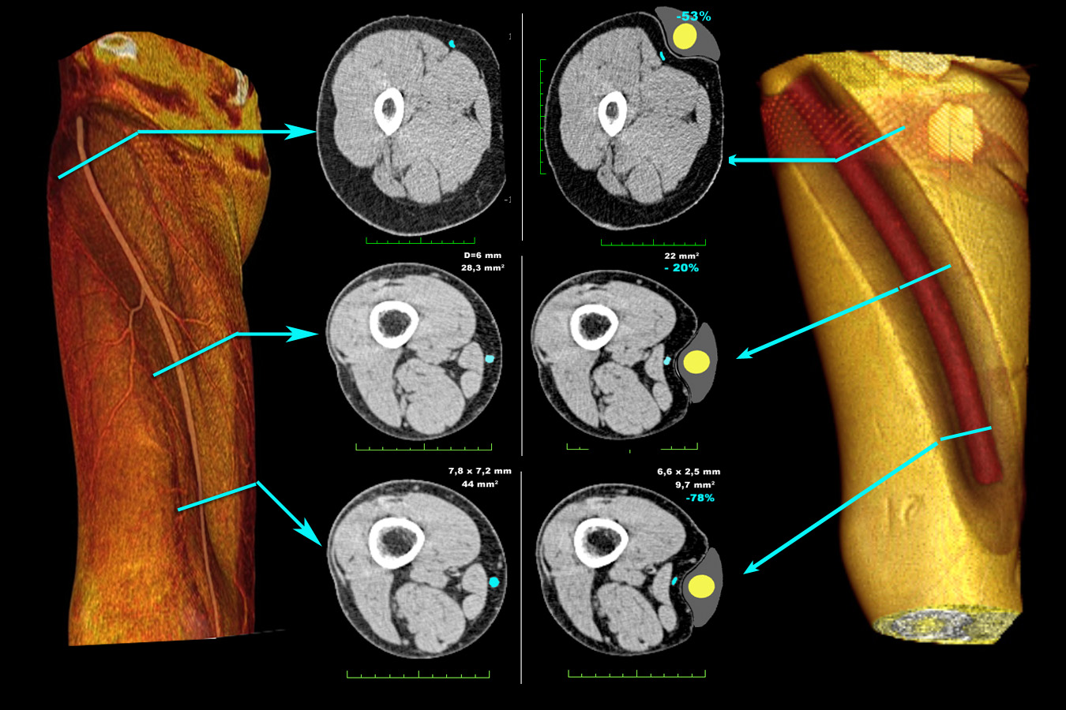
Anatomical effect of eccentric compression 3D modeling of the PAD (CT venography)
2 MCS of 15-20 mmHg >> IP of 50 mmHg

Slide 11
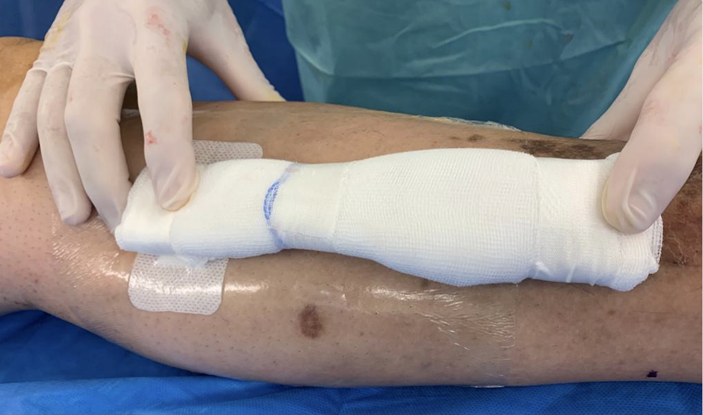
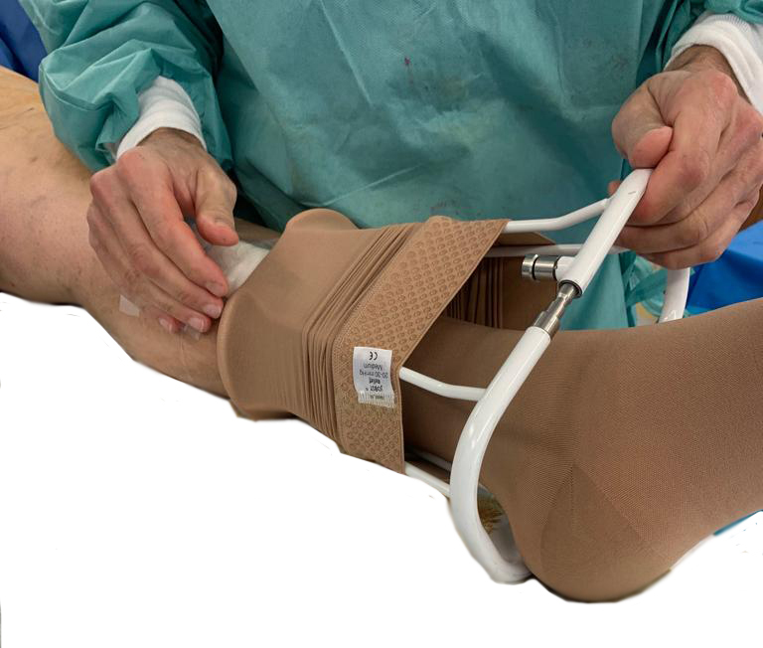
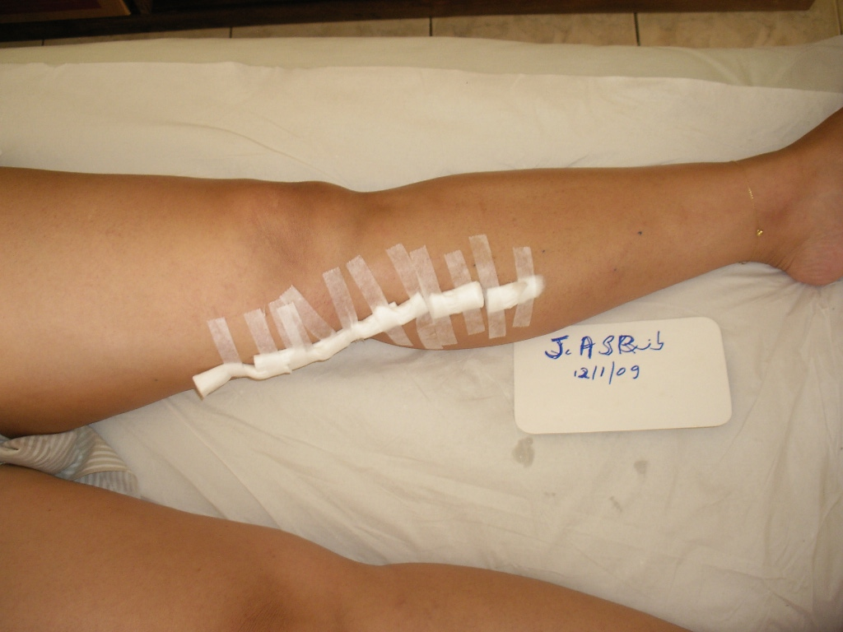
Eccentric compression
of the saphenous path or phlebectomies
Customized pad

Slide 12
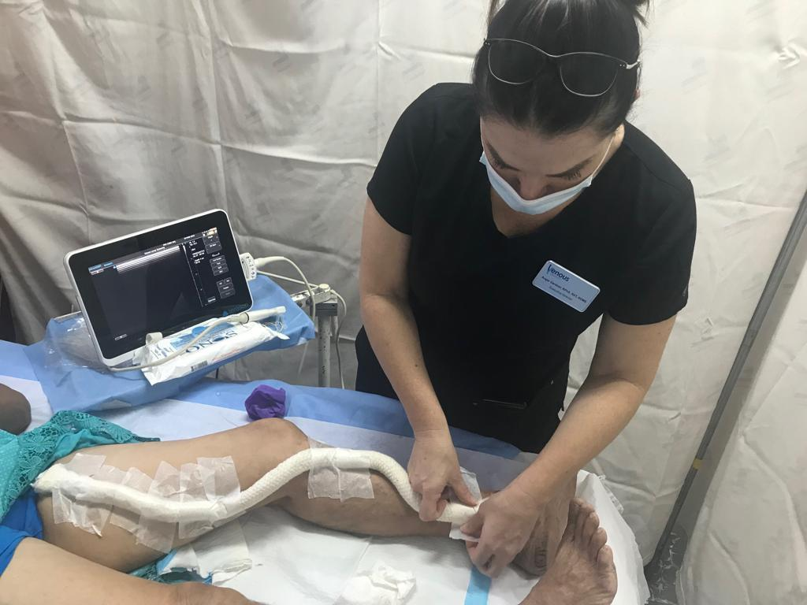

Slide 13
Foam PAD after scleroth.
Diameter reduction with device
epifascial vein Saphenous
Upright
Lying
33% 36%
43% 36%
V. Crebassa et al. Phlébologie 2017, 70, 3, p. 1-9

Slide 14
If you apply compression some questions remain
For which procedure ?
Which duration of compression ?
Which wearing days and schedule ? (Main importance of patient’s compliance ++)

Slide 15
Expected results after procedures stripping & crossectomy), Mini-invasive surgery, EVLA or RFA
To minimize inflammation and pain
To reduce bruising, hematoma, edema
Hemorrhages / bleeding
Prevent recanalization and neovascularization
Prevent thrombosis and clots in situ
Assist in the healing or fusion of vein walls
And finally to reduce recovery
time and work stoppages
Improve compliance
Less recurrence ?

Slide 16
SURGERY
benefits of compression

Slide 17
Compression after GSV stripping
G Mosti* et al. Compared 3 groups of 18 patients:
Group A: MCS 23-32 mm Hg ankle
Group B: Adhesive bandages (47 mmHg)
Group C: MCS + eccentric PAD (68 mmHg)
Results: Group A B C
mmHg standing 16 63 98
Pain & hematoma 10/18 1/18 0/18
Less pain and hematomas with high pressures
* G. Mosti et al. Int Angiol 2009 Aug;28(4):274-80.

Slide 18
Compression after GSV stripping
MARIANI* compares postop bandages versus MCS 23-32 mmHg (sigvaris postop kit) in a RCT with 2 groups of 30 patients
Bandage MCS p
Confort +- ++
Edema at D7 50% 20% <.001
Hematoma NS
Less edema and better comfort were found with MCS
* Mariani F, Marone EM, Gasbarro V, et al. Multicenter randomized trial comparing compression with elastic stocking versus bandage after surgery for varicose veins. JVS. 2011;53:115-122.

Slide 19
Compression after GSV stripping
BENIGNI* compares an eccentric compression in the thigh by a foam pad versus MCS w/o pad.
It was shown reduction of postoperative
pain by 48% with the pad
Group A Pad B no pad p
N 36 17
Thigh mmHg lying 49 14
Week pain score 80 20% <.0001
Pain score D7 15 4 <.0001
*. Benigni et al.., The efficiency of pain control using a thigh pad under the elastic stocking in patients
following venous stripping: case-control study. Perspect Vasc Surg Endovasc Ther. 2011;23:238-243.

Slide 20
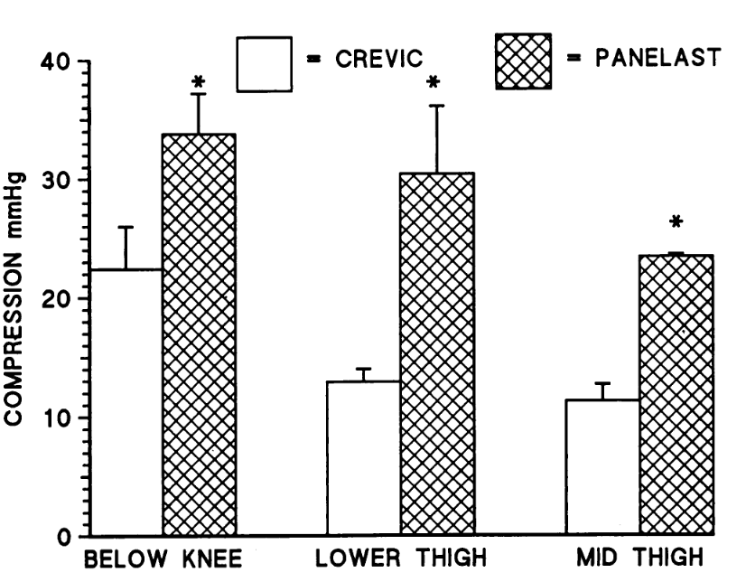
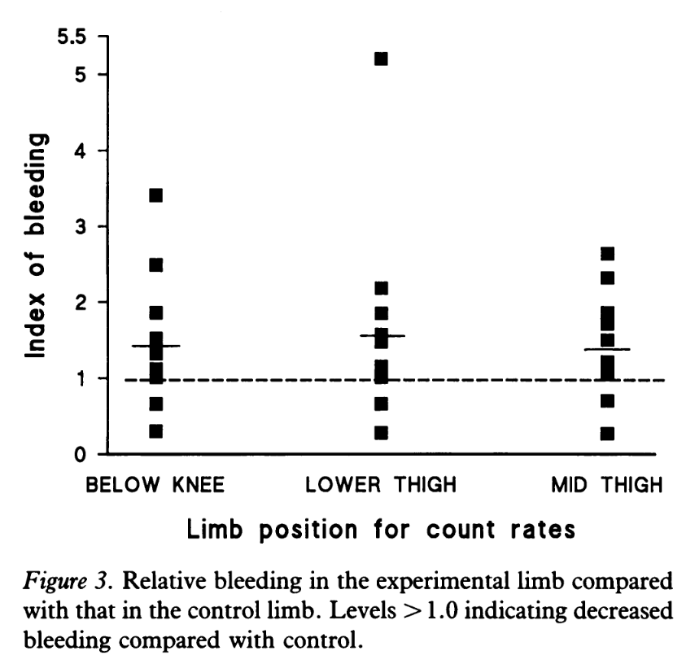
Less bleeding after GSV stripping
Travers* compares in 10 patients 2 bandages Crevic and panelast. Result less bleeding with panelast (>PR)
Less bleeding with Panelast
* J.P Travers, et al.. Annals of the Royal College of Surgeons of England (1993) vol. 75, 119-122.

Slide 21
Reduction of VV recurrence
TRAVERS* RCT 69 patients 3,6,9 12 months FU.
But 39% non compliant rate..
Group A no Comp B stockings
Recurrent VV at 1 Y 71% 6%
* Travers JP, Makin GS. Reduction of varicose vein recurrence by use of postoperative compression stockings. Phlebology. 1994;9:104-109

Slide 22
Improvement of patient’s compliance
Observational study of 1000 patients after varicose surgery under local anesthesia.70% of the patients, not convinced before the surgery, understood its interest after this period of wearing imposed by the surgeon.
 | Before | After
rather hostile | 32 % | 11 %
indifferent | 51 % | 3 %
rather favorable | 14 % | 54 %
very favorable | 3 % | 32 %
14 %
87 %
* Lefebvre-Vilardebo M, Uhl J.F. Le collant de contention, pansement postopératoire idéal en chirurgie veineuse? . Phlébologie. 1995, 48: 337-43

Slide 23
THERMAL ABLATION

Slide 24
Compression after GSV endovenous Laser
M. Lugli* uses an eccentric compression in the thigh.
Stockings Ankle pressure 35 mmHg + PAD
2 groups of 100 patients. VAS of pain at Day 7
demonstrated a significant reduction in postoperative
pain compared to the absence of compression (P<.001)
*Lugli M., et al. Effects of compression by a crossed-tape technique after endovenous
laser ablation of the GSV: a randomized study. Phlebology 2009; 24, 4 :151-6.

Slide 25
Compression after GSV thermal ablation
Meta analysis of 6 RCTs with 1045 patients EVLA or RFA
MCS 18 mmHg versus no compression.
Pain in the first 10 days p<.001
Delay return to normal activity p<.01
Bruising score NS
Complications NS
QOL at 2 weeks NS
Routine compression by MCS is recommended
* Fan Ma et al. Ann Vasc Surgery 2022 Volume 80, P302-312

Slide 26
DURATION of COMPRESSION

Slide 27
Optimal duration of compression after GSV endovenous Laser ?
Meta-analysis : 5 RCTs involving 775 patients
Long duration 1-2 weeks is better than to short 24-48h
- Post-op pain score 1 week p<.0001 (2, 6 weeks NS)
- Recovery time off work p=.04
- Physical function & vitality p=.03
* Jian-Hong Chou et al. Meta-analysis. Intern. J. of Surgery 65 (2019) 113–119

Slide 28
Compression after Phlebectomy (ASVAL) in favor of short duration of compression
Pittaluga* found no difference in pain, ecchymosis and QOL
Among 2 groups of 50 patients undergoing miniinvasive
surgery (ASVAL). under tumescent anesthesia:
Group A. MCS 20 mmHg during 8 days
Group B. MCS 20 mmHg during 2 days
NS for pain, ecchymosis, QOL
* Pittaluga P. Chastanet S Proceedings from the European Venous Forum Annual Meeting. 2011; Ljubljana, Slovenia..

Slide 29
SCLEROTHERAPY
Many studies show no benefit of compression,
but the interface pressure is not assessed…

Slide 30
Compr. after Catheter foam + phlebectomy
CAVEZZI* compares 2 stockings 23/35 mmHg
RCT 92 patients.
It was shown improvement in group B
group A. group B
Pressure 23 mmHg 35 mmHg
Pain & heaviness p=.046
Ambulation p=.046
Tolerability p=.006
Skin healing p=.0012
*. Cavezzi A., Mosti G et al. Compression with 23 mmHg or 35 mmHg stockings after saphenous catheter foam sclerotherapy and phlebectomy of varicose vein. Phlebology 2019

Slide 31
Compression after micro-sclerotherapy of telangiectases and reticular veins
Wearing compression stockings (23 to 32 mm Hg)
for 3 weeks enhance the efficacy of sclerotherapy
of leg telangiectasias by improving clinical vessel disappearance (RCT 100 patients)
P. Kern et al. J Vasc Surg 2007;45:1212-16.

Slide 32
Conclusion
High pressure compression applied after a venous procedure is significantly more effective regarding pain, ecchymosis and hematomas.
This is possible in pratice by the use of a PAD along the treated area.
A duration of compression of more than one week is not mandatory.

Slide 33
Conclusion (2)
Moreover, one of the major interests of postoperative compression is to improve patient compliance thanks to the venous procedure.
Long-term wearing of compression is recommended, in particular for patients at risk in this chronic disease.

