Slide 1
Elastic Compression Stockings or inelastic compression in VLU treatment
in favor of inelastic material
Giovanni Mosti; Lucca; Italy

Slide 2
disclosure: no conflict of interest

Slide 3
basis for my thesis
a direct proof that one treatment is better than the other does not exist
amazingly, only one study reports a comparison between elastic stockings and inelastic bandages including pressure measurements
my thesis on superiority of inelastic compared to elastic material in ulcer treatment is based on:
ulcer pathophysiology
literature
guidelines

Slide 4
pathophysiology of the venous ulcer: AVH
pressure in a dorsal foot vein during walking
85
walking
normal
30
85
Courtesy by C. Wittens
70
valve incompetence

Slide 5
pathophysiology of the venous ulcer: AVH
with venous reflux/obstruction no pressure fall and even pressure increase during walking will lead to:
1. AVH
2. capillary hypertension
3. fluid extravasation
4. hypoxia
5. skin changes
6. ulcer

Slide 6
compression therapy and venous ulcer
I.V. pressure
walking
standing
I.V. pressure
I.B. pressure

Slide 7
compression therapy and venous ulcer
I.V. pressure
walking
standing
I.V. pressure
E.B. pressure

Slide 8
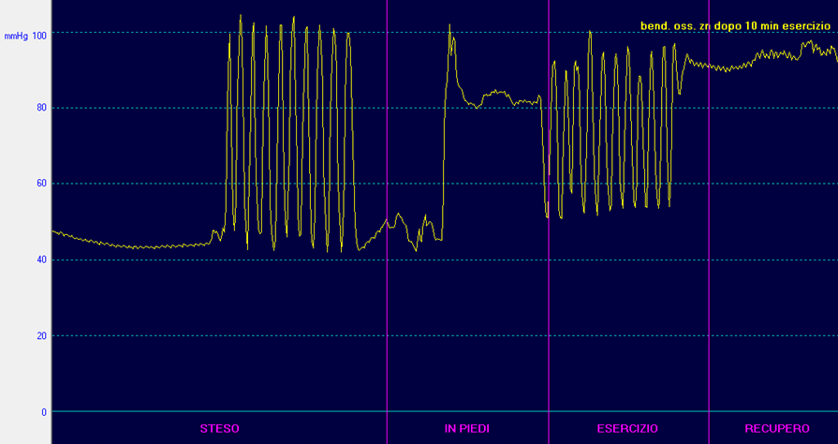
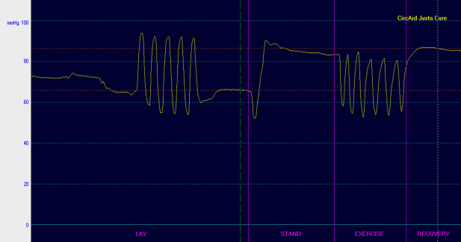
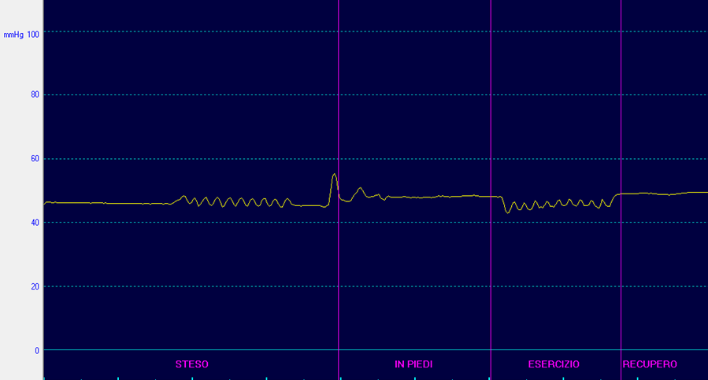
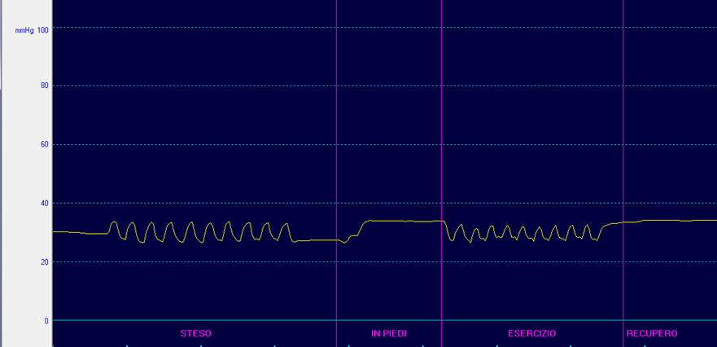
only inelastic material can occlude the veins

Slide 9
compression therapy hemodynamic effect
compared with elastic, inelastic material is significantly more effective in improving venous hemodynamics by:
decreasing venous reflux
increasing venous pumping function
reducing ambulatory venous hypertension
Mosti G et al. Int Angiol. 2010;29:416-20
Mosti G et al. Phlebology. 2008;23:287-94
Partsch B et al. Phlebology 1992;7:101-4

Slide 10
inelastic or elastic material for ulcer treatment?
the first pathophysiologic factor in venous ulcer is AVH
→compression devices (bandages, AVCD) exerting strong pressure and with high stiffness, will be the most effective compression modality to reduce AVH and, as a consequence, the most effective compression modality in ulcer treatment
only inelastic devices will be, at the same time:
able to exert a strong compression and high stiffness
comfortable

Slide 11
inelastic or elastic material for ulcer treatment?
literature and guidelines

Slide 12
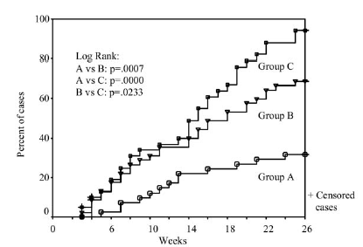
strong compression recommended in venous ulcers
ulcer patients divided in three groups:
tubular elastic device (36 mm Hg)
the same + 1 elastic bandage (54 mm Hg)
the same + 2 elastic bandages (74 mm Hg): poor compliance
The rate of noncompliance was 2% in groups A and B and 21% in group C
74 mm Hg
54 mm Hg
36 mm Hg
Milic D et al. J Vasc Surg. 2010;51:655-61

Slide 13
strong compression recommended in venous ulcers
other papers recommend strong compression to improve the ulcer healing rate
Cullum N et al. Qual Health Care1997; 6:226-231
Partsch H. The Vein Book. Pag 103-109; 2007
Wong IK et al. Journal of Wound Care 2012;161:166-7 21
Nazarko L. doi.org/10.12968/bjcn.2017.22.Sup6.S6
Attaran RR et al.Phlebology. 2017;32:81-88.

Slide 14
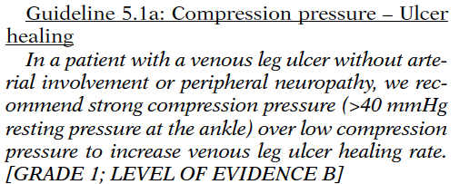
strong compression recommended in venous ulcers
AVF-SVS Guideline
UIP Comment
in promoting venous ulcer healing:
compression is better than no compression
strong compression is better than low compression
multicomponent systems are more effective than single component devices
Statement 5.3.b: in patients with VLU strong compression pressure over low compression pressure is recommended to increase healing.
O'Donnell TF et al. J Vasc Surg. 2014;60(2 Suppl):1S-2S.
Mosti G et. al. Int Angiol. 2015;34:2012-218.
O’Meara S et al. The Cochrane Library 2009, Issue 1.
Franks PJ et al. J Wound Care. 2016 Jun;25 Suppl 6:S1-S67

Slide 15
inelastic or elastic material
many reports on a superior or similar effect of elastic materials (bandages or kits) when compared with inelastic material
Franks PJ et al. Wound Rep Regen 2004;12:157–62
Amsler F et al. J Vasc Surg 2009;50:668-74
Ashby RL et al. Lancet 2014; 383: 871–79

Slide 16
inelastic or elastic bandages comparison
the reference bandage for elastic material has been the four layer bandage that is actually inelastic: 2 inelastic bandages were compared
Mosti G et al. Dermatol Surg 2008;34:631–639

Slide 17
inelastic bandages and elastic stockings comparison
many flaws:
compression pressure (dosage of compression) not measured and what kind of pressure unknown
what kind of bandage (elastic-inelastic)
who applied the bandage (level of expertise)
adherence to treatment (is the patient allowed to remove and re-apply bandage by himself?)
tourniquets? slippage? rolling?

Slide 18
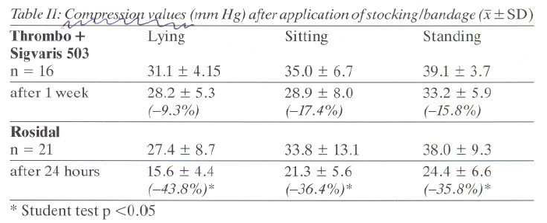
inelastic bandage is often poorly applied
ulcer kit pressure higher than inelastic bandage pressure clearly poorly applied!!!!!!!!
Horakova MA et al. Wien. med. Wschr.1994; 144:242-249

Slide 19
inelastic or elastic material
it can definitely happen that a good elastic stocking/kit was compared with a poorly applied inelastic bandage

Slide 20
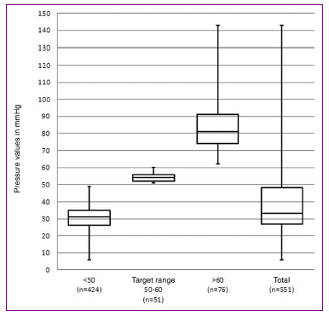
poor application of inelastic bandages: not a simple hypothesis
target pressure
10% personnel
Protz K et al. J Dtsch Dermatol Ges. 2014;12:794-801.

Slide 21
poor application of inelastic bandages: not a simple hypothesis
references review: inelastic compression poorly applied: a correct bandage application was performed by 10 to 60% of “examined” health personnel!!!
S. Reynolds. The impact of a bandage training programme. JWC 1985;8:55-60
E.A. Nelson et al. Improvements in bandaging technique following training. JWC 1995;4:181-84.
Keller A, Müller ML, Calow T, Kern IK, Schumann H. Bandage pressure measurement and training: simple interventions to improve efficacy in compression bandaging. Int Wound J. 2009 Oct;6(5):324-30.
Zarchi K et al Delivery of Compression Therapy for Venous Leg Ulcers. JAMA Dermatol. 2014;150:730-36.
Protz K et al. Compression therapy: scientific background and practical applications. J Dtsch Dermatol Ges. 2014;12(9):794-801.

Slide 22
inelastic material with strong pressure is more effective
29 mm Hg
49 mm Hg
Brizzio E et al. J Vasc Surg 2010;51:410-6

Slide 23
conclusions
a high scientific level study comparing inelastic and elastic material does not exist: an ultimate conclusion cannot be drawn
inelastic compression is significantly more effective than elastic in improving the impaired venous hemodynamics
a strong pressure is recommended by studies and guidelines
a strong pressure is easily exerted and remains comfortable only with inelastic materials

Slide 24
conclusions
overall, compared to elastic, inelastic material is more hemodynamically effective and more comfortable
it has theoretically to be preferred in venous ulcers that are due to an impaired venous hemodynamics
all the studies reporting a better or similar effect with elastic when compared with inelastic materials are burdened with many major flaws

Slide 25
giovanni.mosti10@gmail.com

