Slide 1
Make compression easy to increase compliance and improve care
Em. Prof. dr. Cees H.A. Wittens, MD PhD

Slide 2
Physics
knowledge of compression pressure and stiffness of compression materials → important
only a strong compression pressure, able to compress the veins, will exert a hemodynamic effect:
reflux abolition
venous pumping function improvement
ambulatory venous hypertension reduction

Slide 3
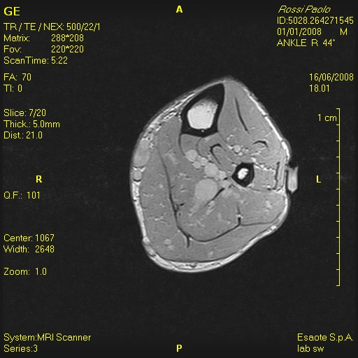
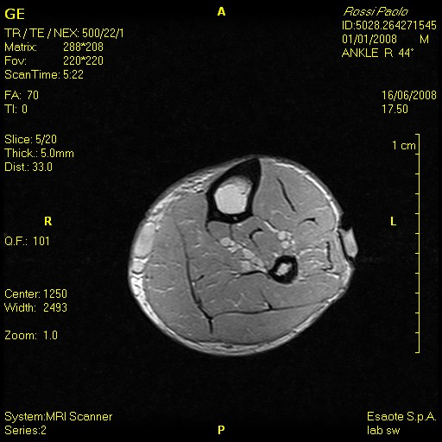
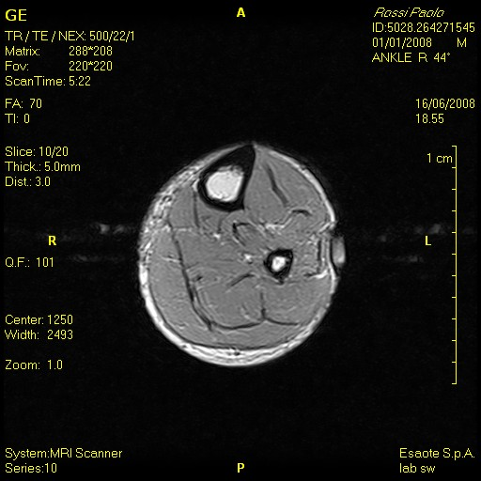
Deep system is compressed
first!
baseline
34→40
51→83

Slide 4
elastic material
distended vein (sitting)
narrowing
narrowing
0
40
45
muscle contraction doesn‘t cause intermittent vein occlusion

Slide 5
inelastic material
distended vein (sitting)
narrowing
occlusion
0
40
70
muscle contraction causes intermittent occlusion of veins

Slide 6
Effects of compression on
venous system:
reduction of venous volume and increase of blood flow velocity → effective on DVT prevention
reduction of venous reflux and increase of venous pump → effective in reducing AVH

Slide 7
What innovations do we need:
Alternative inelastic stockings because they are more effective.
Only calf compression!!
Only calf compression can be inelastic
Can be easily put on and of although inelastic!
Same hemodynamic effect

Slide 8
Why do we need better scientific proof:
Trials not enough powered ( <<n)
Compliance bias!!!
Because stockings are not worn → the outcome is negatively influenced
Influence of mobility on outcome

Slide 9
What scientific proof do we need when we are going to use easy inelastic devices:
Compression :
Reduces PTS after a DVT
Incompetence/obstruction
Improves symptoms in PTS
Improves symptoms in C3,4,5
Improves outcome after superficial vein treatment.

Slide 10
With scientific proof we can:
Improve care
Improve compliance
Improve reimbursement

Slide 11
How can we do it:
Large (double blind) RCT trials with enough power to prove that inelastic easy devices are better.
Trials with sensor in stocking
Measure compliance
Measure influence of mobility
Validated Compression questionnaires
Validated QoL questionnaires
Disease specific Veines Qol/Sym
Generic: EQ/5D/5L
Self assessed clinical scores
Duplex data on incompetence and obstruction

Slide 12
Sensor use:
Benefits:
Compliance
Yes/No check
Analyses not influence by bad compliance
Mobility
Influence of mobility on
QoL
Disease specific
Generic
Compliance
Comfort

Slide 13
Validated QoL questionnaires:
Veines QoL/Sym
EQ/5D/5L
Cost –effectiveness
QALY’s

Slide 14
Validated Compression questionnaires:
Prof. dr. Nele de Voogdt
V
E C
European Venous Centre; Aachen-Maastricht
14

Slide 15
How can we do it:
Large randomized control trials with inelastic easy devices comparing with traditional devices with low compliance!!
With sensor in (in)elastic stocking
Compression and QoL questionnaires
Create European trial centre to get it organized
Trial DVT
Trial PTS
Trial C3,4,5
Trial posttreatment stocking

Slide 16
Benefit for inelastic easy compression:
High quality publications
Hard data on effectiveness (incompetence/obstruction)
Extra data related to sensor readout.
Do patients use the stockings
Influence of mobility

Slide 17
Conclusion
Innovative inelastic calf stockings
Let’s get started.

